Slide 1
Tweets, Skeets, and Podcasts: Harnessing 21st Century Tools for Medical Education
Cristina Popa, MD
Iasi, Romania
@nephroseeker.medsky.social

Slide 2
Conflicts of interest
Member of WCN2025 social media team
Ordinary Board Member of European Renal Association social media team
NephJC Executive Editor and Board Member
NephJC (www.nephjc.com) is a 503c organization that supports social media in medical education and is sponsored by its readers
Nephrology Education Collective (ex- Nephrology Social Media Collective)- faculty
Visual abstract creator: ASN journals, KIreports, NephMadness

Slide 3
Education is the most powerful weapon which you can use to change the world
Nelson Mandela (1918-2013)
Education accounts for 50% of global growth
Every $1 a government spends on education increases GDP on average by $20
With more children completing basic education, more peaceful the country (especially if girls were more educated)
GPE and Institute for Economics and Peace, 2024
Gethin A, 2024
World Bank WDI Report 2022
Notes:
https://www.globalpartnership.org/results/education-data-highlights

Slide 4
The most precious resource we have is time
Topic 1
Topic 2
Sub topic
Sub sub topic
Steve Jobs (1955-2011)
22 countries
China, Mexico, South Corea, Austria, India, Canada, Portugal, USA, New Zeeland, UK, Ireland, Poland, Germany, Netherlands, Turkey, Norway, Denmark, Finland, Belgium, Greece, Spain, France, Italy
Person aged 15-64 ani
Data collected 2009- 2016
Adapted after Organisation for Economic Co-operation and Development, Time Database, 2024
Notes:
https://data-explorer.oecd.org/vis?fs[0]=Topic%2C1%7CSociety%23SOC%23%7CWell-being%20and%20beyond%20GDP%23SOC_WEL%23&pg=0&fc=Topic&bp=true&snb=8&df[ds]=dsDisseminateFinalDMZ&df[id]=DSD_TIME_USE%40DF_TIME_USE&df[ag]=OECD.WISE.INE&df[vs]=1.0&dq=.._T&to[TIME]=false

Slide 5
Medium time spent online
7 h
Medium sleep time
6h 36 min
versus
Coutrout A et al, Nature Communications, 2022
Notes:
https://www.statista.com/statistics/433871/daily-social-media-usage-worldwide/

Slide 6
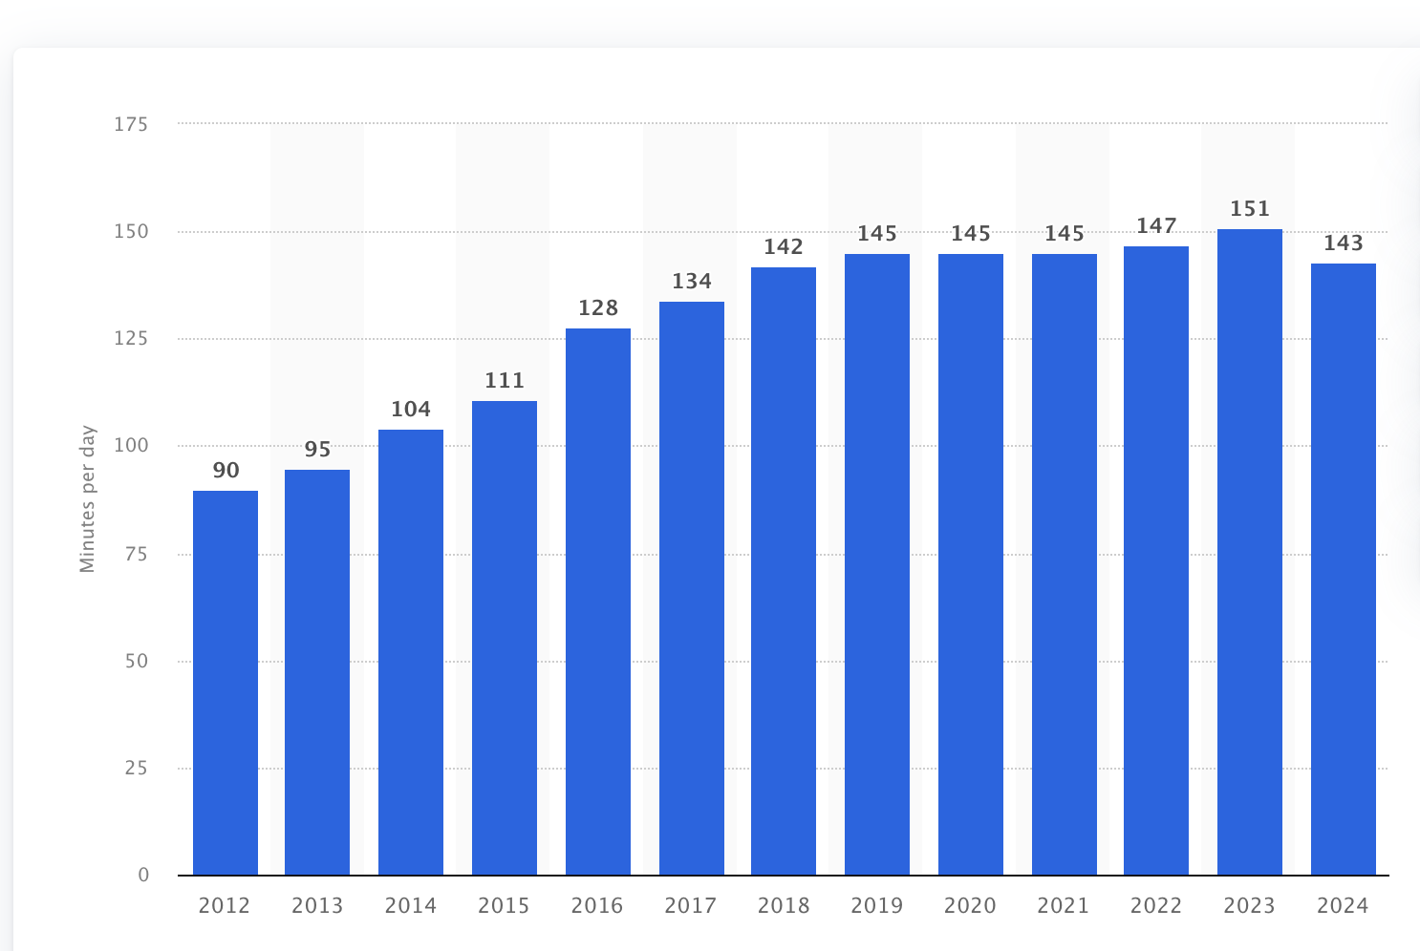
From 6h online, 2h 23 min are spent on social media
2h 23 min
Topic 1
Topic 2
Sub topic
Sub sub topic
Source: statista.com
Notes:
https://www.globalpartnership.org/results/education-data-highlights

Slide 7
Morev
4.8 billion people world wide use social Media
Approx 30-40% are addicted
Notes:
https://www.globalpartnership.org/results/education-data-highlights

Slide 8
The most precious resource we have is time, but…
45 min for education
6h 36min online
2h 23min social media
Notes:
https://www.globalpartnership.org/results/education-data-highlights

Slide 9
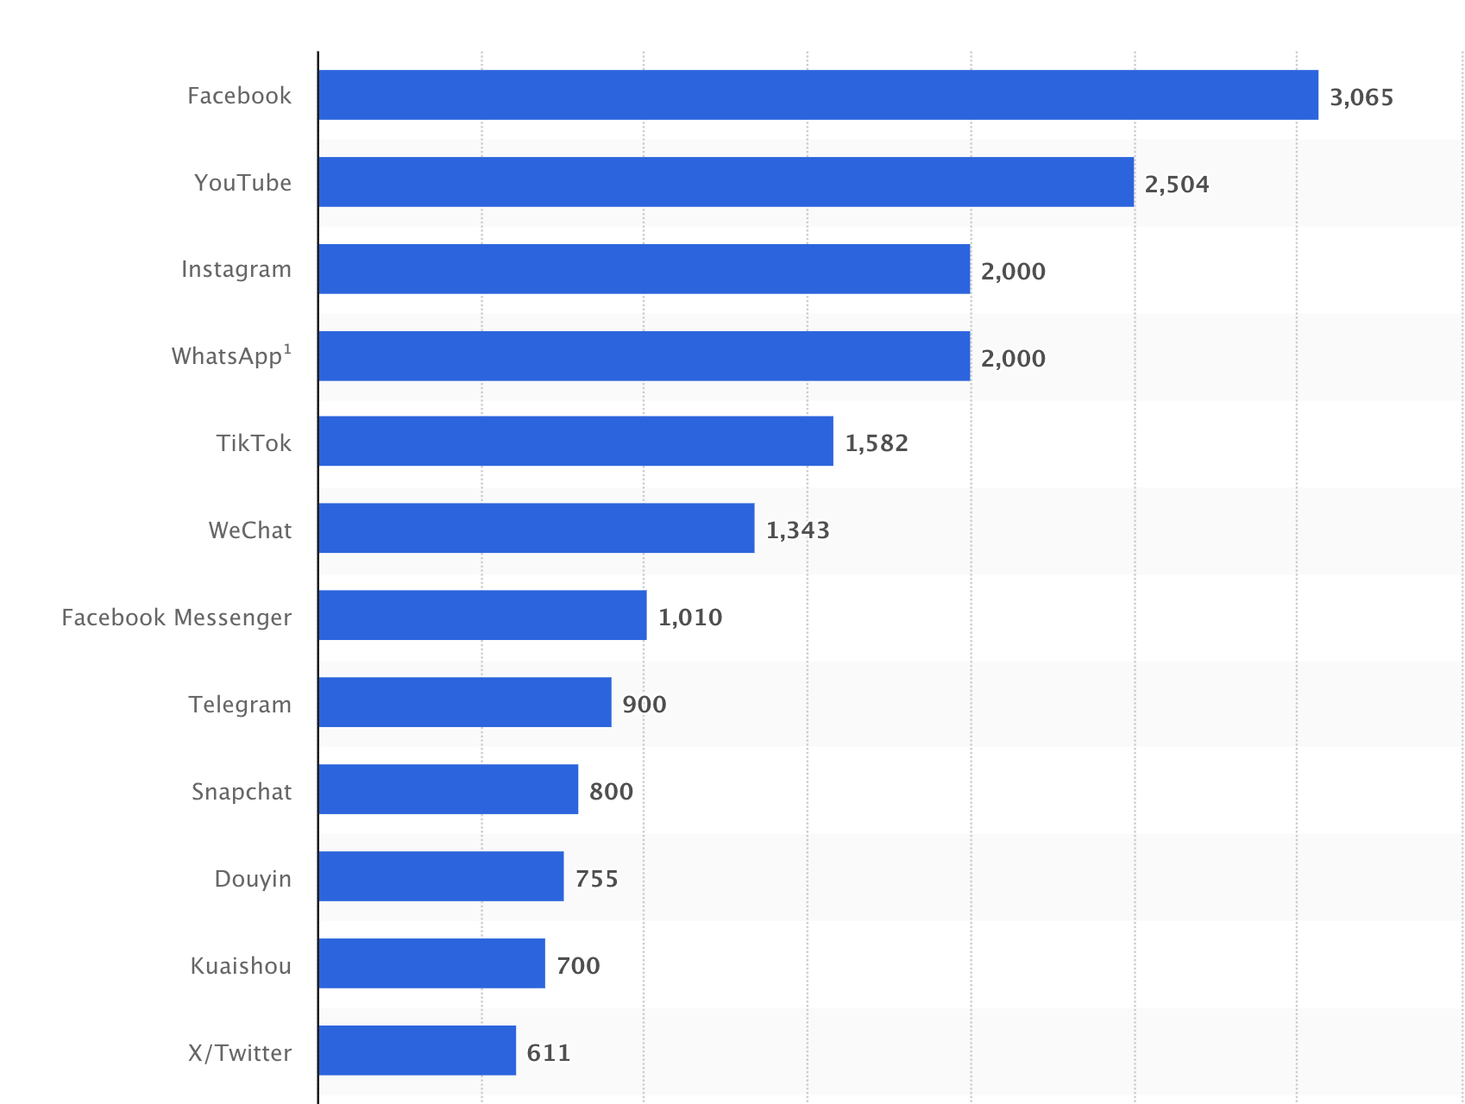
Most popular social media networks
By number of monthly actively users (2024)
1
2
3
Topic 1
Topic 2
Sub topic
Sub sub topic
12
Source: statista.com
Notes:
https://www.globalpartnership.org/results/education-data-highlights

Slide 10
How can we use social media for education?

Slide 11
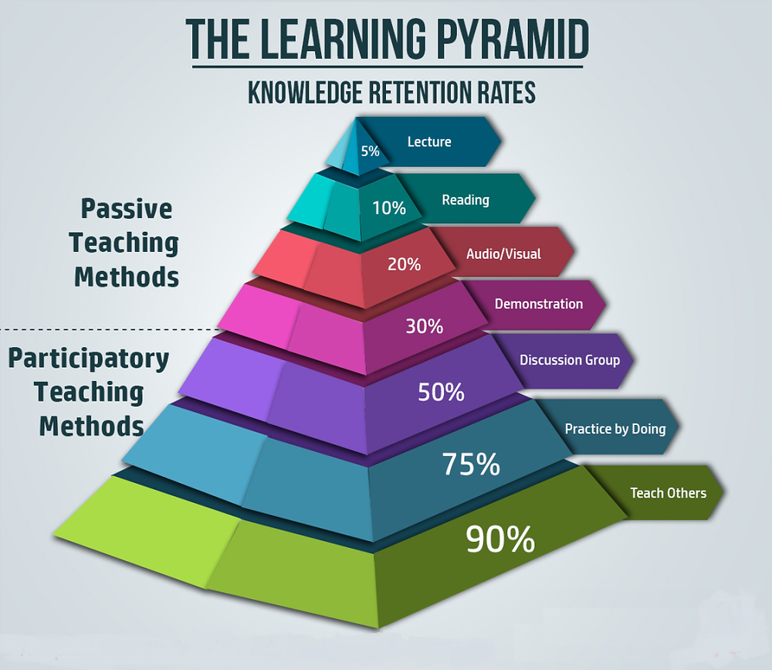
Youtube, TikTok
Learning Pyramid (Retention Rates) & Corresponding Social Media Platforms
The Learning Pyramid ranks learning methods by retention rates. Here’s how different social media platforms fit:
Lecture (5%) → YouTube, TikTok
Passive watching of educational videos, lectures, and tutorials.
Reading (10%) → Wikipedia, LinkedIn Articles, Blogs
Consuming written content, research papers, and wikis.
Audio-Visual (20%) → Instagram Reels, Twitter/X Threads, Podcasts
Engaging with infographics, short explainer videos, and audiobooks.
Demonstration (30%) → YouTube, Twitch, TikTok (Live)
Watching live-streamed tutorials, product demos, or scientific experiments.
Discussion Group (50%) → Reddit, Facebook Groups, Discord, Quora
Engaging in debates, Q&A, and collaborative problem-solving.
Practice by Doing (75%) → Slack, GitHub, Online Coding Platforms
Interactive projects, coding collaboration, and hands-on exercises.
Teaching Others (90%) → Wikipedia (Editing), YouTube (Content Creation), Blogging
Creating explainer videos, writing guides, and answering community questions.
Social constructivist platforms (Reddit, Discord, Quora, Slack, Wikipedia) fall into the higher retention categories, promoting deep learning through discussion, practice, and peer teaching.
Blogs, Twitter, Facebook
Youtube, TikTok,Twitter, Facebook, Threads
Youtube, TikTok live
Facebook, Twitter
Slack, WhatsApp, Twitter
Youtube, Twitter
Adapted from the National Training Laboratories Institute of Applied Behavioral Science Learning Pyramid

Slide 12
Youtube, TikTok
Learning Pyramid (Retention Rates) & Corresponding Social Media Platforms
The Learning Pyramid ranks learning methods by retention rates. Here’s how different social media platforms fit:
Lecture (5%) → YouTube, TikTok
Passive watching of educational videos, lectures, and tutorials.
Reading (10%) → Wikipedia, LinkedIn Articles, Blogs
Consuming written content, research papers, and wikis.
Audio-Visual (20%) → Instagram Reels, Twitter/X Threads, Podcasts
Engaging with infographics, short explainer videos, and audiobooks.
Demonstration (30%) → YouTube, Twitch, TikTok (Live)
Watching live-streamed tutorials, product demos, or scientific experiments.
Discussion Group (50%) → Reddit, Facebook Groups, Discord, Quora
Engaging in debates, Q&A, and collaborative problem-solving.
Practice by Doing (75%) → Slack, GitHub, Online Coding Platforms
Interactive projects, coding collaboration, and hands-on exercises.
Teaching Others (90%) → Wikipedia (Editing), YouTube (Content Creation), Blogging
Creating explainer videos, writing guides, and answering community questions.
Social constructivist platforms (Reddit, Discord, Quora, Slack, Wikipedia) fall into the higher retention categories, promoting deep learning through discussion, practice, and peer teaching.
Blogs, Twitter, Facebook
Youtube, TikTok,Twitter, Facebook, Threads
Youtube, TikTok live
Facebook, Twitter
Slack, WhatsApp
Youtube, Twitter
Adapted from the National Training Laboratories Institute of Applied Behavioral Science Learning Pyramid

Slide 13
The most effective methods to learn are the participatory one
Group discussions
Teaching others
Knowledge retention rate
50%
90%
SoMe platforms
Twitter, Facebook
Youtube, TikTok, Twitter
Disadvantages
Facebook- unnacesible for everyone (closed groups)
90% - only for the lecturer; for asssiting to the lecture knowledge retention is 5-20 %
Scientific mistakes
Easely corrected by the community
Difficult to correct

Slide 14
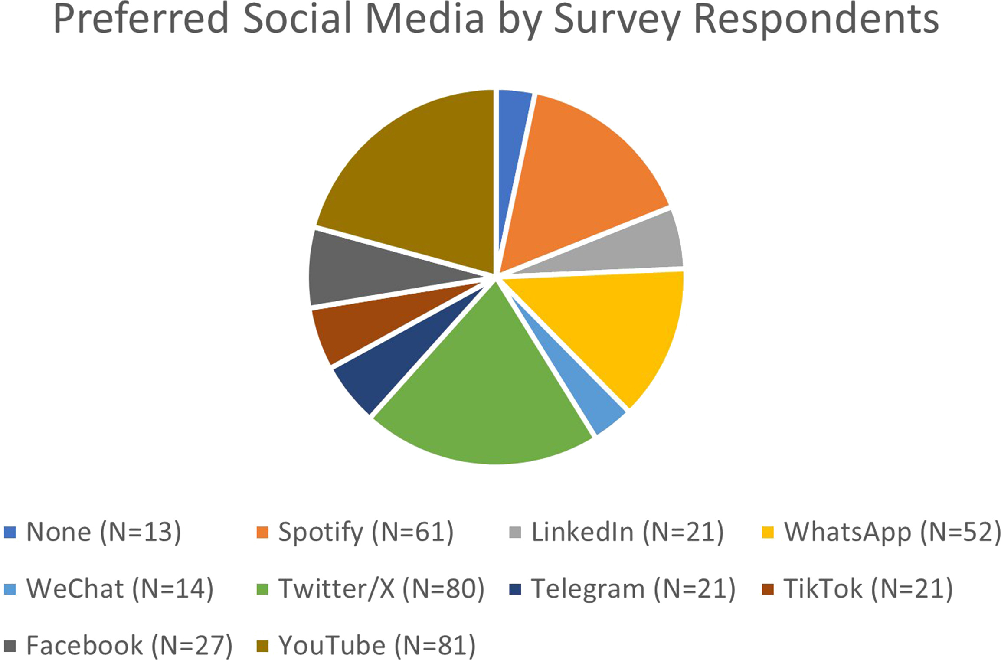
What are the nephrologists’ preferences for social media?
1
YouTube 20.7%
2
Twitter 20.5%
3
Spotify 15.6%
4
WhatsApp 13.3%
Beck SG, KI reports, 2024

Slide 15
#Nephtwitter was the happy place for nephrologists
Learning and teaching
Networking & mentorship

Slide 16
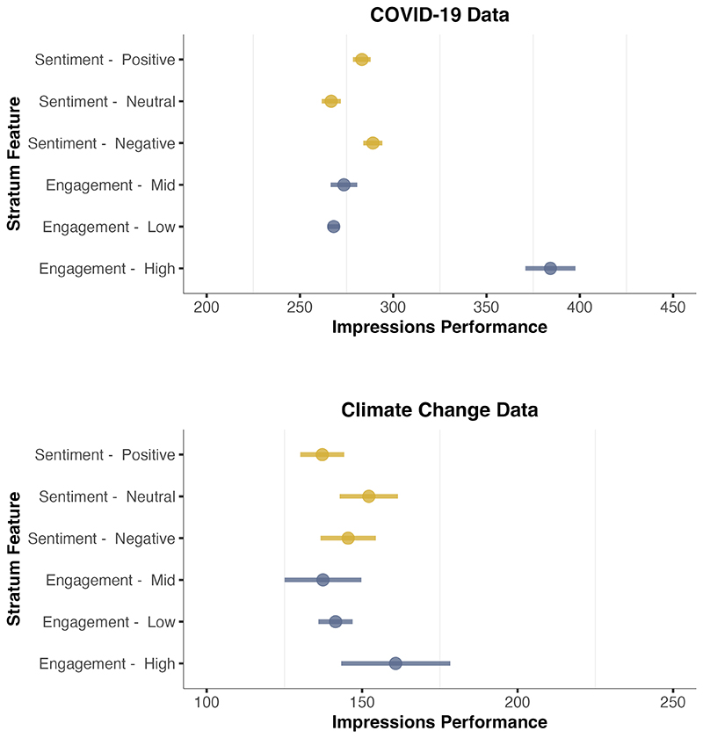
But the algorithm is broken
Low-credibility tweets get more impressions than high-credibility
COVID-19: +19.2% amplification (median +17.3%)
Climate change: +95.8% amplification (median +90.1%)
Corsi G, arXiv, 2023

Slide 17
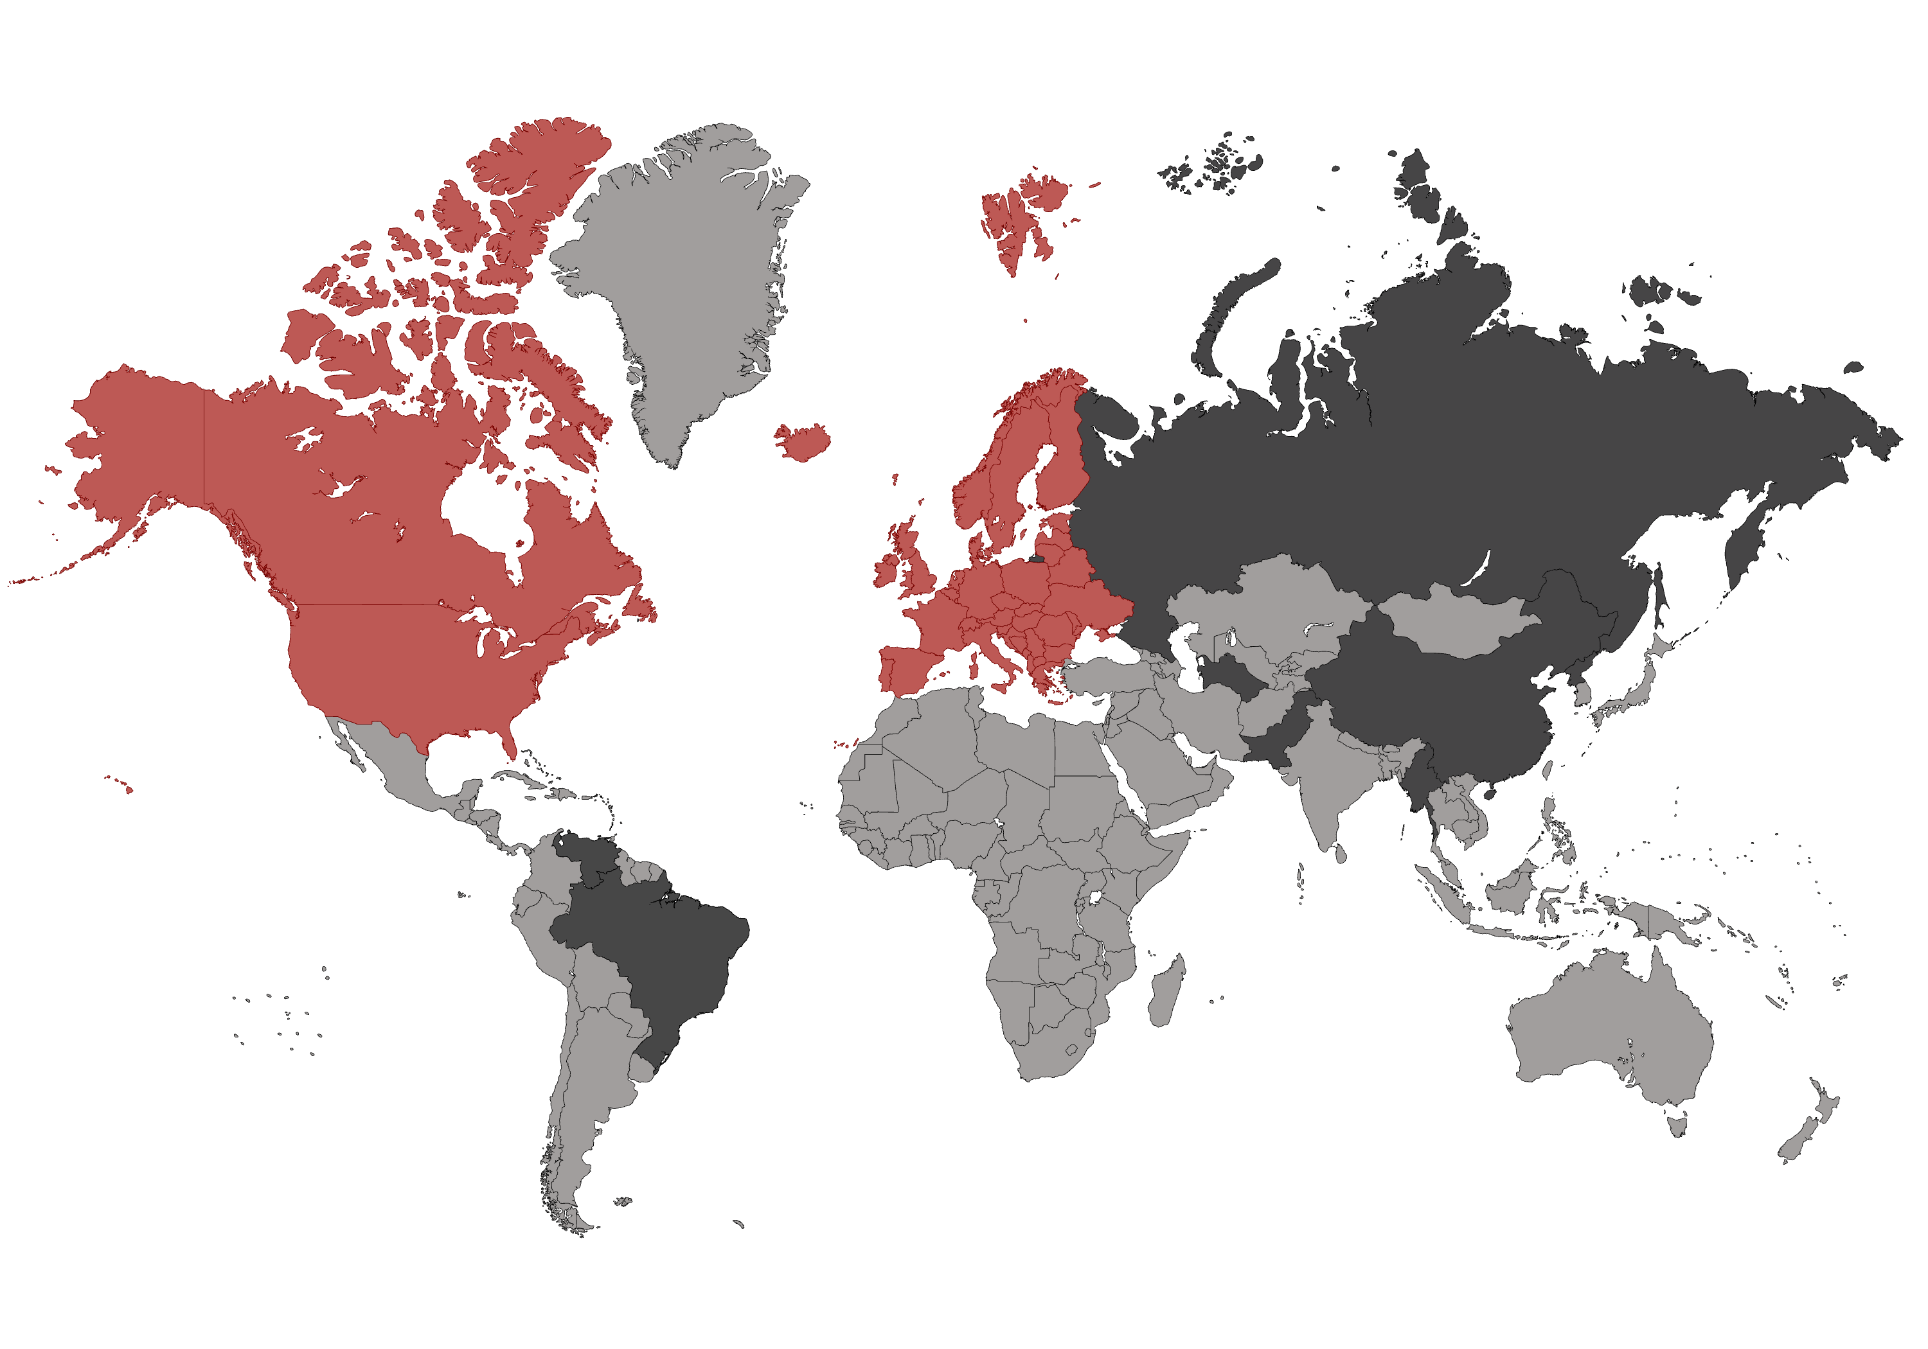
X is not a place to learn anymore
Issues with the algorythm
Banned

Slide 18
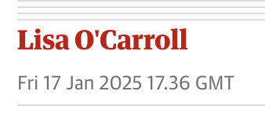
X might be banned in Europe

Slide 19
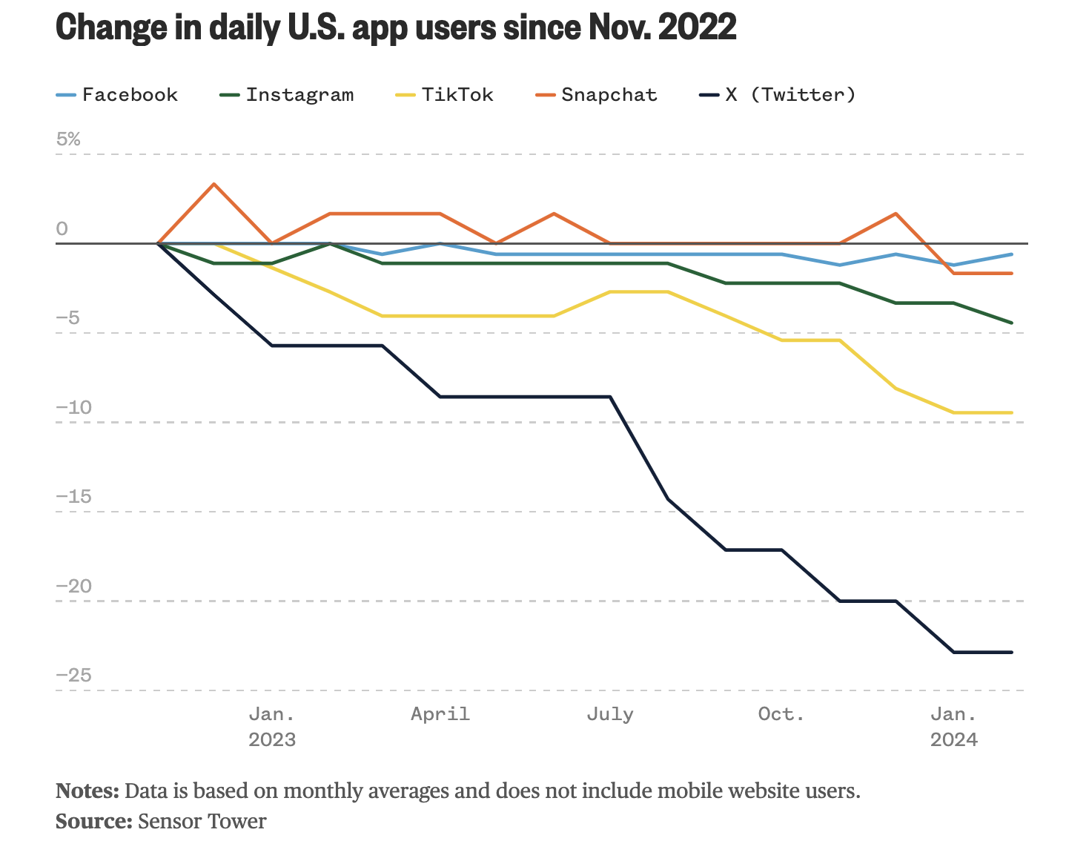
X is constantly losing users

Slide 20
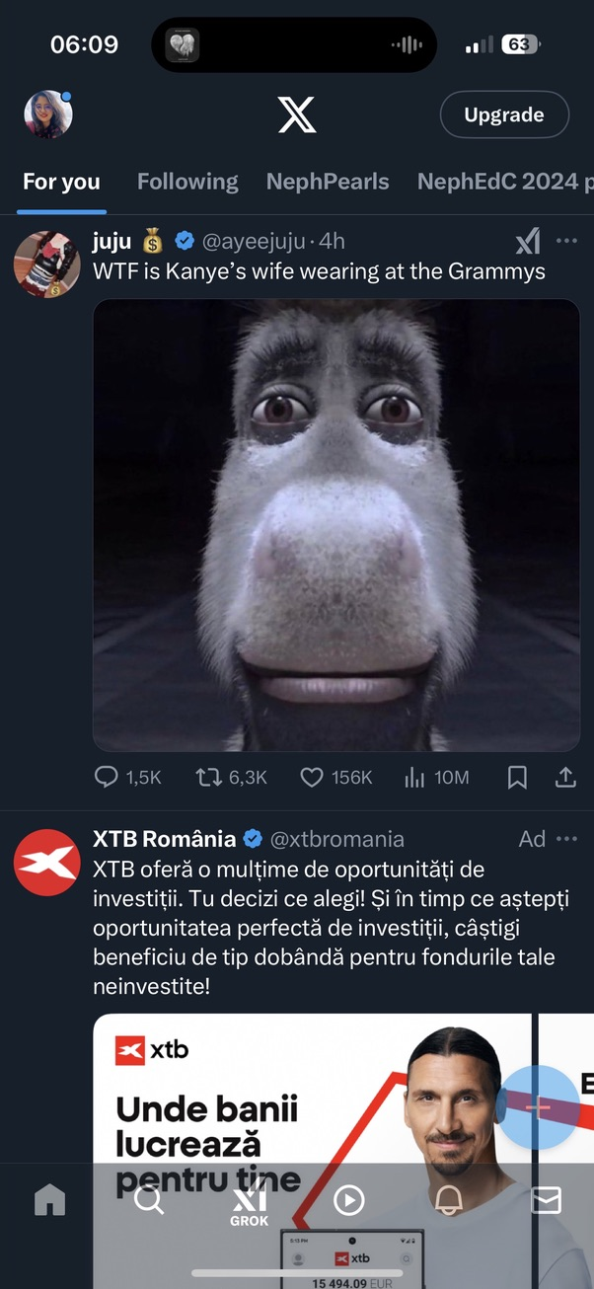
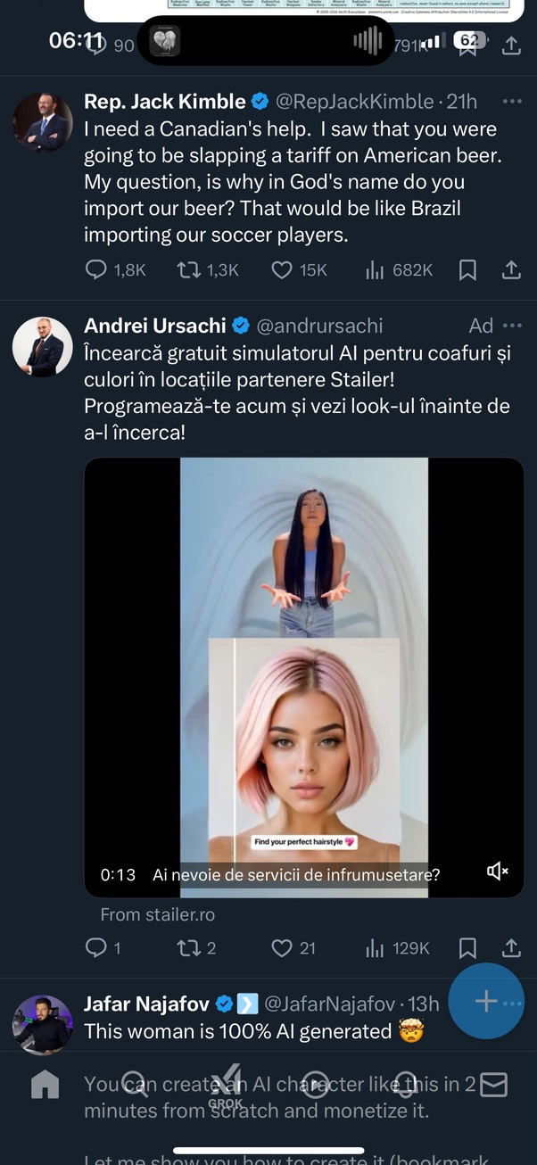
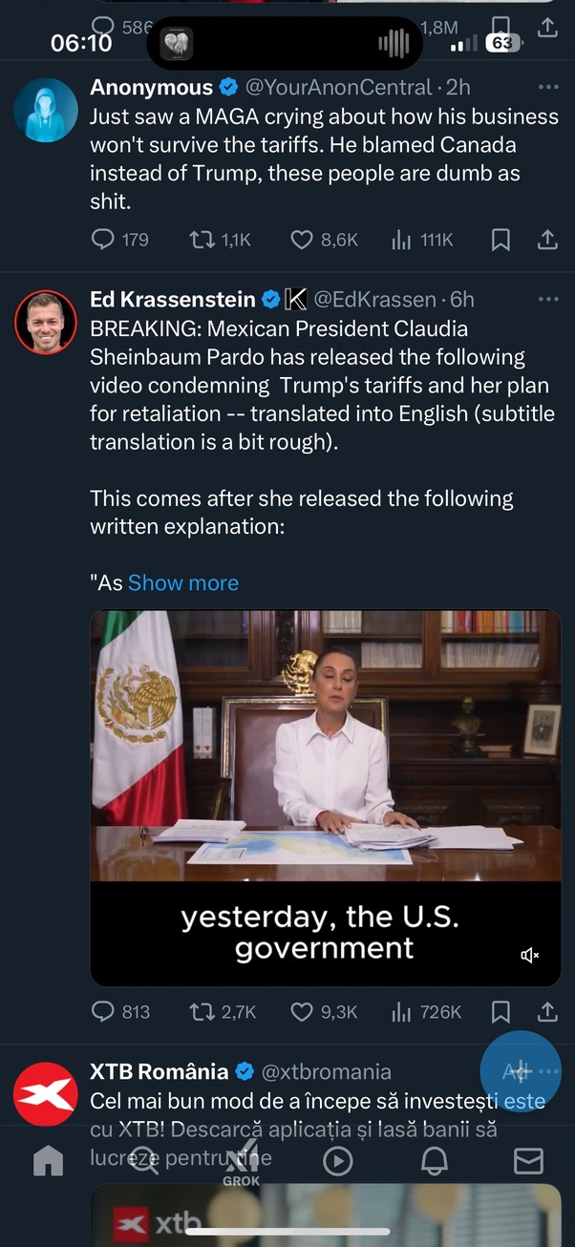
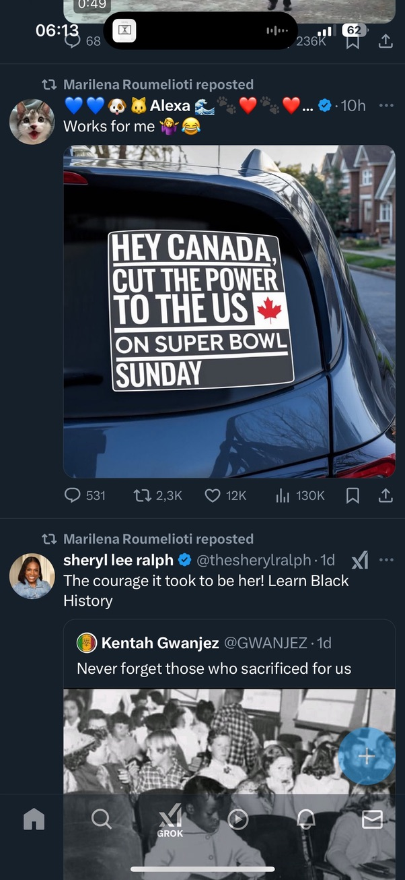
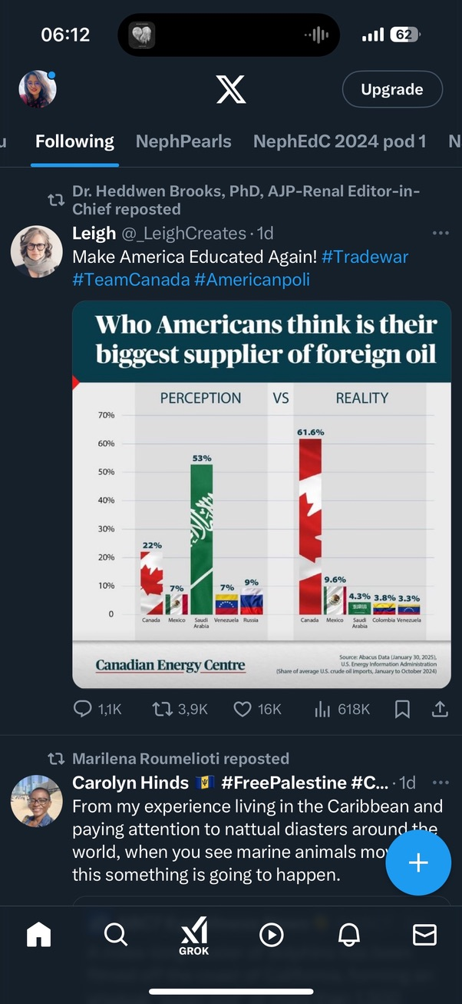
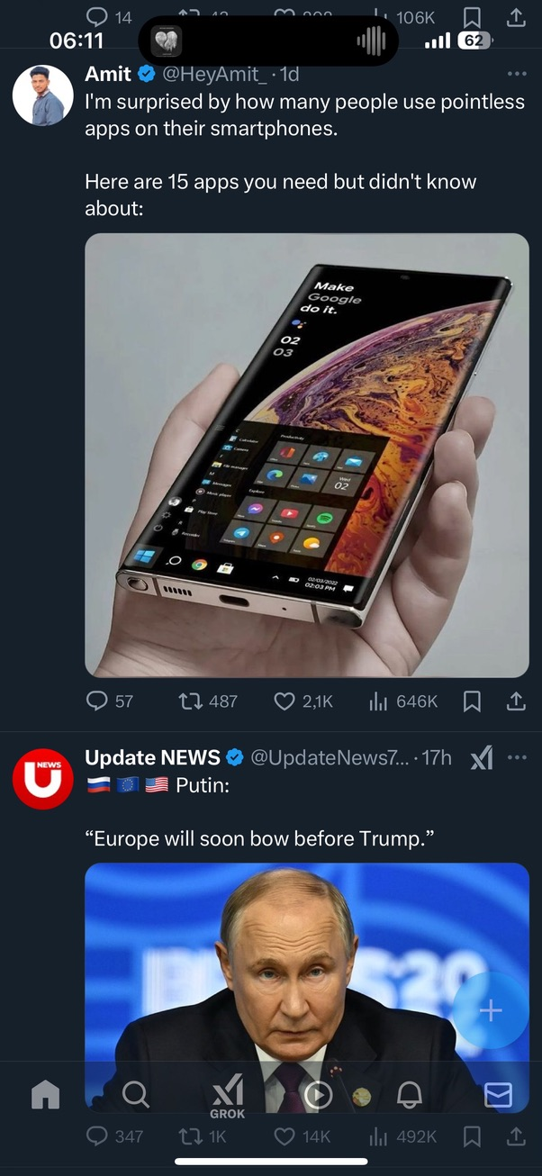
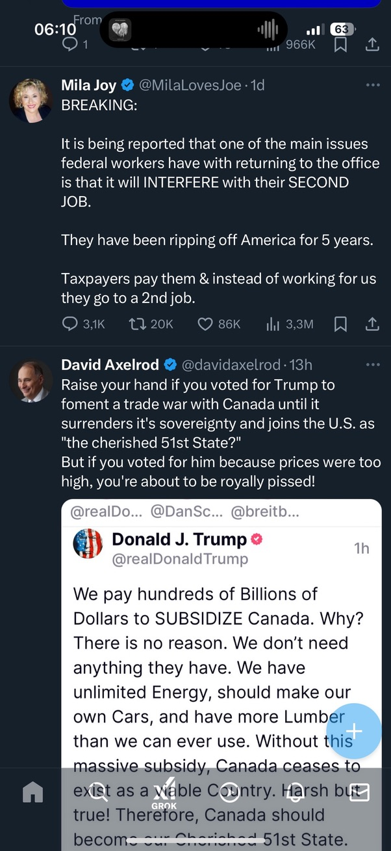
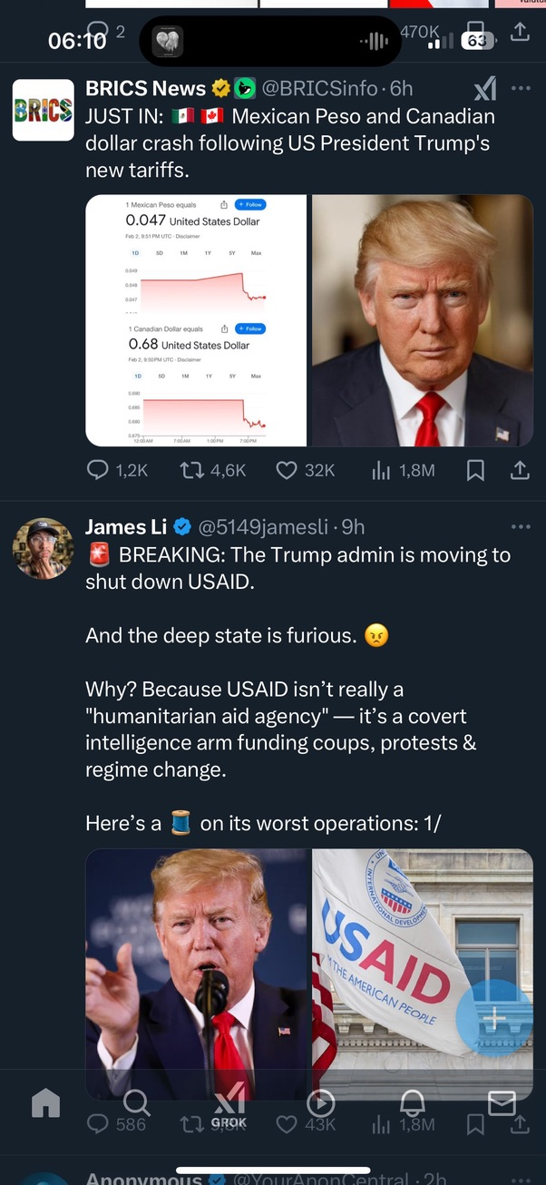
X in Europe as a nephrologist
Science/ Nephrology is imposible to reach on X from some parts of the world

Slide 21
X is constantly losing users

Slide 22
What’s the alternative?

Slide 23
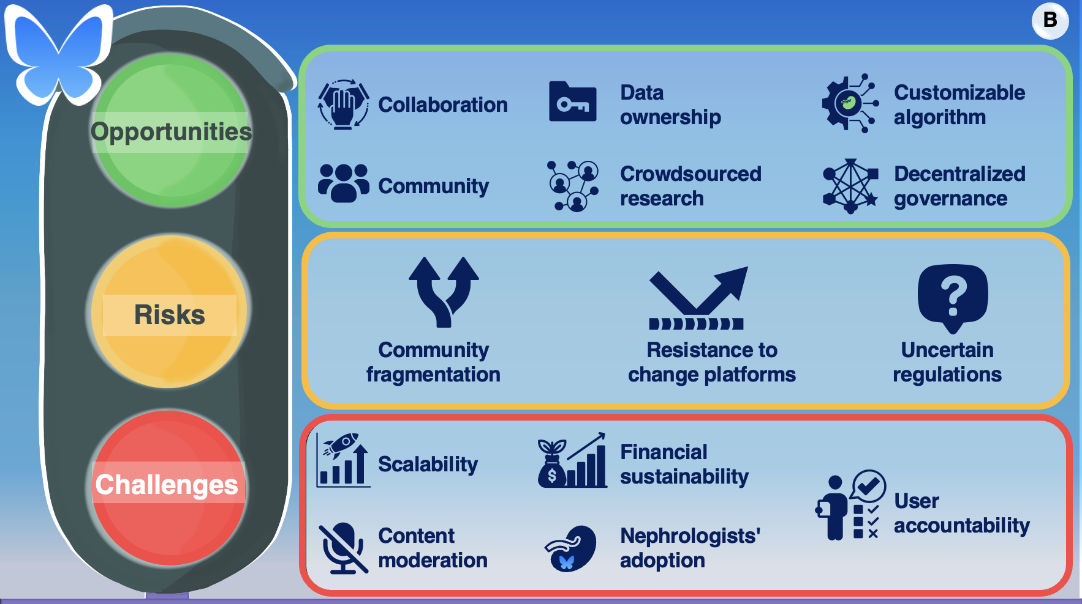
BlueSky
microblogging social media, similar to old twitter
aims to foster decentralized networking
includes some choice of algorithms
brings improved blocking functions
Popa C, KI reports, 2025

Slide 24
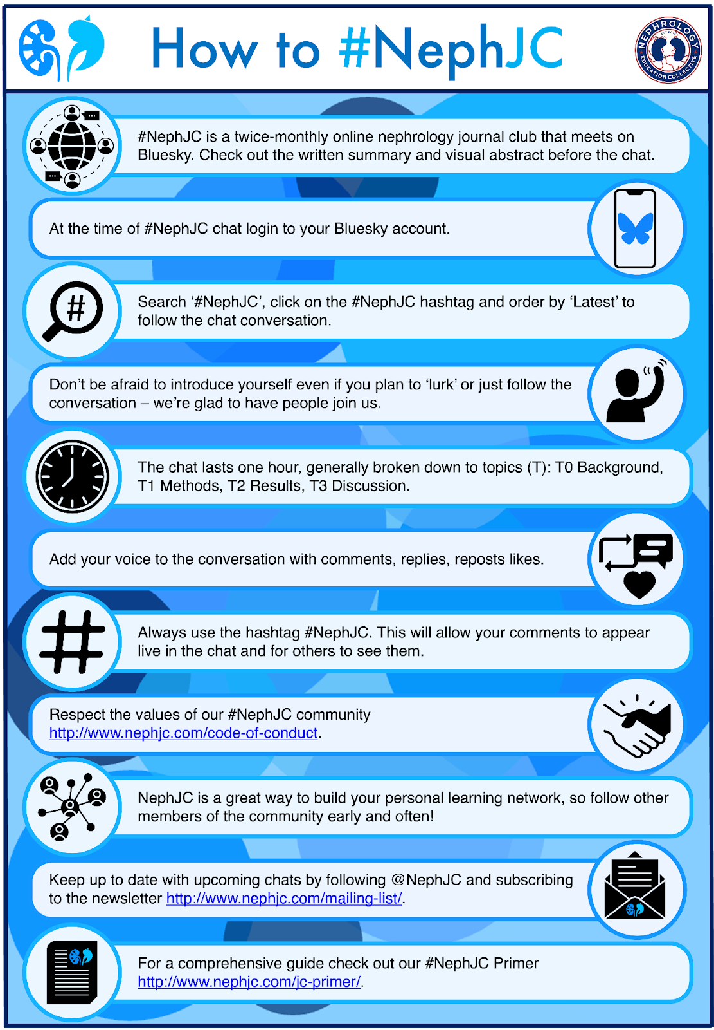
NephJC is already on bluesky
1st chat on November 19th 2024
5 chats
30-50 participants
More genuine interaction

Slide 25
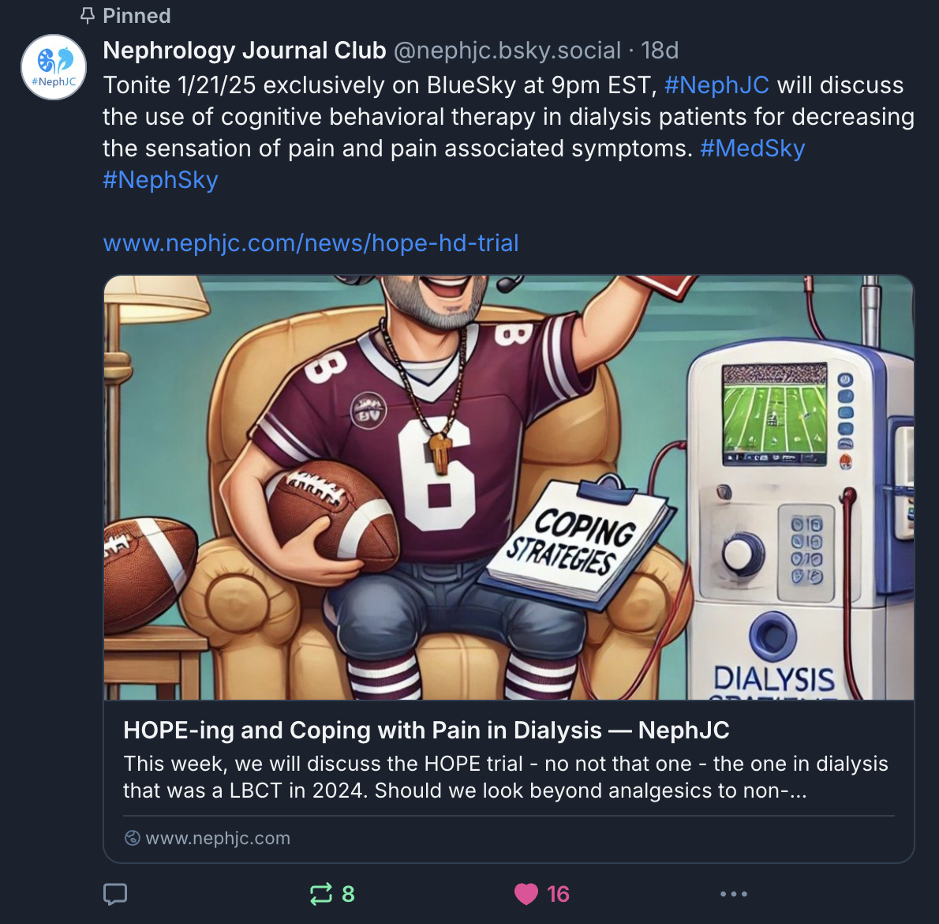
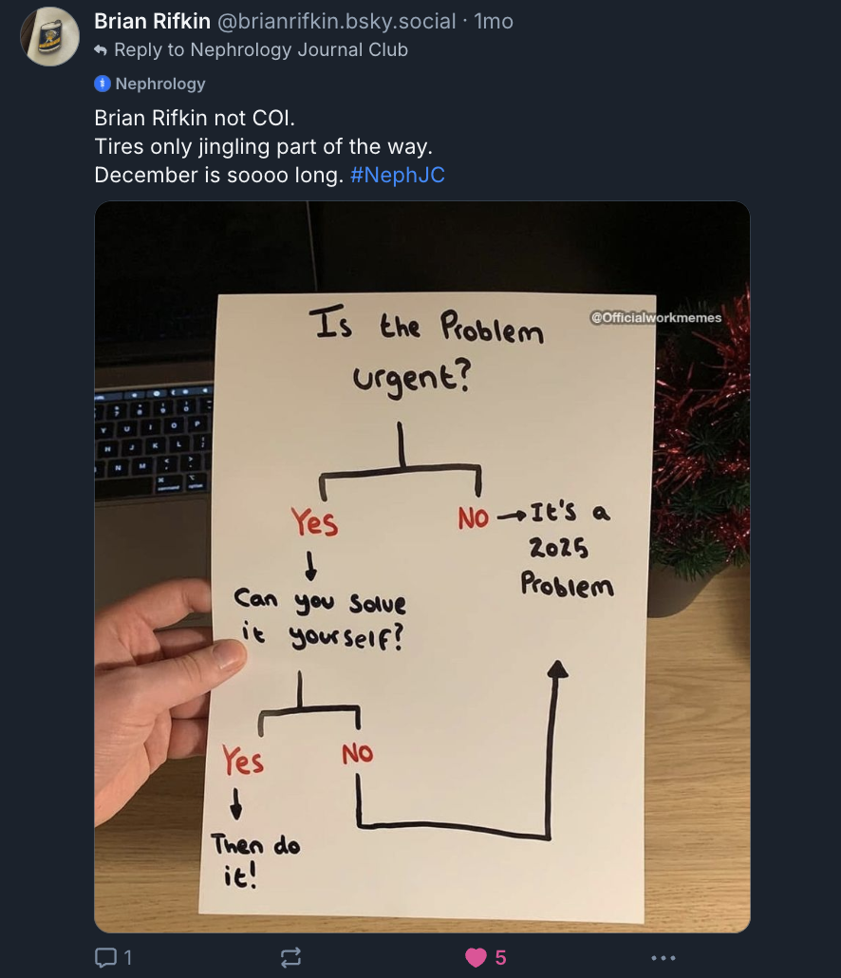
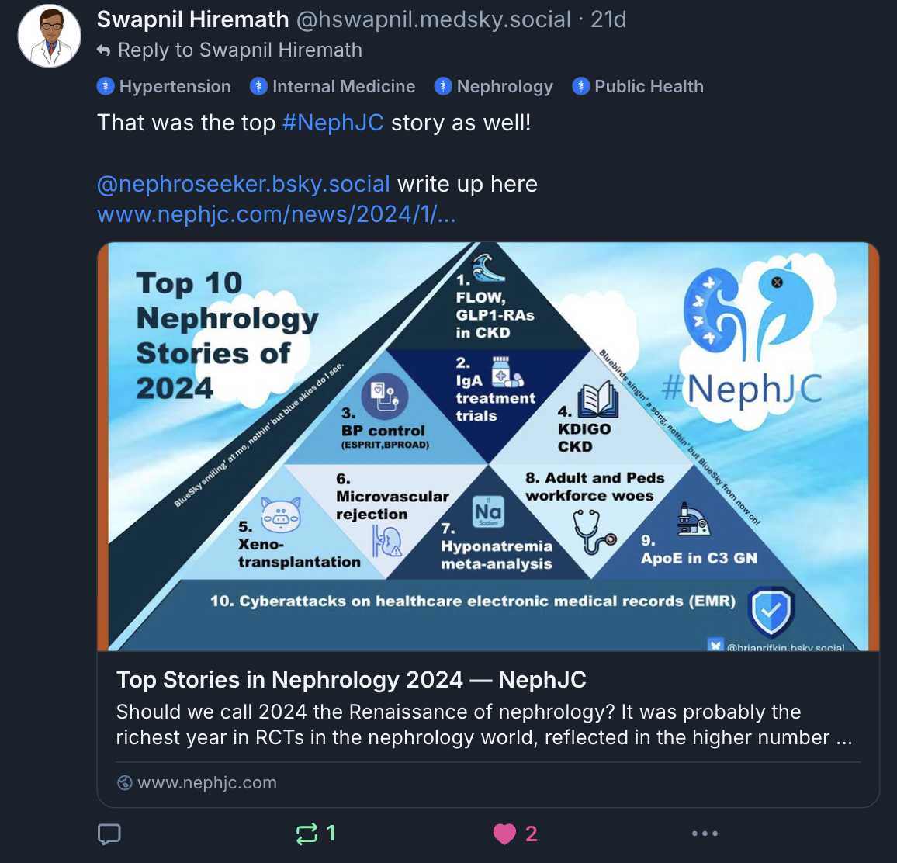
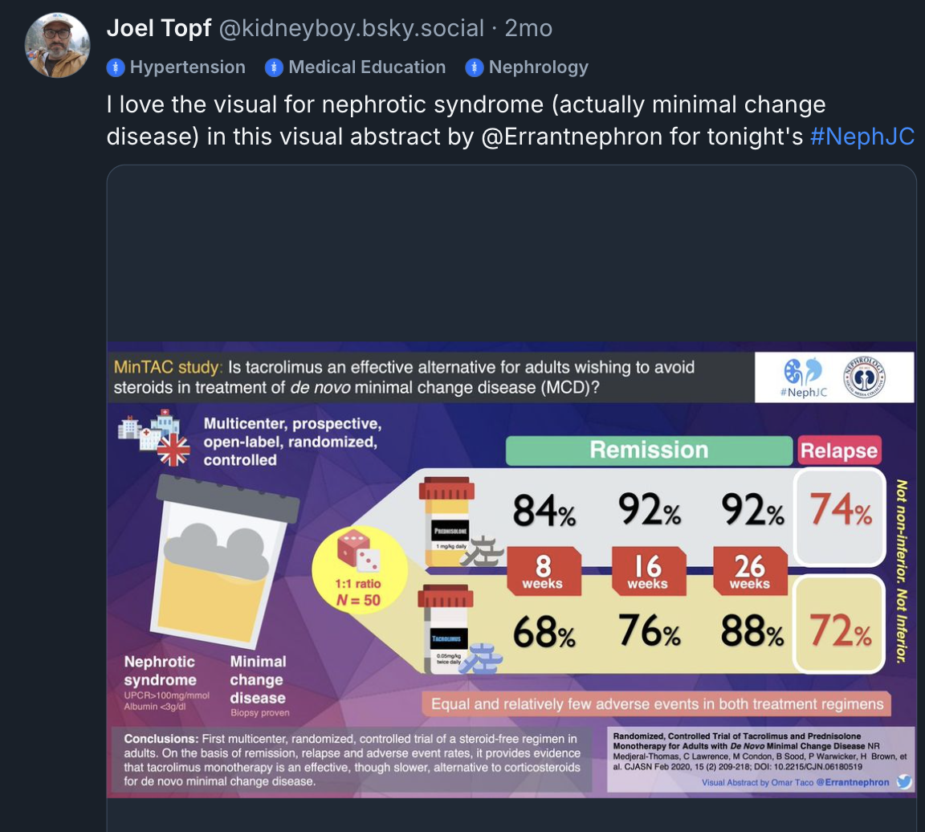
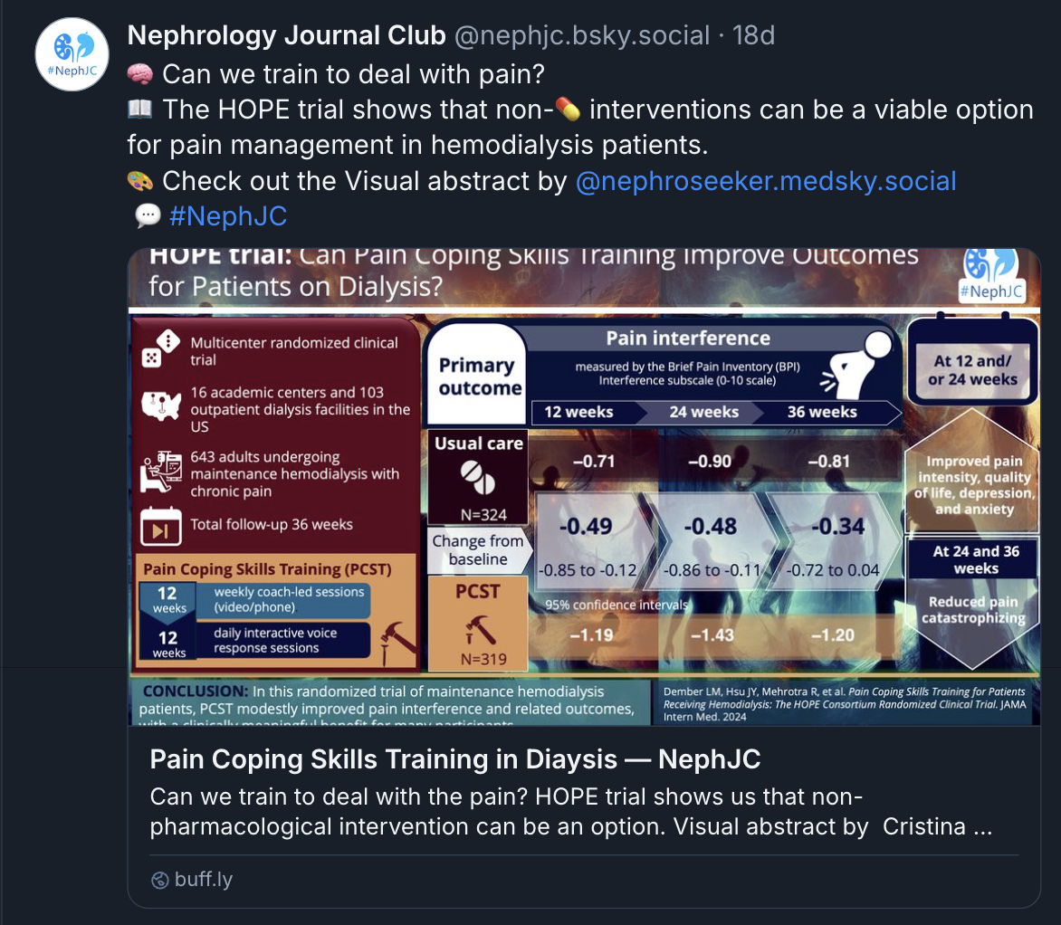
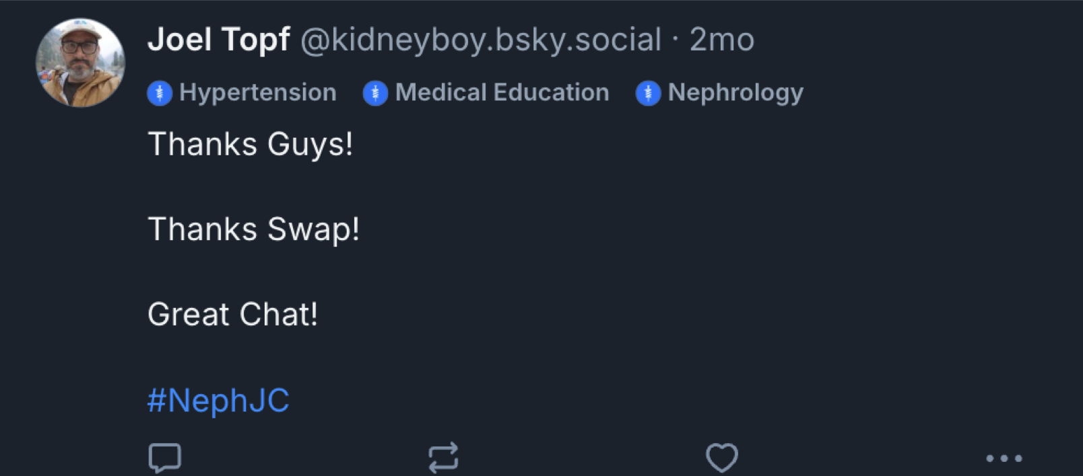
NephJC is already on bluesky

Slide 26
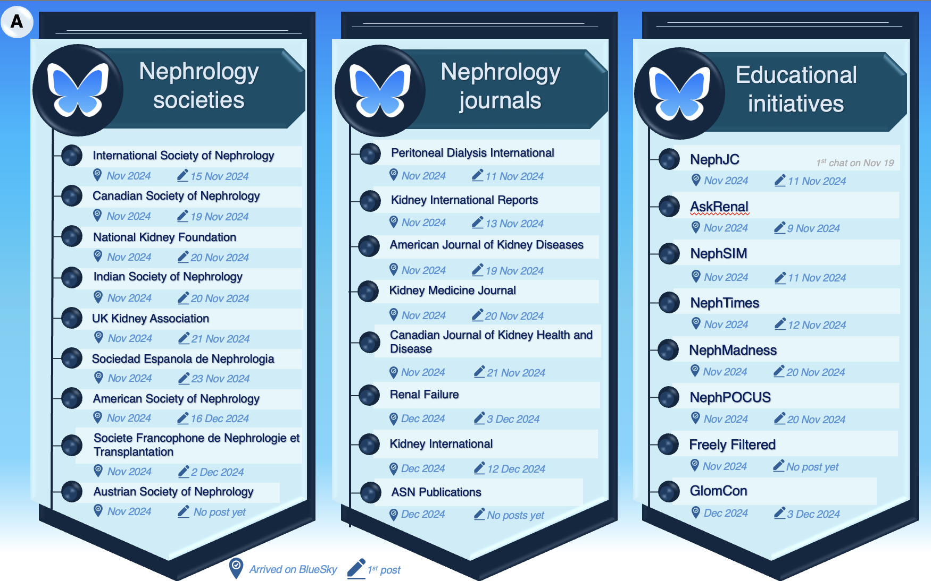
More initiatives, journals and societies are on Bluesky
Popa C, KI reports, 2025

Slide 27
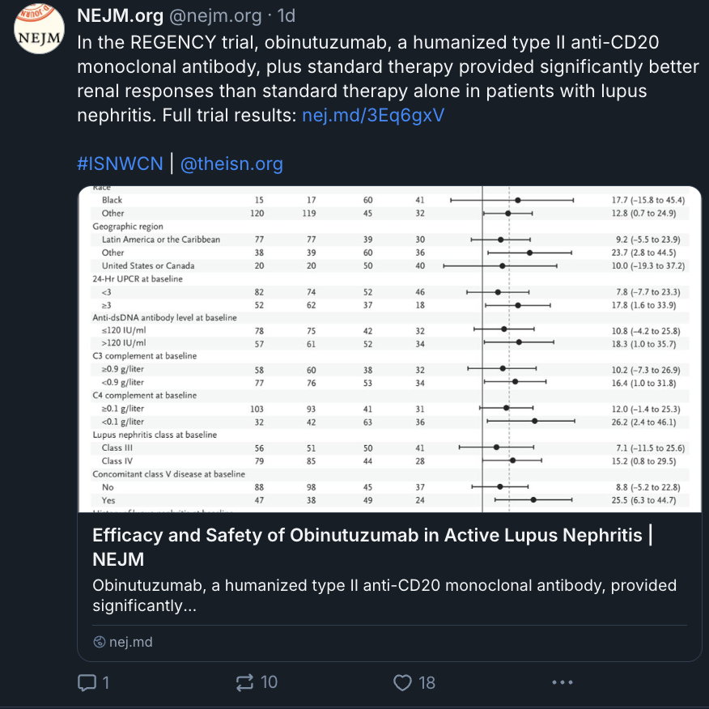
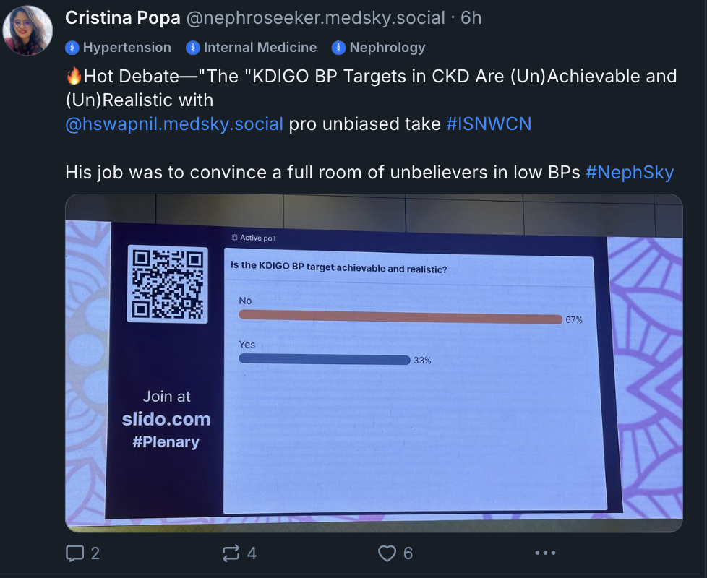
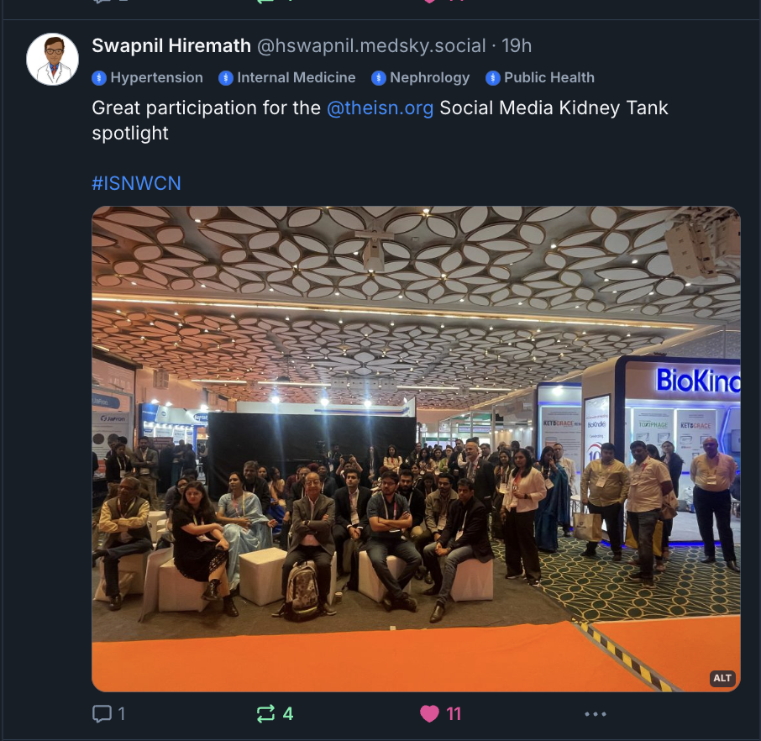
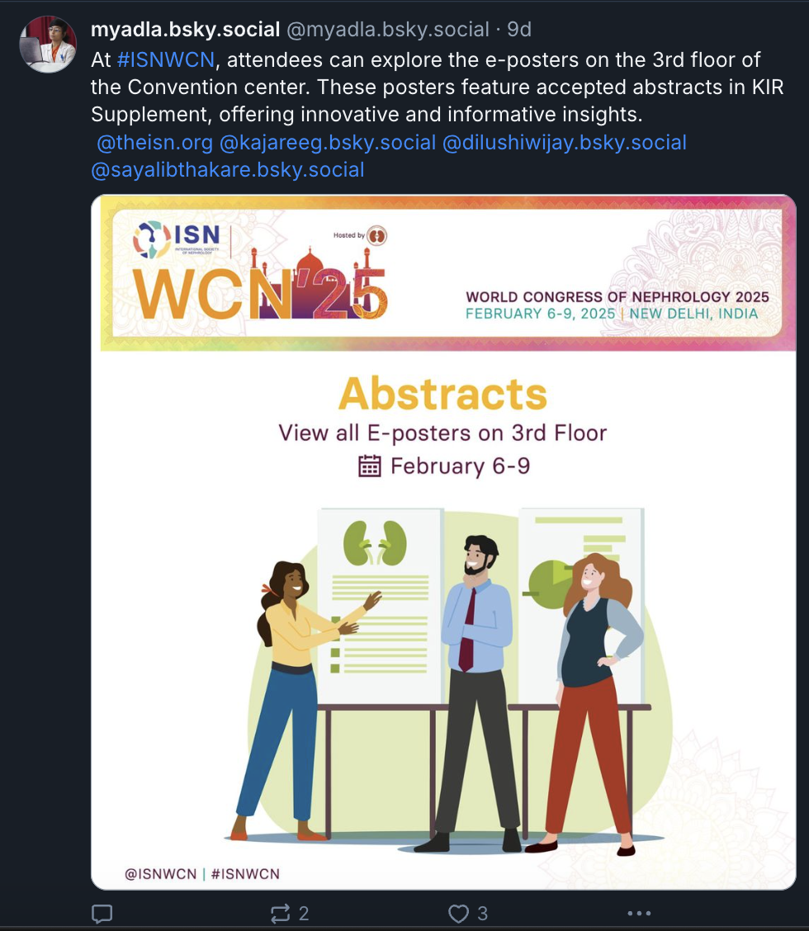
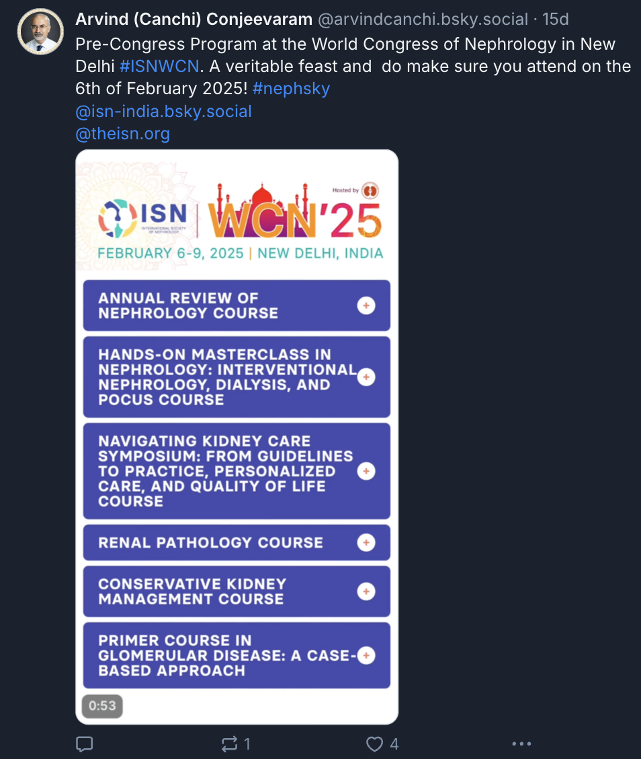
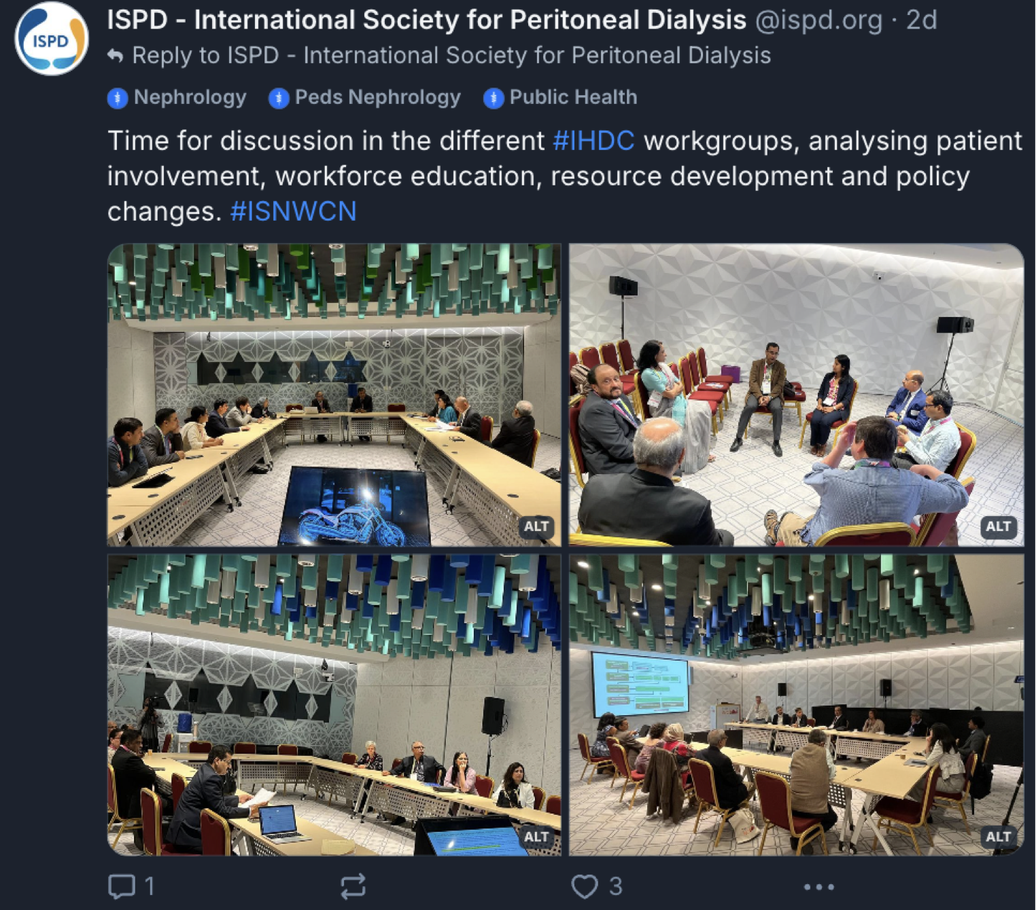
#ISNWCN is there

Slide 28
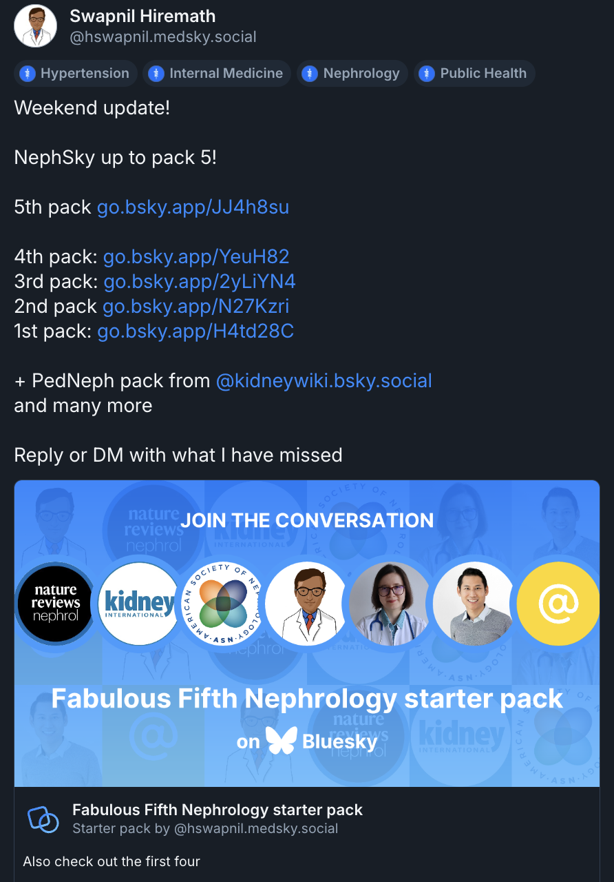
Easy to find #NephSky people

Slide 29
The most precious resource we have is time
Topic 1
Topic 2
Sub topic
Sub sub topic
Steve Jobs (1955-2011)
Adapted after Organisation for Economic Co-operation and Development, Time Database, 2024
Notes:
https://data-explorer.oecd.org/vis?fs[0]=Topic%2C1%7CSociety%23SOC%23%7CWell-being%20and%20beyond%20GDP%23SOC_WEL%23&pg=0&fc=Topic&bp=true&snb=8&df[ds]=dsDisseminateFinalDMZ&df[id]=DSD_TIME_USE%40DF_TIME_USE&df[ag]=OECD.WISE.INE&df[vs]=1.0&dq=.._T&to[TIME]=false

Slide 30
Need more time for education?
Audio kind of learner?

Slide 31
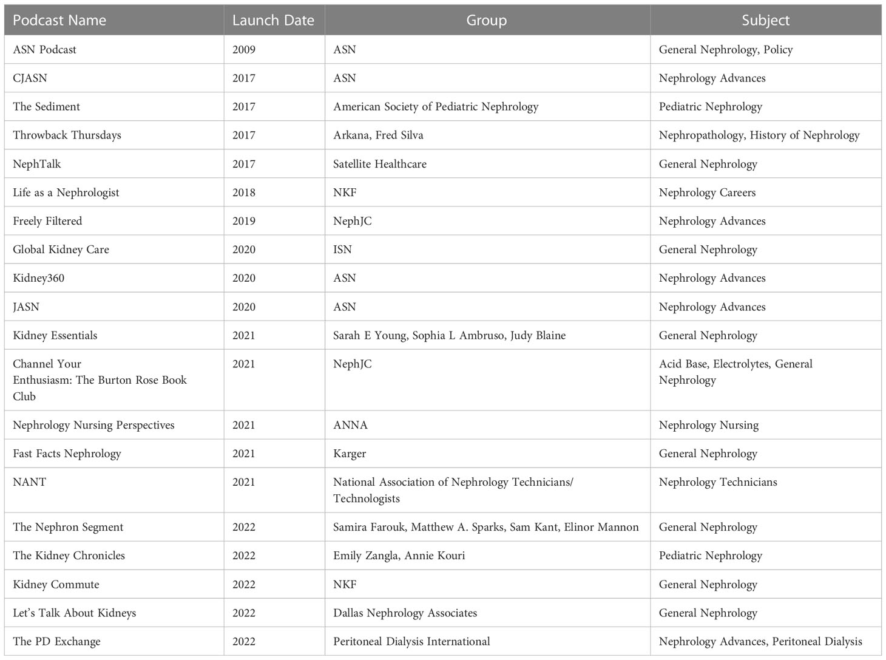
Podcasts might be the solution
Shankar M, Sparks M, 2023

Slide 32
Take home message
Subscribe to NephJC newsletter
Lots of news to come!

Slide 33
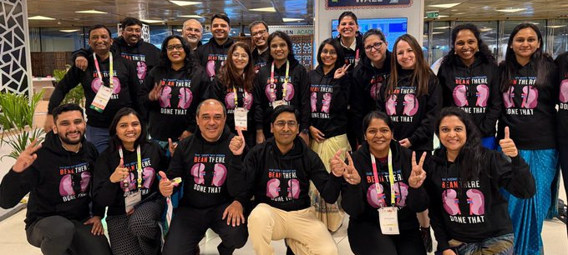
Let’s keep our community together!

