Slide 1
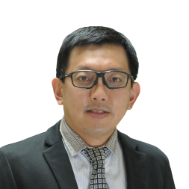
Dr Siow Sze Li is the Head of the Department of General Surgery and Head of Day Care Services at Sarawak General Hospital. He is a senior consultant surgeon with more than 20 years of experience in minimally invasive gastrointestinal, bariatric, hernia, and robotic surgery.
Widely recognised as a pioneer of minimally invasive surgery in Sarawak, Dr Siow introduced and developed several advanced laparoscopic procedures in the state, including the first laparoscopic totally extraperitoneal (TEP) inguinal hernia repair and many complex laparoscopic gastrointestinal operations. He also performed the first series of single-incision laparoscopic cholecystectomy reported in Malaysia. More recently, he has been at the forefront of robotic general surgery in East Malaysia, performing robotic bariatric surgery, robotic inguinal and abdominal wall hernia repair, and serving as a proctor for Da Vinci robotic surgery.
Dr Siow obtained his Master of Surgery from the University of Malaya and subsequently underwent advanced laparoscopic gastrointestinal and bariatric training under Professor Jean-Louis Dulucq at the Institute of Laparoscopic Surgery, Bordeaux, France. He has authored more than 50 peer-reviewed publications in national and international journals, many highlighting surgical innovation and clinical research originating from Sarawak.
He is the Immediate Past President of the College of Surgeons, Academy of Medicine of Malaysia, Honorary Secretary of the Malaysian Society for Metabolic and Bariatric Surgery, Adjunct Professor at Taylor’s University School of Medicine, Adjunct Lecturer at Universiti Malaysia Sarawak (UNIMAS), and an examiner for postgraduate surgical examinations. His current focus is on advancing safe and evidence-based robotic and minimally invasive surgery throughout Malaysia.
Dr Siow Sze Li

