Slide 1
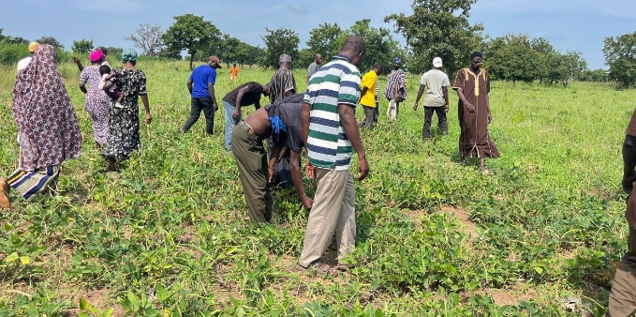
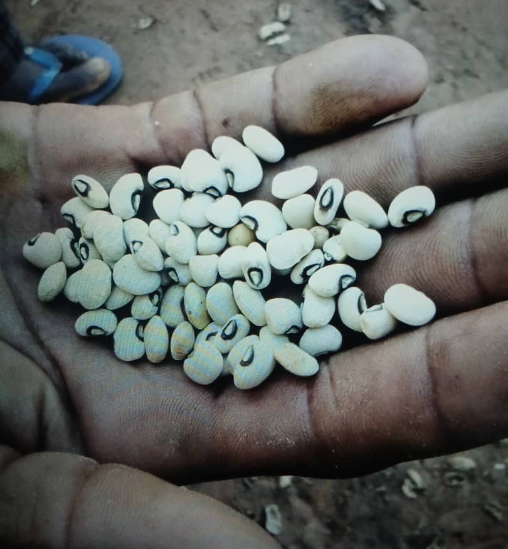
Public–Private Partnerships in Scaling Innovation:
Lessons from the Pod-Borer Resistant Cowpea in Ghana
Prince M. Etwire, Edward Martey, Desmond S. Adogoba, Philip Agrengsore, Mukhtaru Zakaria, James Y. Kwabena, Gloria Adazebra, Yahaya Asieku, Haruna K. Ali and Jerry A. Nboyine
The African Seed Trade Association 2026 Congress, Cape Town

Slide 2
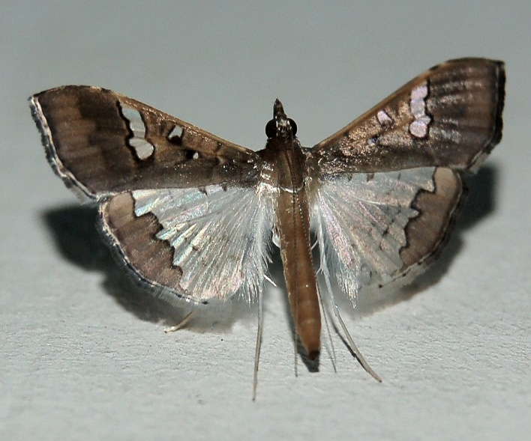
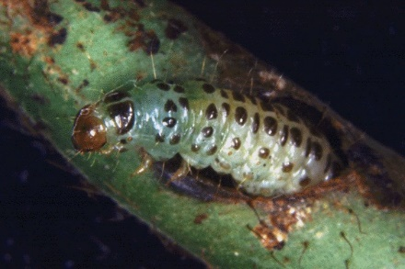
Introduction
Development and release of Pod‑Borer Resistant Cowpea in Ghana
2013–2019
2016–2021
2022–2023
2012
2020
2021
2022
2023
2024
CFT application submitted to NBA
Cry1Ab trials conducted
Cry2Ab trials conducted
Env. release application to IBC
Env. release application to NBA
Env. release approved
National performance trials
Application for variety release
Variety officially released
PBR seed (eight companies)
Early generation seed (Mt) | 16
Certified seed (Mt) | 480
Area that can be planted (Ha) | 19200
Ghana's cropped area in 2024 (Ha) | 201000

Slide 3
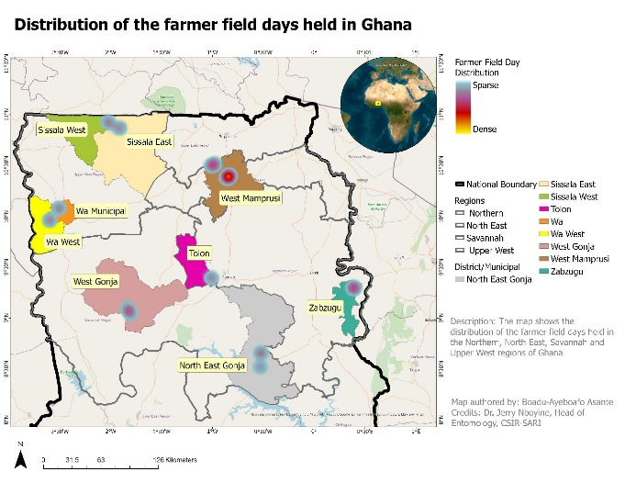
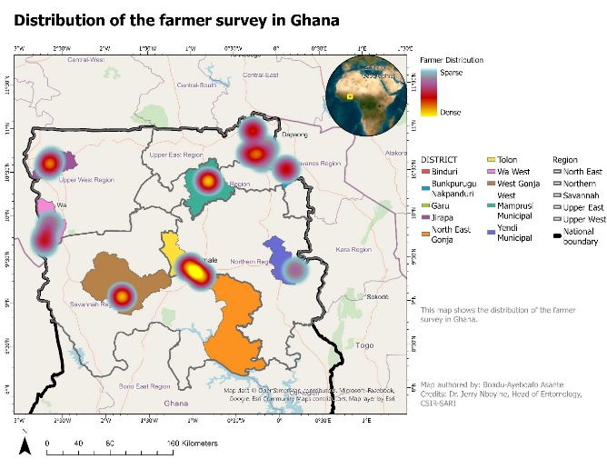
Methodology
N=490
N=615
8 seed companies and 87 seed producers

Slide 4
Findings
Number of times seed fields were sprayed against insects
Number of times grain fields were sprayed against insects
  Average cost ≈ GHs450/Ha/spray
  High labour and health burden due to inappropriate PPEs
  Strong economic case for resistant varieties

Slide 5
Findings
Seed grower awareness of PBR
Farmer awareness of PBR

Slide 6
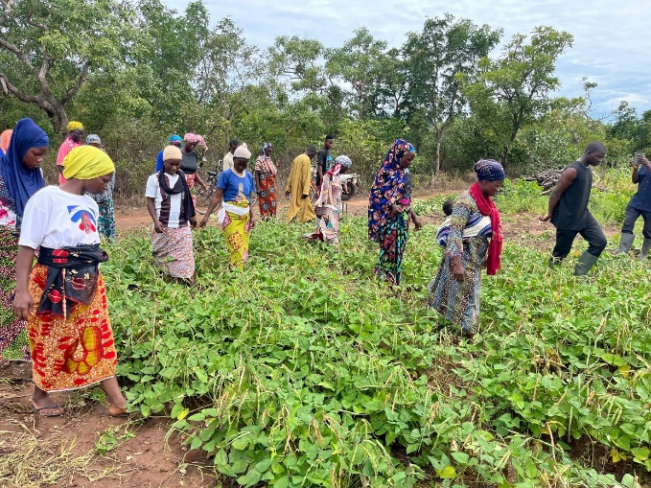
Adoption intentions after demonstration
Farmers’ WTP for PBR
99.8% willing to plant next season
  99% willing to recommend to neighbors
  High diffusion potential

Slide 7
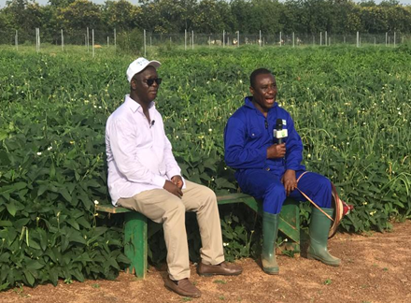
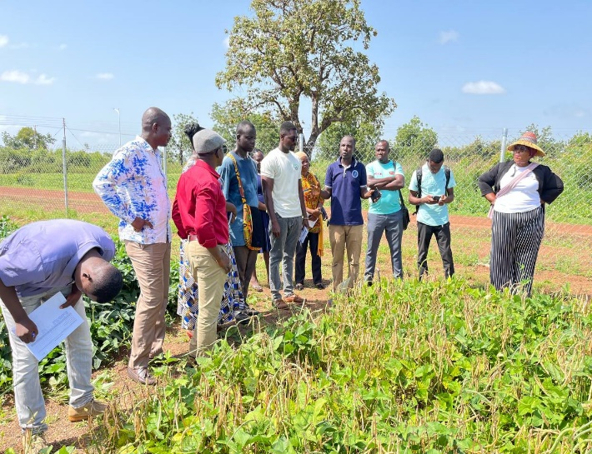
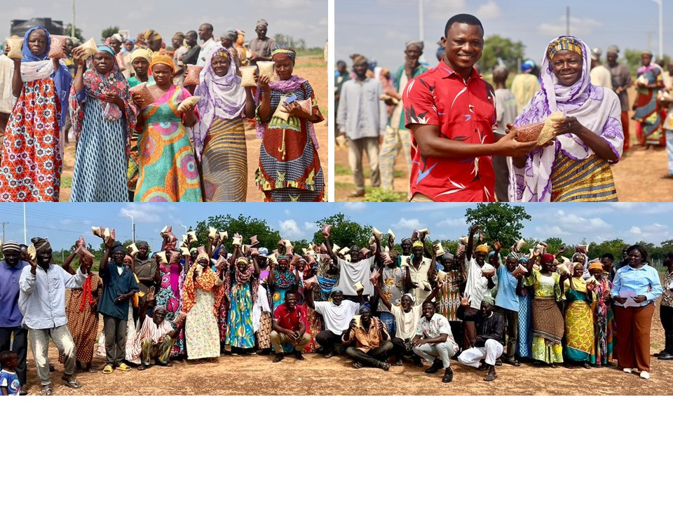
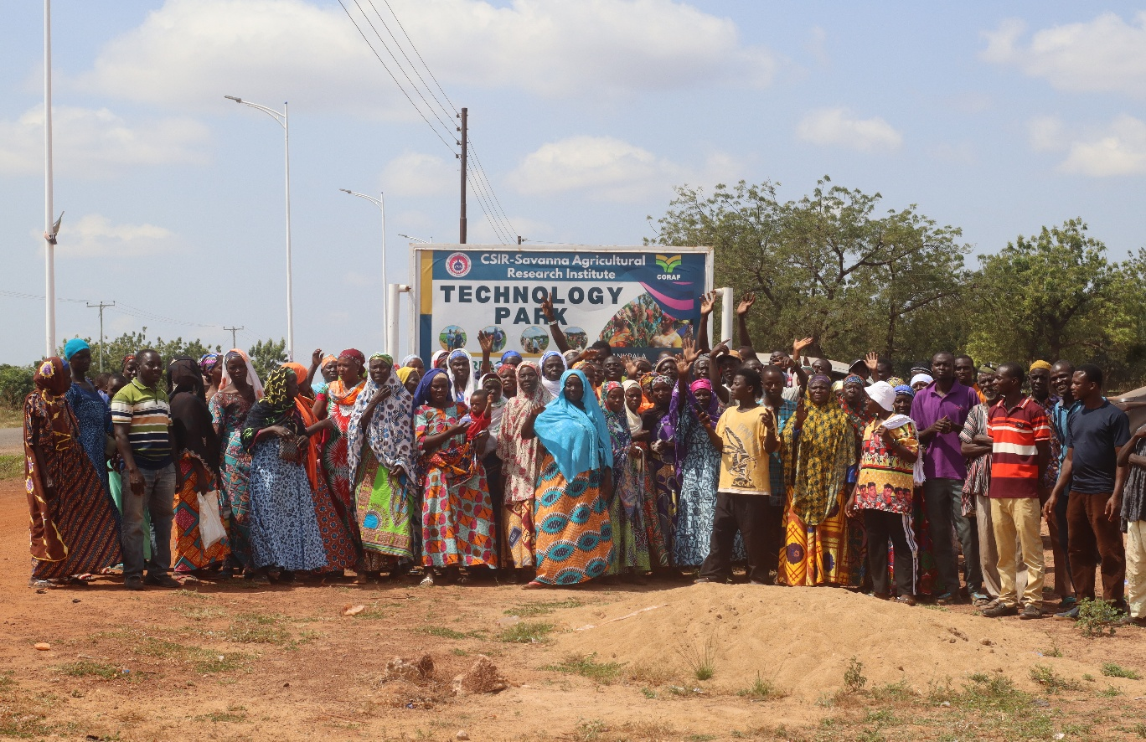
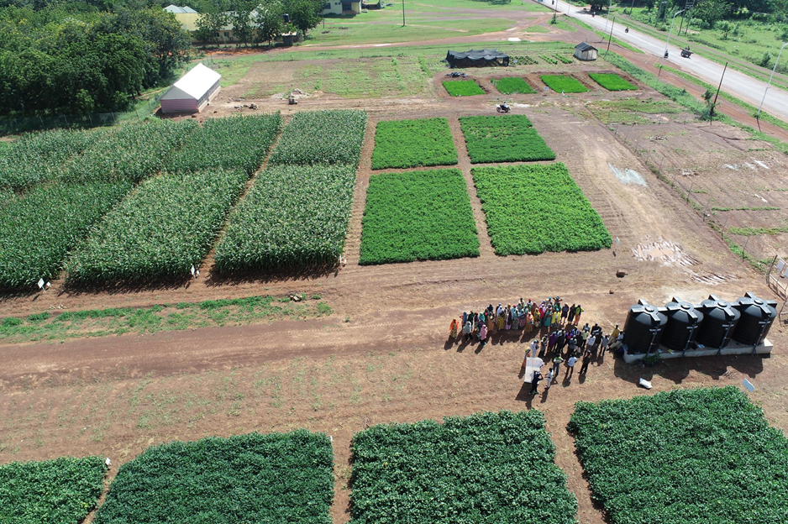
Success factors in scaling: creating awareness

Slide 8
Key challenges identified
Strategic recommendations for seed companies
Dominance of informal seed systems
  High intention to recycle seed (88%)
  Gender disparities in purchasing power
  Low awareness
Engage early in PPP research pipelines (storage weevil)
  Invest in demonstrations
  Strengthen agro-dealer networks
  Develop gender-responsive marketing
  Offer small seed packs

Slide 9
Conclusion
PBR cowpea shows strong commercial potential.
PPPs are essential for scaling innovation.
Seed companies play a central role in transformation.

Slide 10
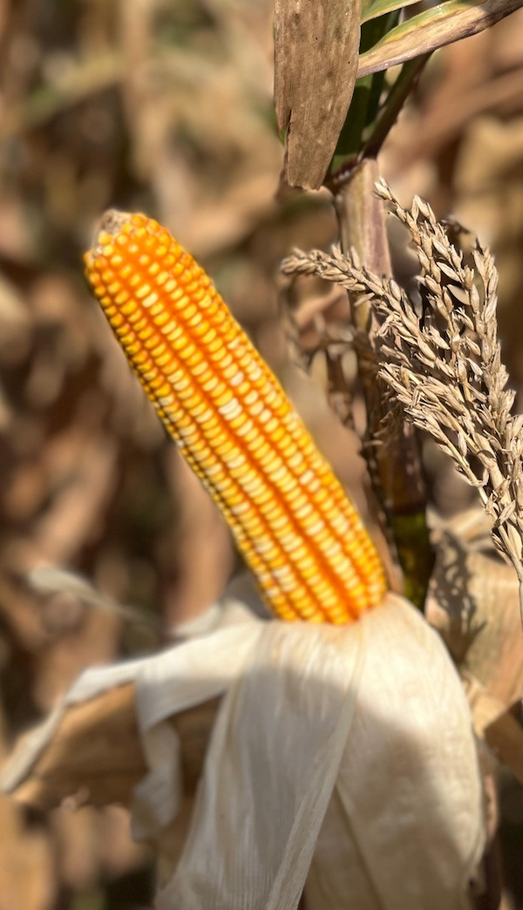
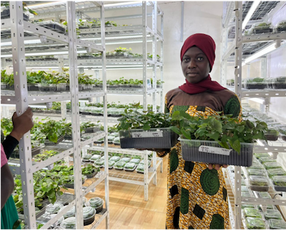
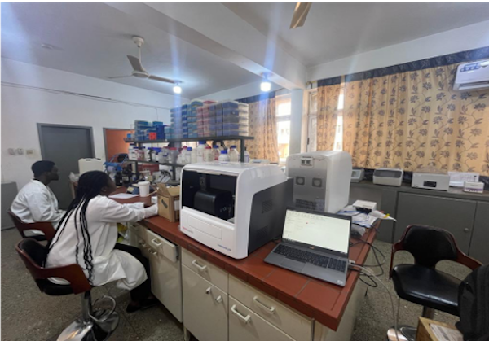
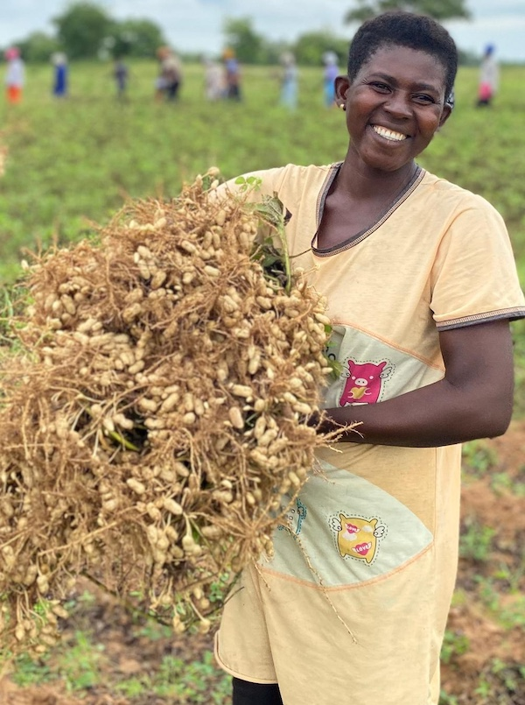
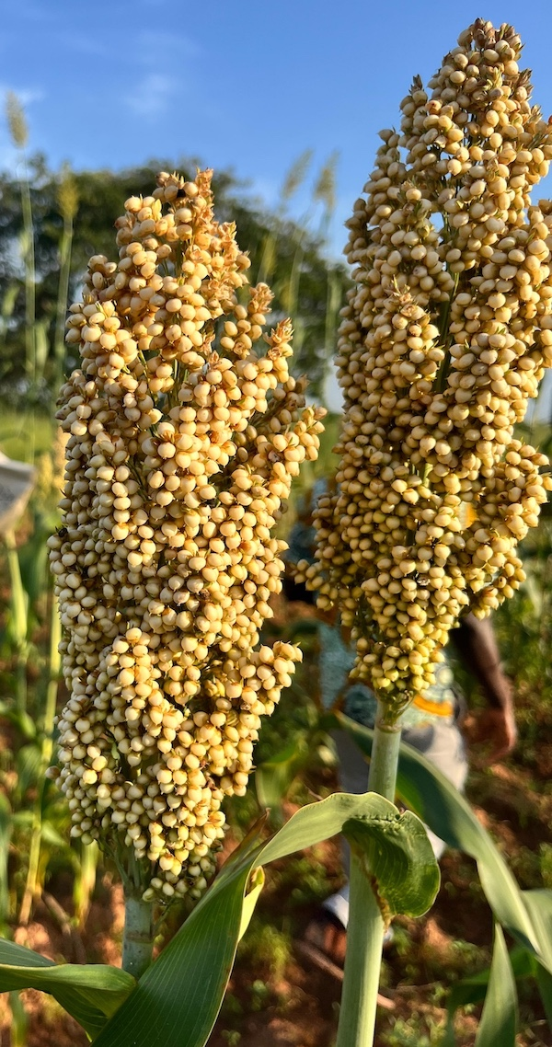
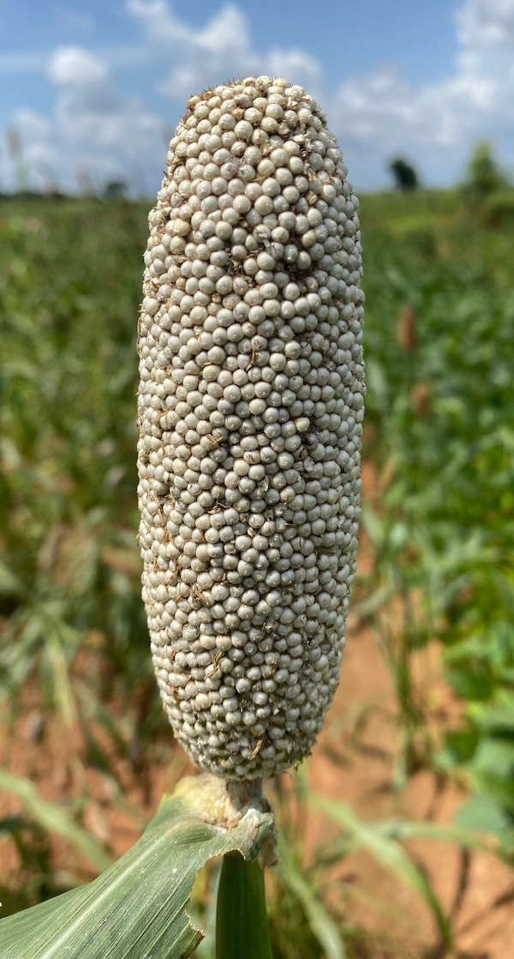
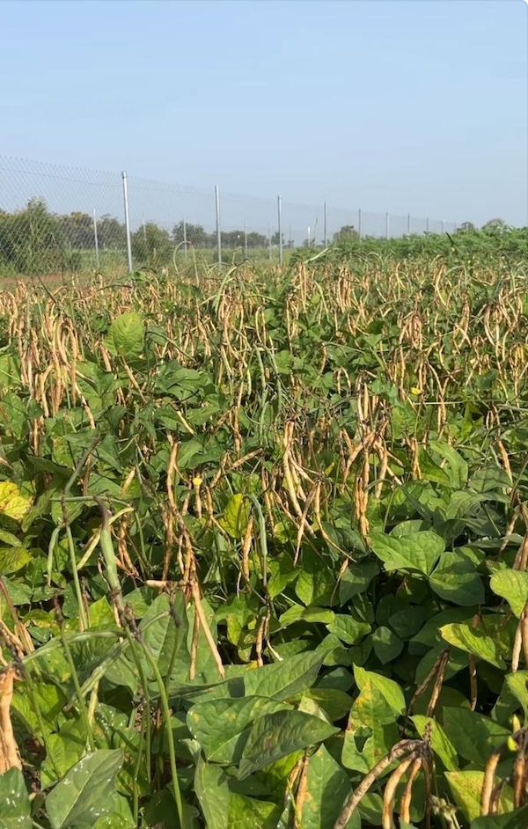
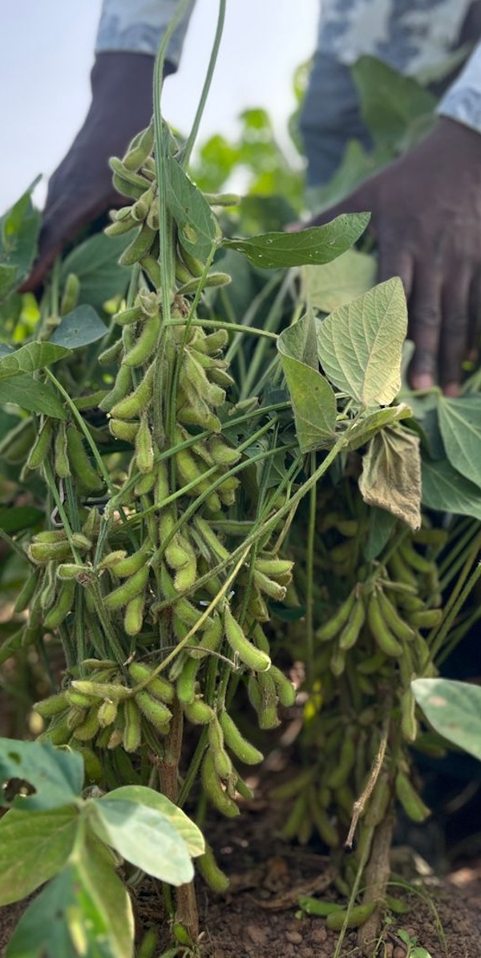
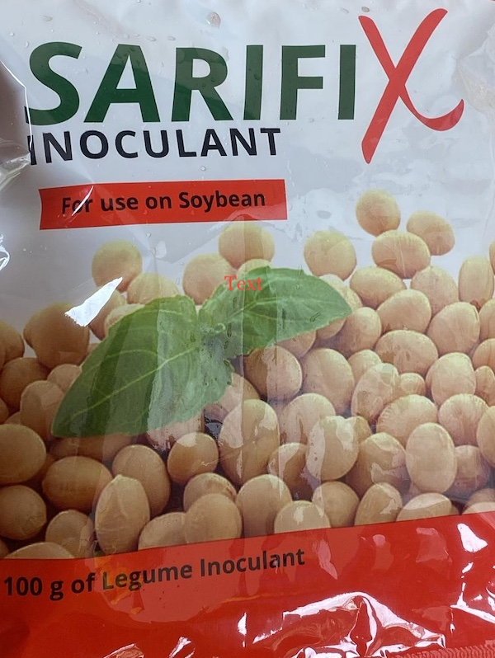
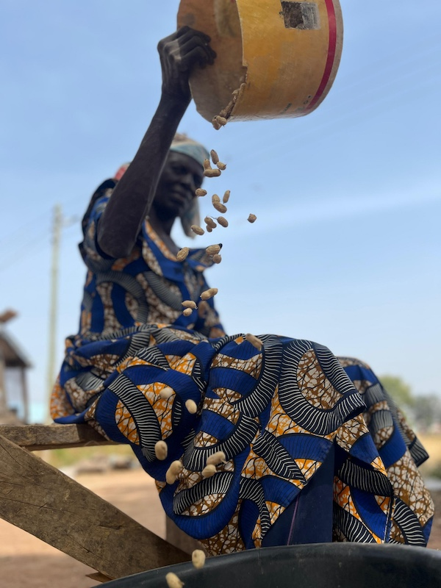


Thank you for your attention !!!
https://sari.csir.org.gh/
Survey Funding Acknowledgement
Funded through
by

