Slide 1
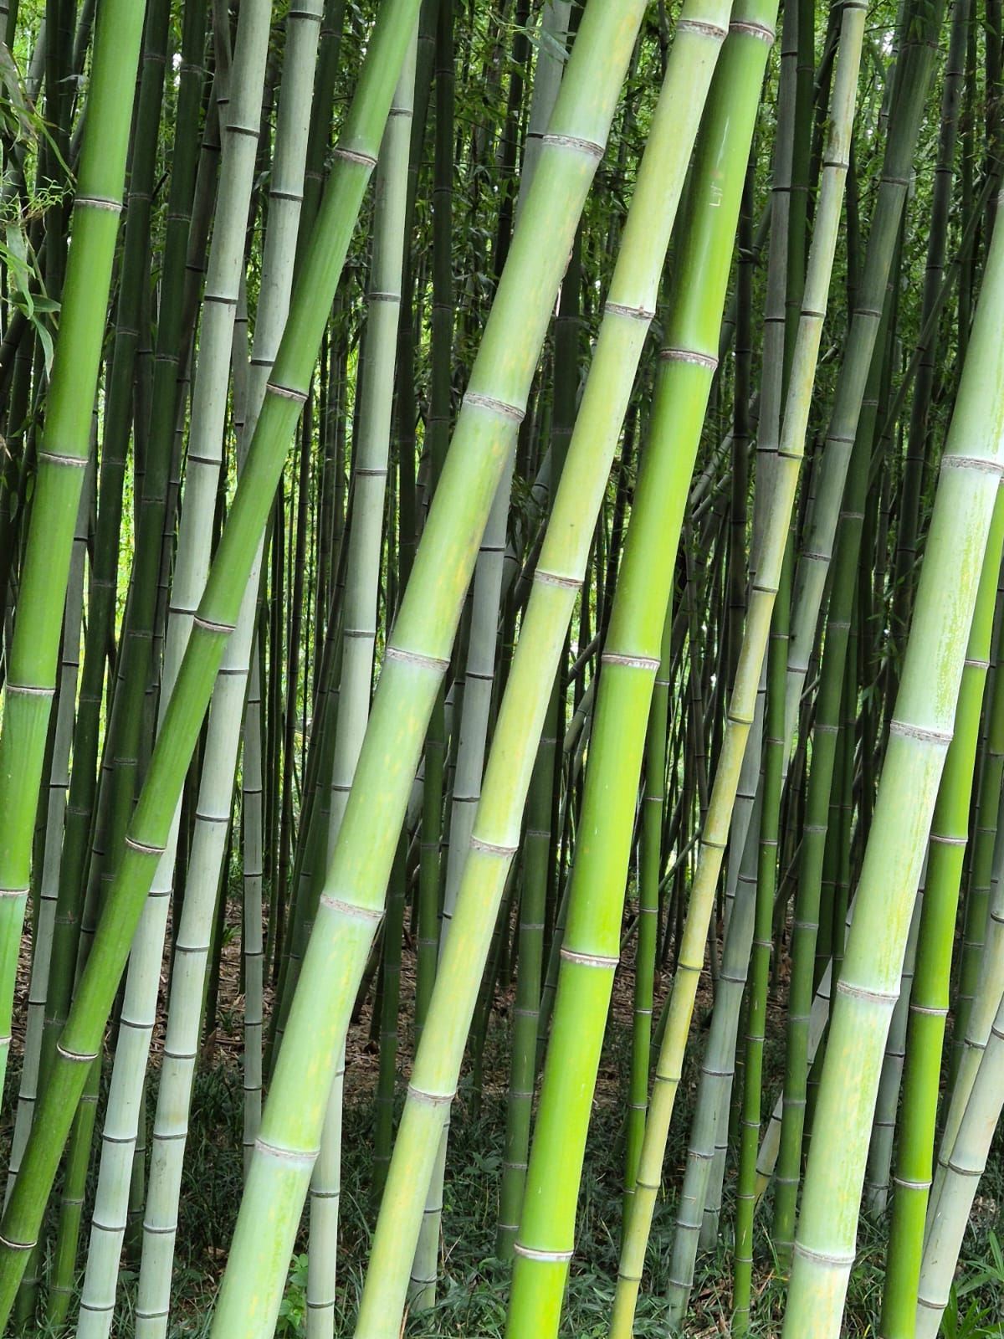
Country-level perspective on ensuring efficient seed movement
24 March 2026
JH Venter
Directorate Plant Health
Department of Agriculture
South Africa

Slide 2
I AM A REGULATOR

Slide 3
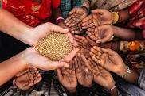
International Goals for Sustainable Development:
No Hunger
“But the world is still very hungry”
The 2025 State of Food Security and Nutrition in the World (SOFI): indicates
673 million people (8.2% of the population) hungry in 2024,
Hunger is rising in Africa
Improvements are noted in Asia and Latin America.
Overall, down from 2023

Slide 4

Seed is life
The Beginning of Life:
A living embryo
Heartbeat of the Food System:
Seeds are the first link in the food chain.
Genetic Blueprint for Continuity:
Every seed carries an unique genetic code

Slide 5

Seed also a carrier of pests
Seed borne diseases
Seed needs to be safe from pests
More seeds more pests
Seeds are foundational to food security and trade
Supports climate-resilient agriculture and improved varieties
Balance between trade facilitation and phytosanitary protection crucial
Guided by the Agreement for Sanitary and Phytosanitary Measures of the World Trade Organisation (WTO, SPS) and the International Plant Protection Convention (IPPC)
BIOSECURITY

Slide 6
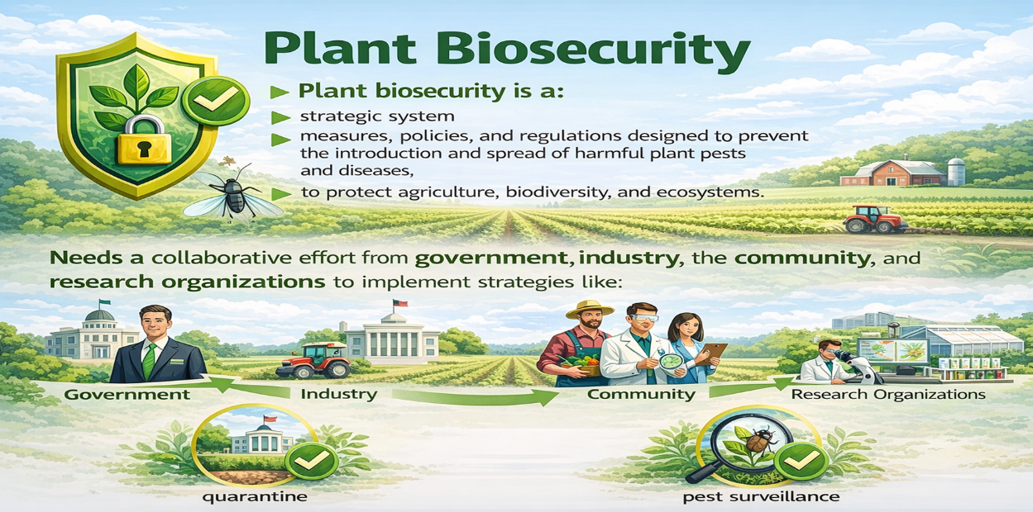

Slide 7
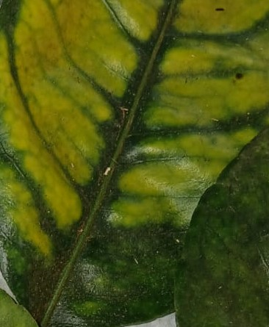
What are we protecting?
Plant pests destroy up to 40 percent of agricultural crops, including food crops each year, which cost the world approximately USD 220 billion annually in global trade losses.
Seed spread Diseases Globally: They allow pathogens to move long distances through international trade, introducing new strains to areas that lack natural resistance, and seed has reduced germination and is of bad quality
“Our food and food for the region (food security)
Our ability to trade with food (reduce poverty and increase economic growth)”

Slide 8
IPPC and International Standards for Phytosanitary Measures (ISPMs)
These international standards:
Protect sustainable agriculture and enhance global food security
Protect the environment, forests and biodiversity
Facilitate economic and trade development
New Standards are adopted during the Commission for Phytosanitary Measures (CPM) every year
2026 was CPM 20

Slide 9
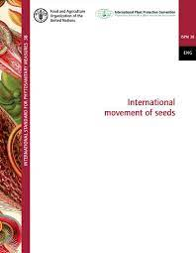
How ISPMs can help
ISPM 7- Phytosanitary certification system
ISPM 14- The use of integrated measures in a systems approach for pest risk management
ISPM 24-Guidelines for the determination and recognition of equivalence of phytosanitary measures
ISPM 38-International movement of seeds (Annex for Systems Approach ?)
ISPM 45-Requirements for national plant protection organizations if authorizing entities to perform phytosanitary actions
ISPM 47- Audit in the phytosanitary context

Slide 10
Seed is life- the beginning
Moving seed have challenges
Multiple countries involved
Flow of material worldwide
Once in the soil always in the soil
Very low seed borne percentage can be accumulative
Poor Pest (Disease) Reporting
IPPC Principles
Necessary
Technically justified
Equivalence
And least restrictive
Multiple phytosanitary measures
Some over restrictive

Slide 11
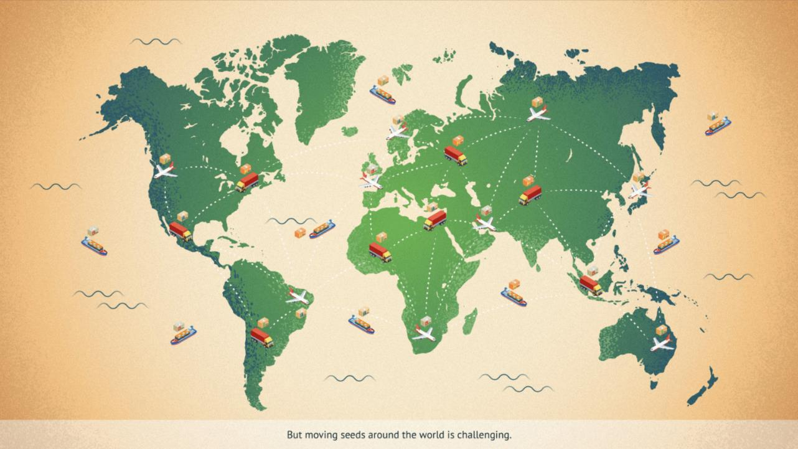
International movement of seed is complicated
Pests carried by seed – gray areas, lack of science
Over regulation prohibits innovation and growth
What would be least restrictive?
Seed moves multiple times from, through and to countries
Developed, produced, multiplied, exported and re- exported
Creating phytosanitary nightmare (from a regulator’s perspective)
Seed Harmonization in Africa?
What about a Systems Approach?

Slide 12
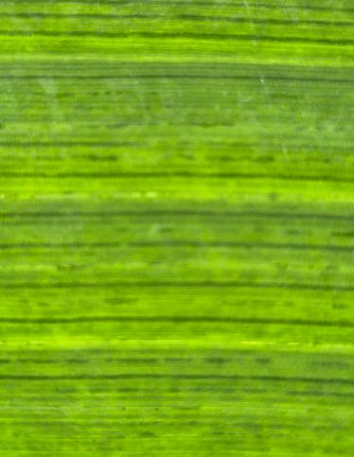
Regulatory and Institutional Framework Requires
Strong Government oversight
Phytosanitary certification systems
Alignment with ISPMs
Import/export permits, PRA, inspections
Inter-agency coordination and ePhyto systems

Slide 13
Challenges at Country Level
Different pieces of legislation not aligned
Lengthy regulatory procedures to amend or develop legislation
Limited scouting and inspection capacity to detect disease outbreaks
Limited diagnostic capacity to identify new diseases
Limited disease response and reporting capacity
Inadequate infrastructure
Trade disruptions (conflicts, port closures)
Misalignment between trading partners (Harmonisation)

Slide 14
Strategic Approaches & Recommendations
Harmonisation with ISPMs, measures between countries
Pest Risk-based approaches
Regional and intercontinental cooperation and mutual recognition
Investment in diagnostics and digital systems
Public-private partnerships (Share funding, capacity, develop trust)
Transparent regulatory procedures
Technological cooperation (Diagnostic Networking, Surveillance, Reporting Systems)

Slide 15

Safe trade can be achieved
A multilateral agreement or agreements means like minded countries ensure seed safety together through collaboration with private entities across borders
Pest information is shared and mitigated in a harmonized and equivalent manner
Trade is streamlined and can ensure good quality and safe seed is delivered to all

Slide 16
What is in place or in progress?
National South Africa
Diagnostic Networking
Surveillance systems
Emergency Plant Pest Response Plan
Plant Health Act – to be proclaimed caters for export,
re- export and in-transit movement of consignments
E -Phyto
E –permitting system
Biosecurity Hub
International
Diagnostic Networking
African Phytosanitary Program
Pest Outbreak and Response System
ISPM’s , Guides and IPPC Campus
E Phyto

Slide 17

Thank You janhendrikv@nda.gov.za

