Slide 1

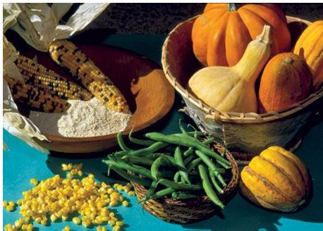

COMESA SEED HARMONIZATION IMPLEMENTATION PLAN (COMSHIP)
STATUS
26th AFSTA CONGRESS
CAPE TOWN, SA.
John Chambamakasa,
AgriBusiness and Policy Advisor
COMESA / ACTESA Secretariat.

Slide 2


COMSHIP is a framework for implementing the COMESA Seed Trade harmonization Regulations across 21 member states.
Its goal is to enhance regional seed production and reliability while increasing competitiveness in the ESA Markets.
The COMSHIP targets a regional seed trade value of $5 Billion.
The Alliance for Commodity Trade in ESA (ACTESA) implements it.
EXECUTIVE OVERVIEW OF COMSHIP

Slide 3
















21 COMESA MEMBER STATES
Burundi
Comoros
D R Congo
Djibouti
Egypt
Eritrea
Eswatini
Ethiopia
Kenya
Libya
Madagascar
Malawi
Mauritius
Rwanda
Seychelles
Somalia
Sudan
Tunisia
Uganda
Zambia
Zimbabwe

Slide 4
CURRENT IMPLEMENTATION STATUS (BY COUNTRY)
Launch Progress: As of late 2025, 19 of 21 Member States had officially launched COMSHIP.
Fully Aligned/Gazetted (11+ Countries): Burundi, Egypt, Ethiopia, Eswatini, Malawi, Rwanda, Kenya, Tunisia, Uganda, Zambia, and Zimbabwe.
Active Progress: DR Congo was earmarked for official gazetting by May 2026.
Next Steps: Encouraging countries like Mauritius and Djibouti to harmonize fully

Slide 5
COMSHIP STATUS PHASED DOMESTICATION
LEVEL | COMESA MEMBER STATE | STATUS OF DOMESTICATION OF COMESA SEED TRADE HARMONISATION REGULATIONS
 | BURUNDI | GAZETTED
 | KENYA | GAZETTED
 | MALAWI | GAZETTED
A | RWANDA | GAZETTED
 | ZAMBIA | GAZETTED
 | ZIMBABWE | GAZETTED
 | UGANDA | GAZETTED
 | EGYPT | GAZETTED
 | ETHIOPIA | GAZETTED
 | ESWATINI | GAZETTED
B | DJIBOUTI | NATIONAL SEED REGULATIONS BEING DEVELOPED WITH SUPPORT OF FAO
 | DR CONGO | DRAFT ALIGNED REGULATIONS AWAITING PARLIAMENT ENDORSEMENT
 | MAURITIUS | NATIONAL SEED REGULATIONS BEING DEVELOPED WITH SUPPORT OF FAO
 | ERITREA | DRAFT COMESA ALIGNED SEED REGULATIONS, WITH SUPPORT OF FAO
 | SEYCHELLES | COMSHIP LAUNCHED IN JULY, 2017
 | MADAGASCAR | COMSHIP LAUNCHED IN DECEMBER, 2014
C | SUDAN | COMSHIP LAUNCHED IN NOVEMBER, 2014
 | COMOROS | COMSHIP LAUNCHED IN JULY, 2017
 | TUNISIA | ROAD-MAP FOR COMESA ALUGNED NATIONAL SEED LAWS IN PLACE
D | SOMALIA | COMSHIP NOT YET LAUNCHED
 | LIBYA | COMSHIP NOT YET LAUNCHED

Slide 6
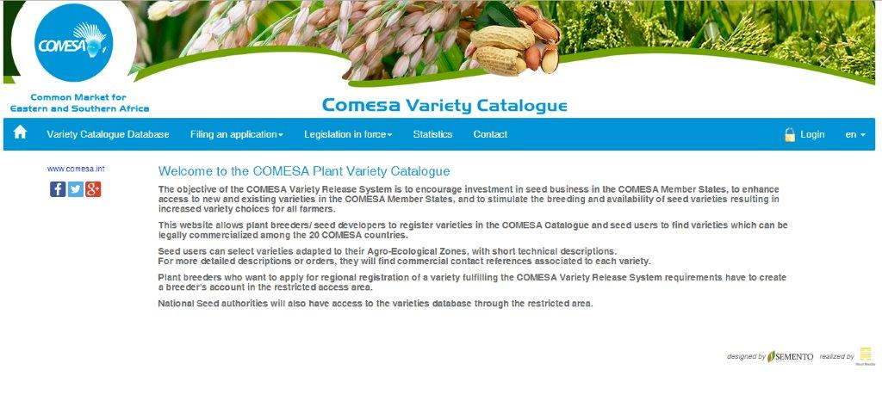
COMESA VARIETY CATALOGUE IS OPERATIONAL
Details: https://varietycatalogue.comesa.int/web/login
So far 128 varieties registered from 24 seed companies / Breeders / CGIAR centres in the COMESA Region in line with COMESA Seed Harmonisation Implementation Plan (COMSHIP). Seed companies are now able to commercialize their seed without 2-3 years required before commercialization.

Slide 7
COMESA Seed Information System (COMSIS): A digital platform validated in late 2022 to provide real-time data for governments and seed companies has been developed.
The COMSIS will help to track the Seed commercial activities in the region to inform policy on regional integration.
DIGITAL TRANSFORMATION & MONITORING

Slide 8
CHALLENGES AND FUTURE OUTLOOK
Slow utilization of regional seed labels by some National Seed Authorities.
Need for further capacity building to meet Malabo commitments by 2026/2027.
2026 and beyond Projections:
Increase regional seed trade volume to 2 million metric tonnes per year.
Commercialization of the COMESA Seed Labels up to 10 million per year.

Slide 9
COMSHIP MOVING FORWARD
AWARENESS CREATION OF THE EXISTENCE OF THE COMESA SEED TRADE HARMONISATION REGULATIONS AND DOMESTICATION OF THE COMESA SEED TRADE HARMONISATION REGULATIONS;
WORK WITH CGIAR CENTRES IN MAKING SURE VARIETIES REGISTERED IN TWO COMESA MEMBER STATES ARE REGISTERED ON THE COMESA VARIETY CATALOGUE IN CLOSE COLLABORATION WITH NSAs AND SEED COMPANIES;
PRODUCTION AND DISTRIBUTION OF COMSHIP STANDARD OPERATING PROCEDURES (SOPs) TO NSAS / SEED COMPANIES AND FINALISE TEST PILOTING OF COMESA SEED LABELS;
IN CLOSE COLLABOARTION WITH AATF, HOLD HIGH COMSHIP DIALOGUE, SUPPORT PRIVATE SECTOR EXPORT OF REGIONAL SEED / UTILISATION OF COMESA SEED LABELING SYSTEM AND LAUNCH OF THE ONLINE COMESA SEED INFORAMTION SYSTEM (COMSIS).

Slide 10
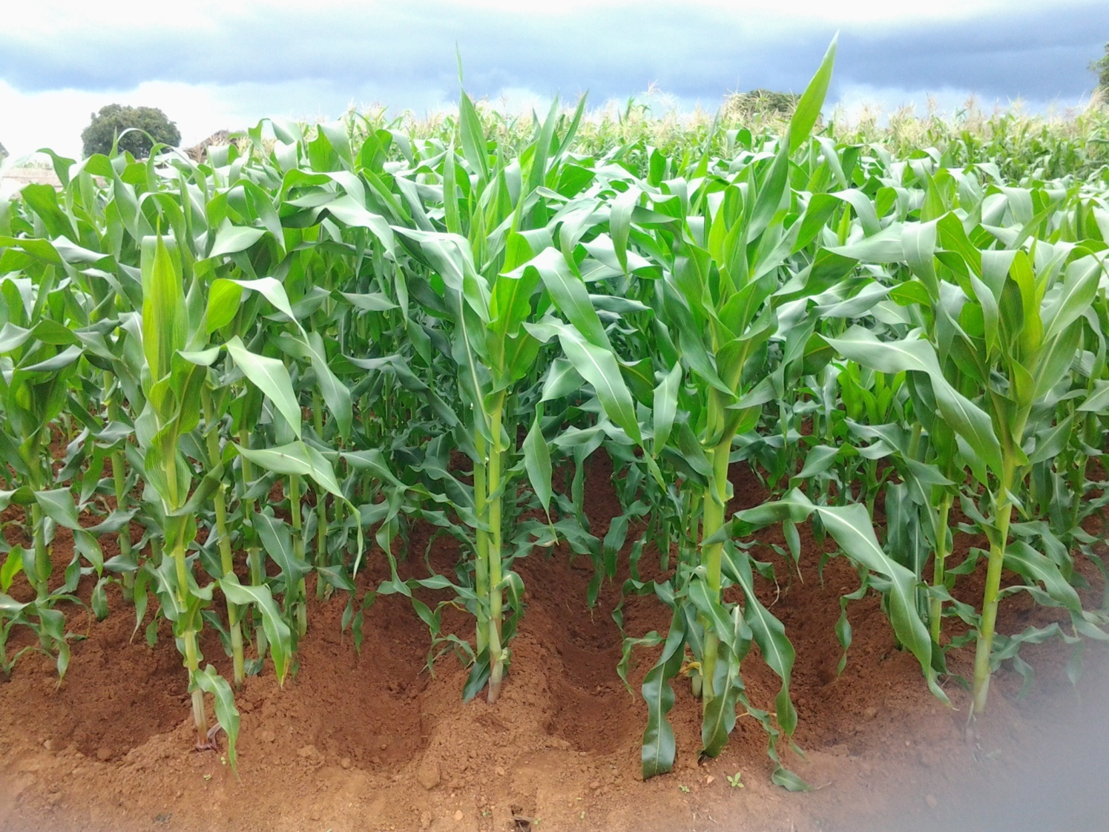
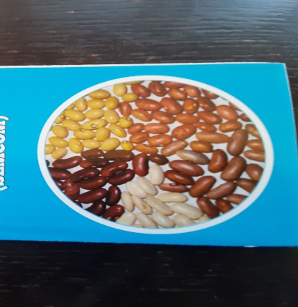
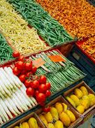
THANK YOU FOR YOUR ATTENTION

