Slide 1
Innovation in Seed enhancement and treatments
March 23rd, Stefano Martinuzzi

Slide 2
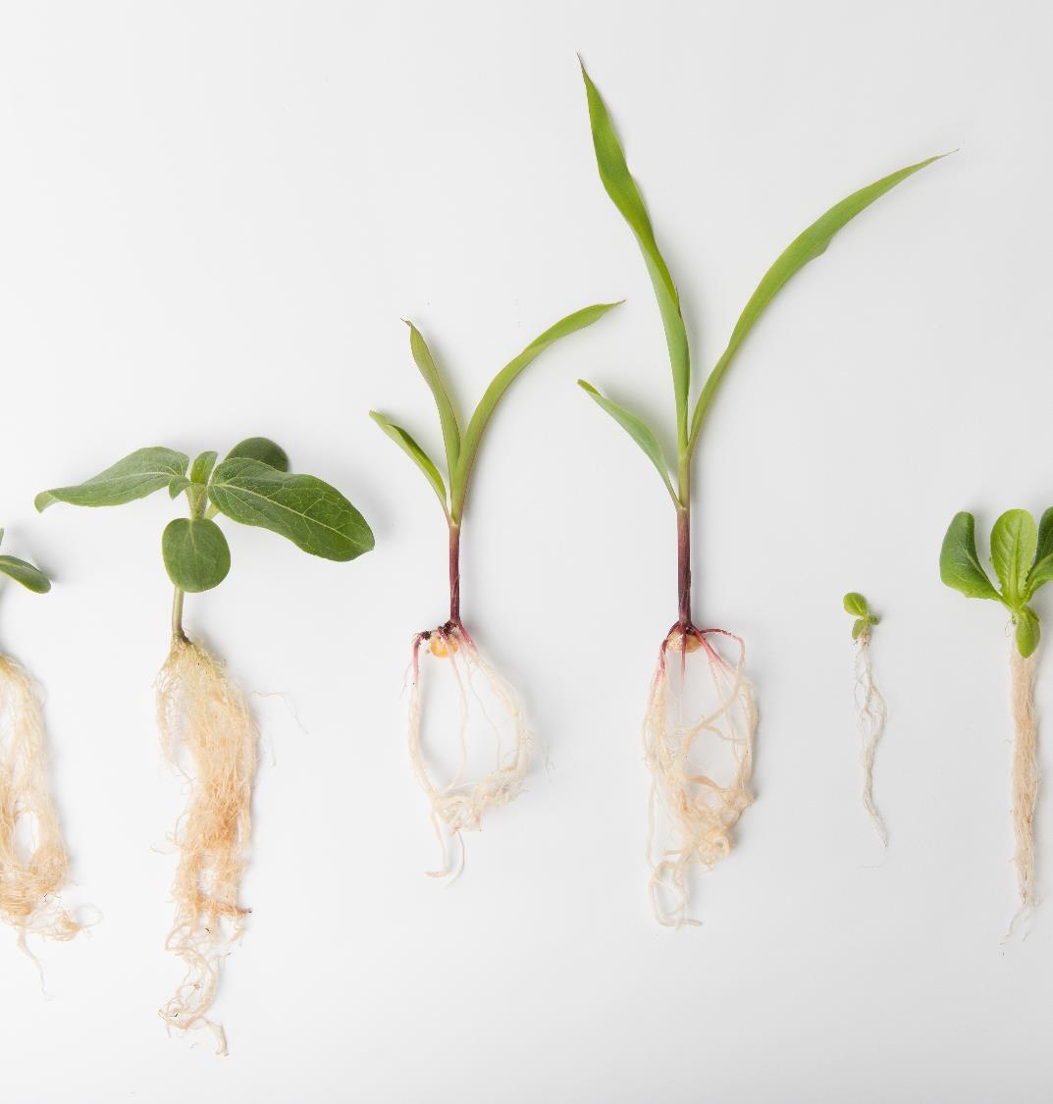

What is Seed Enhancment
Seed enhancement happens between seed harvest and planting and aims to improve physical purity, germination and plant health. It is also the best way to apply actives, additives and biologicals to maximize the efficiency or yield.
SUPPORT FEEDING THE WORLD WITH SUSTAINABLE SEED ENHANCEMENT

Slide 3





Trends in global agriculture
=
Global
population
Food demand
Agricultural land
Pesticide
use
Climate change effects yield
Challenge to produce more with less

Slide 4
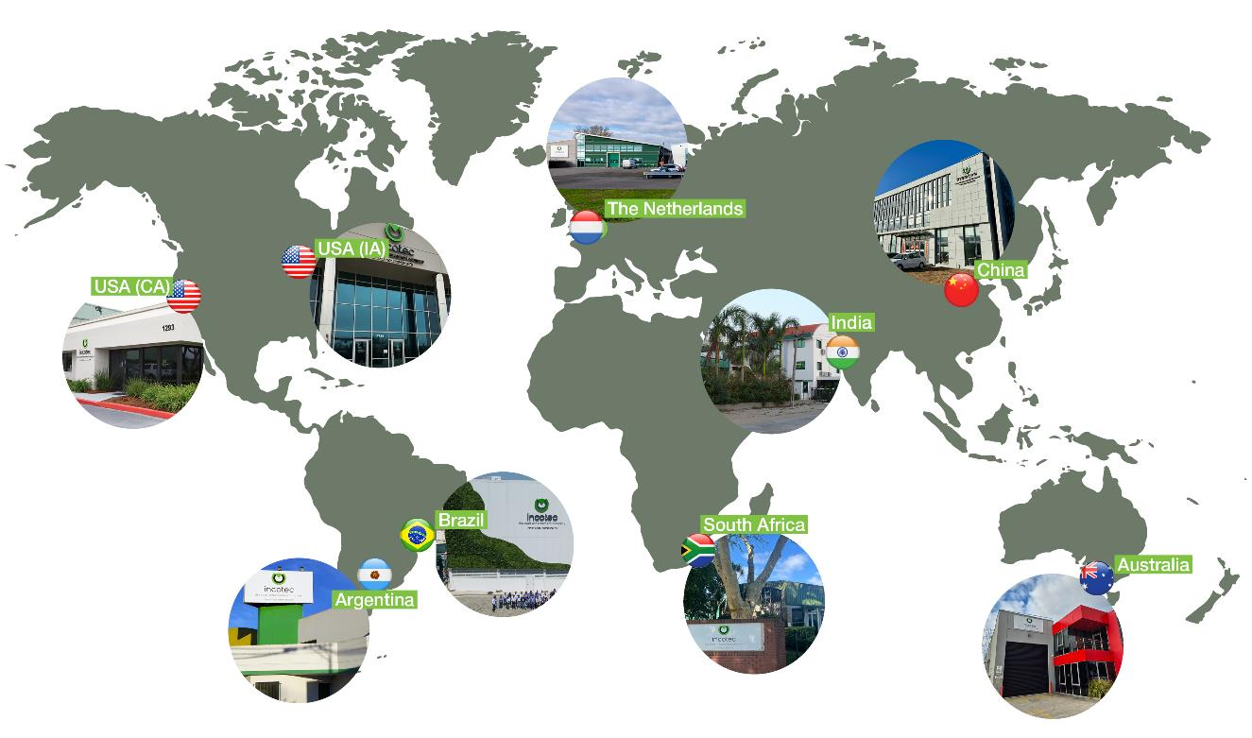

Incotec
Headquartered in Enkhuizen, the Netherlands
400 employees
Seed treatment facilities in 8 countries
Global reach for local solutions
7 technologies
Both active in vegetables and field crops seeds
Established in 1968
Part of Croda since 2015

Slide 5
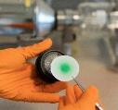
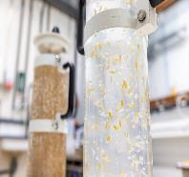
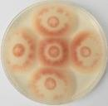


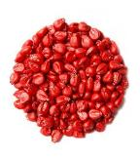
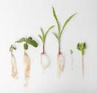
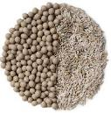
Incotec seed technologies
Analytical services
Priming
Seed hygiene
Upgrading
Film coating
Encrusting & Pelleting

Slide 6
Filmcoating
1

Slide 7
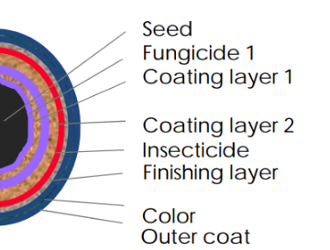
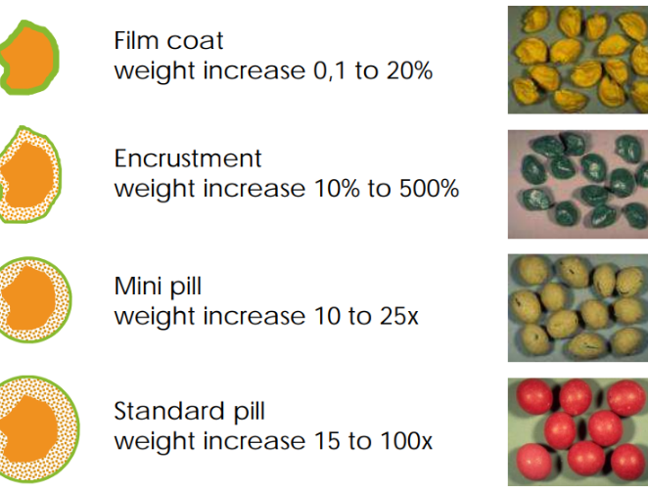
Seed coating
Seed Coating
Different options

Slide 8
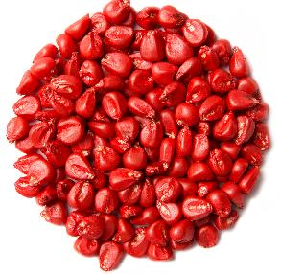

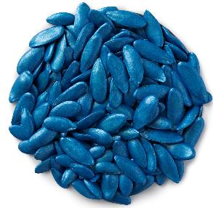
Film coating
A film coat is a thin seed coating, optimized per crop and active - to be applied at customer’s location
Advantages
Easy planting
Microplastic free
Low dust
Smooth flow and minimal abrasion
Good cosmetics
Effective and safe use of PPPs
Quick dry down
Notes:
The film coating keeps the PPPs firmly attached to the seed, holding them exactly where they are most effective and preventing them from washing off easily.

Slide 9
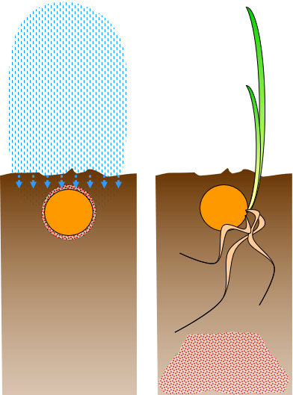
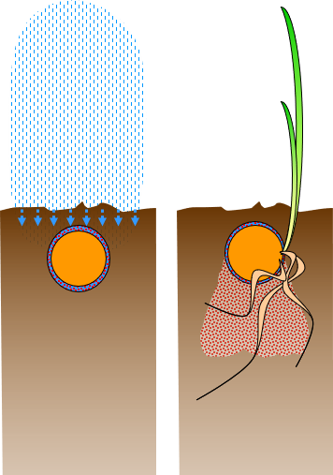
Film coat: Keeping PPPs exactly where they work best

Slide 10

Film coating

Slide 11
New developments
Incotec
Microplastic free coatings
The use of data science and AI in seed treatment
Expanding seed Incotec treatment facility in South Africa in 2026

Slide 12
Microplastic-free developments
2

Slide 13

Microplastics in seed treatment
Microplastics are small, usually microscopic, solid particle made of a polymer
They pose a serious and invisible threat to human health and environment
The seed industry is part of the problem
We need to understand the legislation in other regions and be prepared
Incotec treats this as an opportunity to build innovation
We want to take the lead in eliminating microplastics

Slide 14
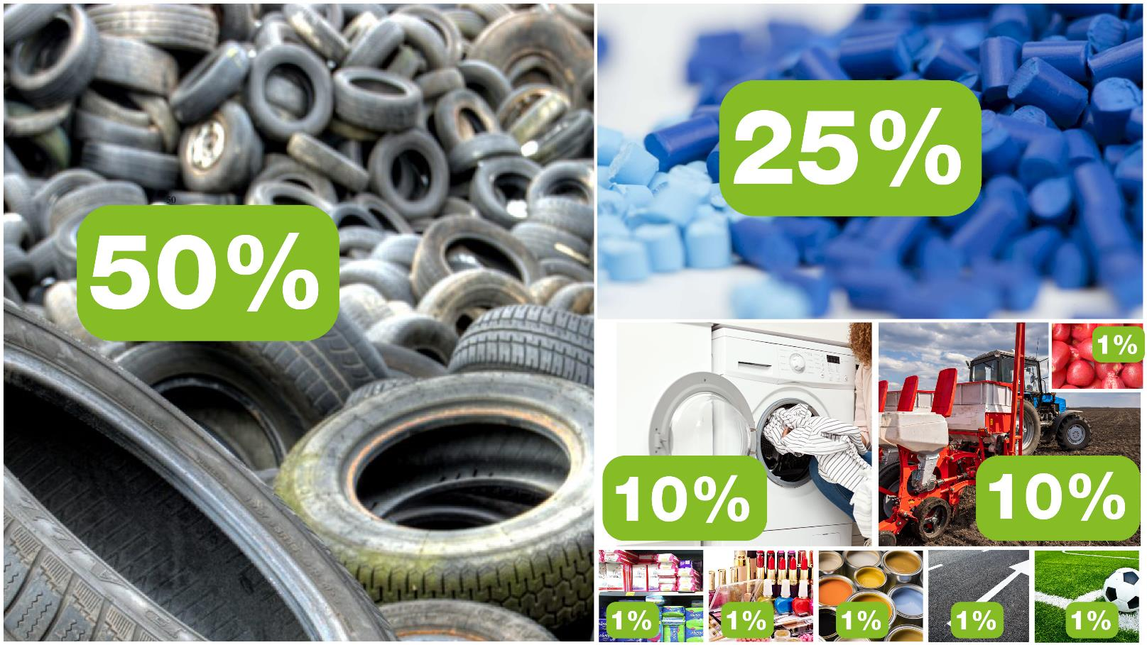
Sources of microplastics

Slide 15
Roadmap in Europe
Dec 2020
Final opinion
sent to EC
Adoption restriction proposal = Entry into Force
October 2028 (EiF + 5)
Restriction effective for ‘binders’ (affecting film coatings, encrustments, pellets)
EU states vote
Transition period for binders
‘20
2021
2022
2023-2027
2028-2031
Transition period for PPPs
EU prepares proposal
Scrutiny by EU Council & Parliament
October 2031 (EiF + 8)
Restriction effective for PPPs

Slide 16

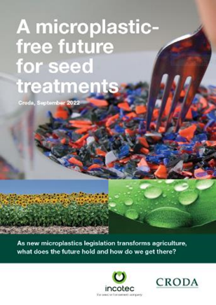


Incotec’s Microplastic-free solutions
Whitepaper.pdf
DISCO Plus.pdf

Slide 17
Data science and AI
3

Slide 18

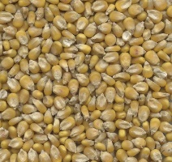
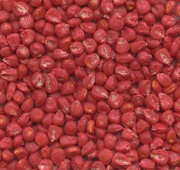
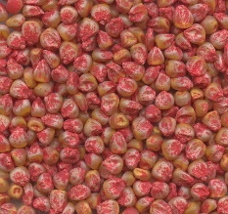



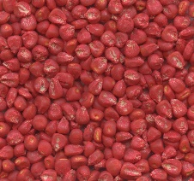

Abrasion resistance analyser
TECHNOLOGY
Problem
Seed coatings are (stressed / worn) by handling and machinery
AI Solution
A machine is trained to identify the exact resistance of seed coatings
Result
- Fast and accurate measurements
- Improved quality and safety
- Higher crop yields
Coating
Mechanical damage
Low resistance
High resistance

Slide 19
Developments at SA-location
4

Slide 20
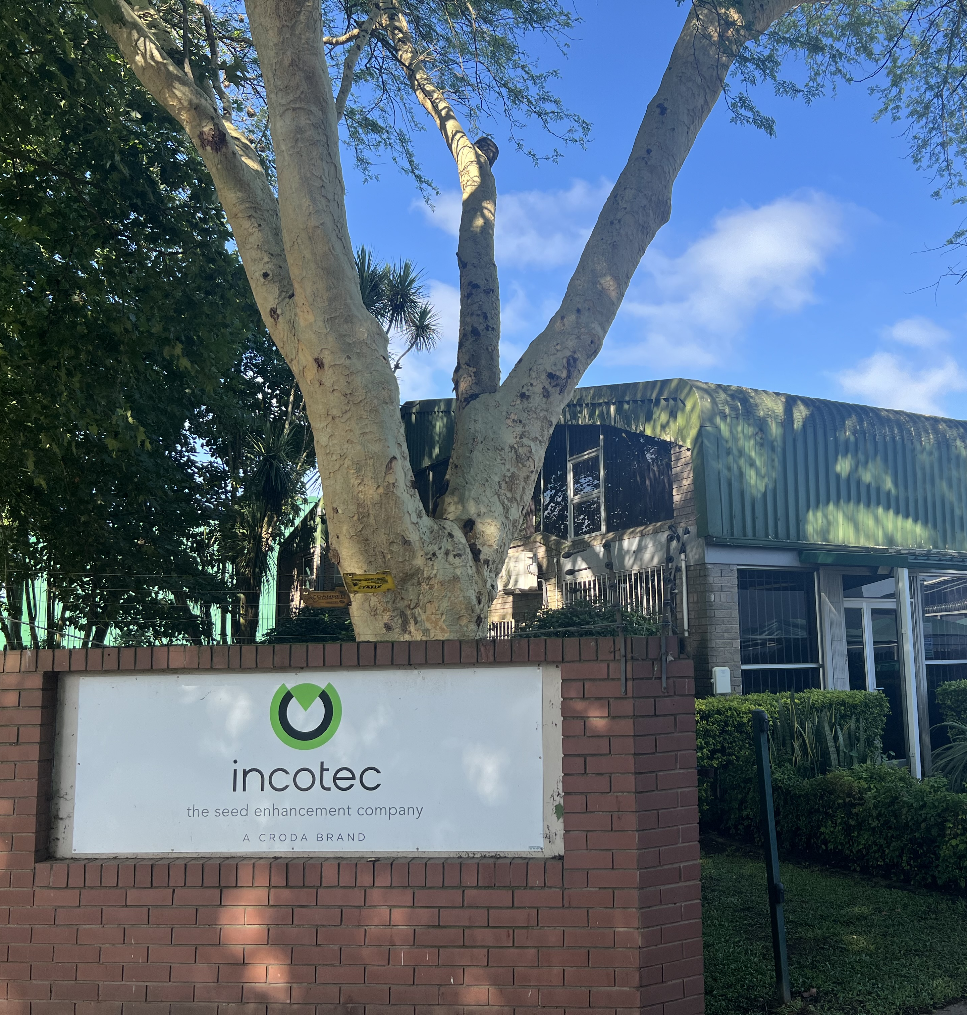
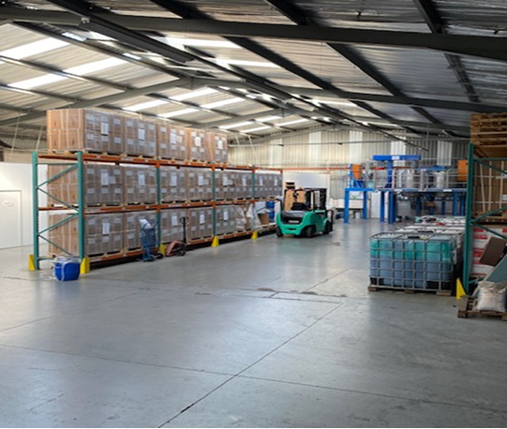
New Production facility by 2027

Slide 21
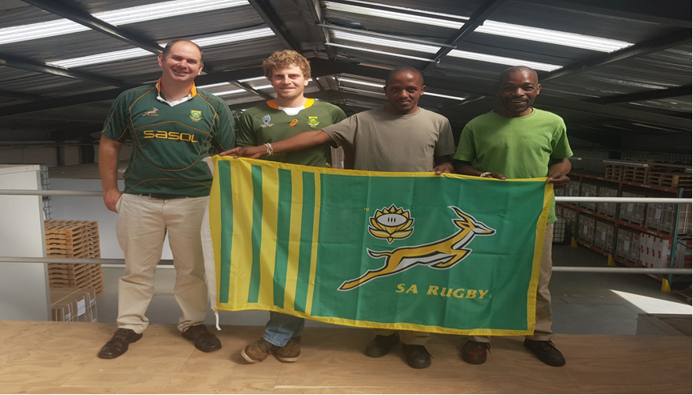
THANK YOU

Slide 22
Thank you for your attention

Slide 23


