Slide 1




The impact of the Treaty on private breeding companies
Dr Glendon Ascough | R&D | Starke Ayres

Slide 2
Progression & Evolution of International Treaties…
Convention on Biological Diversity (CBD; 1992)
Nagoya Protocol (2014)
Cali Fund (2025)
ITPGRFA (SMTA)
Notes:
CBD – Biodiversity conservation (sovereign rights of each country)
Nagoya – Physical genetic resources – permit, informed consent, bilateral agreement with mutually agreed terms
ITPGRFA – specialised instrument under Article 4 of Nagoya, focused on food security to simplify and allow expansion of use – 64 crops, SMTA. Enhancements were being negotiated and included better payment / subscription mechanisms
Cali-Fund – Formed under COP16; DSI not mentioned in any previous documentation

Slide 3

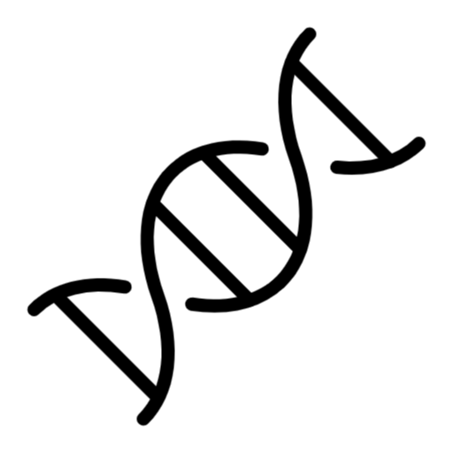





Starke Ayres Journey…
UPOV
Seed merchant – selling other companies seed
Begin breeding – better adaptability + focused market types
Pathology support – local diversity, resistance screening, QA/QC
DNA markers – fingerprint, QA/QC, marker-assisted selection, backcross
CALI FUND
ITPGRFA
Mutation, gene editing, speed breeding, doubled haploids, high throughput phenotyping
Data science, prediction models, machine learning, climate integration, genomic selection
DNA sequencing – bioinformatics, new markers, understand germplasm and how traits function
Collaboration – work with universities and other R&D institutions - SMTA
Notes:
Starke Ayres + other companies – revenue is a mix of selling other companies products + our own

Slide 4

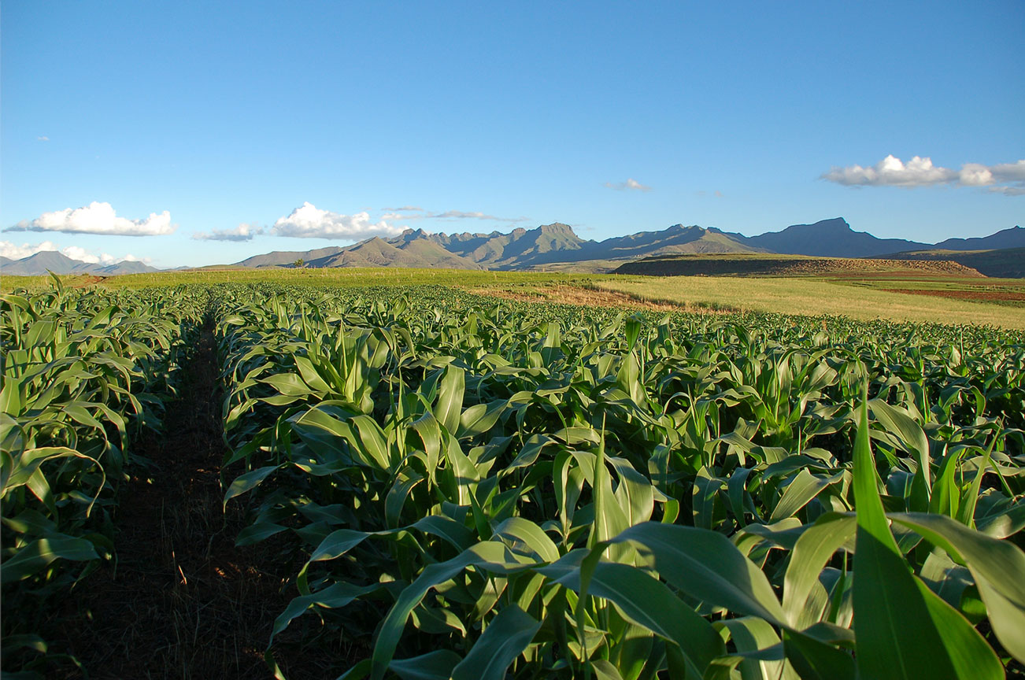
Context …
Africa
South Africa
Starke Ayres

Slide 5




Company Capabilities Vary Substantially
Breeding, ITPGRFA, SMTA
Pre-breeding; pathology, DNA markers, basic use of public DSI
Data science capability, prediction models, AI, genomic selection
Public DSI very NB
Speed breeding, digital phenotyping
GMO
PBI / NBT / GE

Slide 6
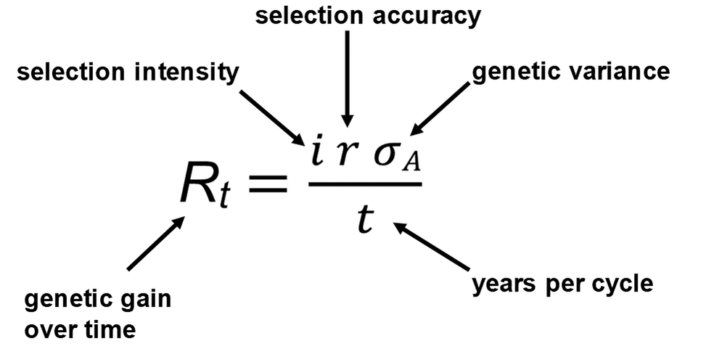
Understanding the “Breeder’s Equation”
Crop improvement depends on physical genetic resources, variation, time, accuracy and strictness of selection
No improvement without physical genetic resources – diversity required
DSI is a tool to understand the GR – of no value if separated – improve selection accuracy + speed
Public DSI provides a standard “map” and “coordinates” – helpful, but not essential for product release
Notes:
Public DSI provides no benefit or advantage to medium and large companies
Cali Fund will penalise small businesses that rely on it

Slide 7
ITPGRFA – very effective
Hundreds of accessions requested
Benefits companies of all sizes
Increases genetic diversity + impact of new varieties
How will Cali fund be implemented?
Notes:
Companies are happy to pay for access

Slide 8
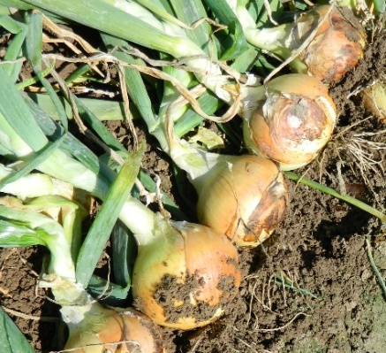
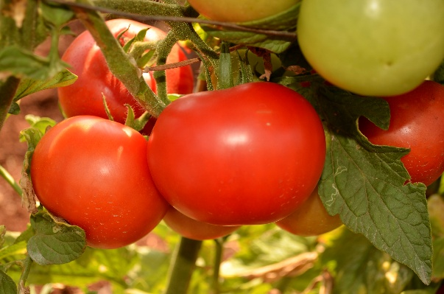
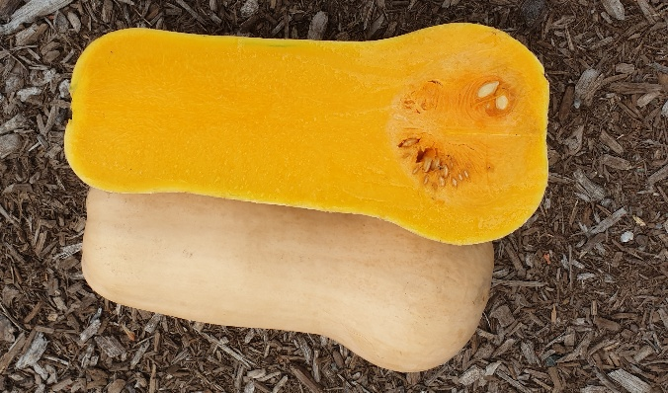
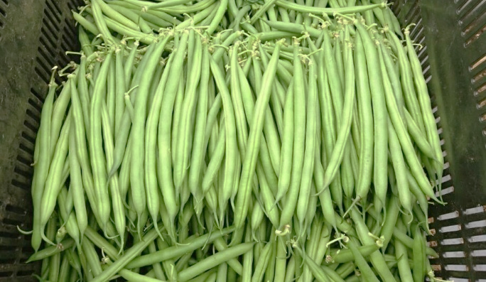
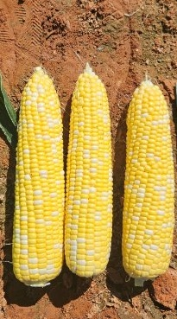
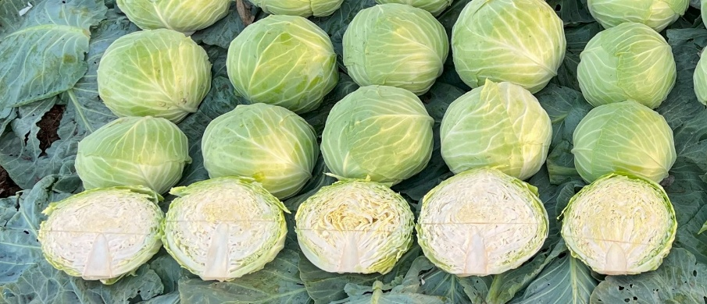
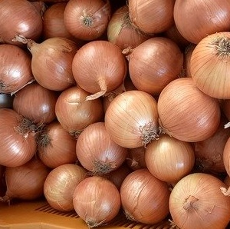
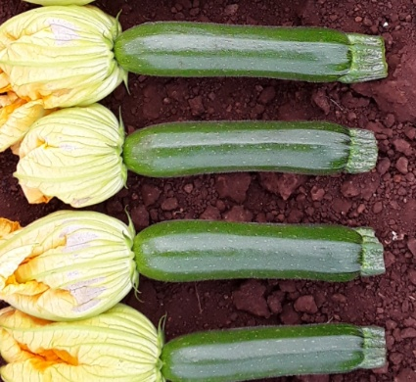
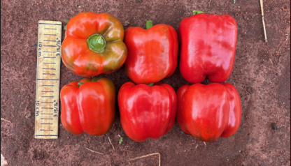
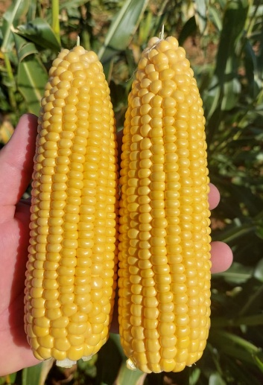
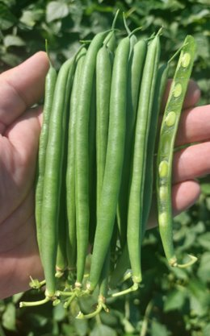
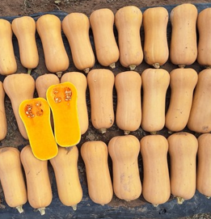
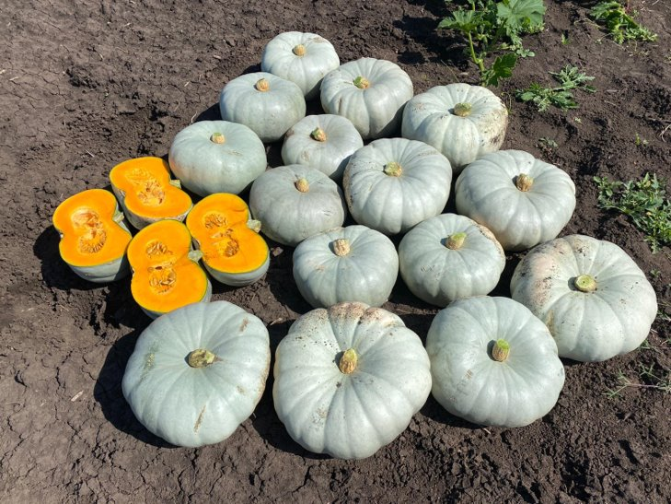
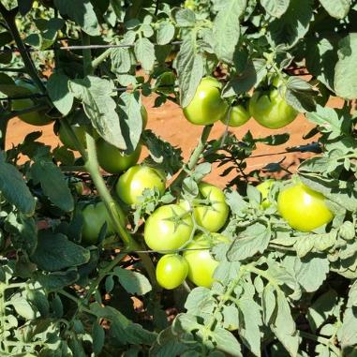
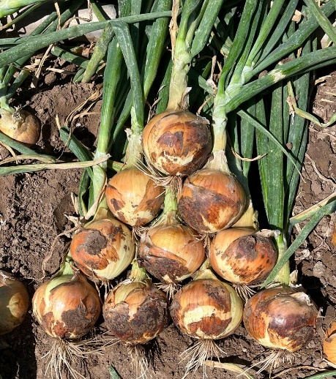
Eat more vegetables

Slide 9

Thank you

