Slide 1
the industry view: accessing plant genetic resources for breeding
Ivo Gariboldi

Slide 2
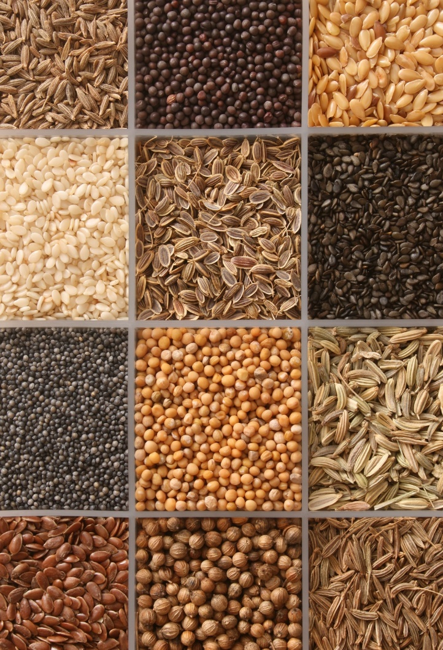
Plant genetic resources
Plant breeding: development of new varieties
Combining positive traits in one variety for any particular farming system and for any market/consumer preference
Excellent seed qualities
Free from diseases, high germination and seedling vigour

Slide 3
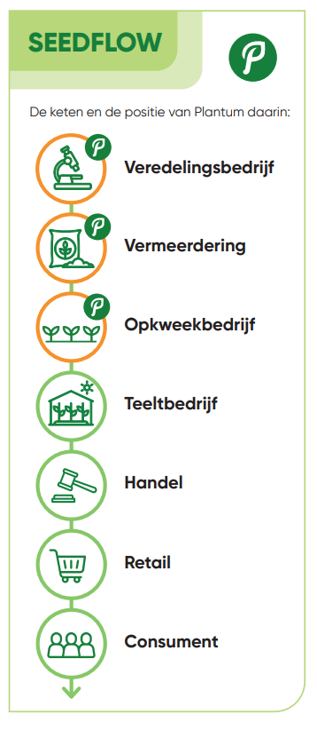
Members
+- 375 members
Ornamentals
Field Crops
Young plant propagation
Vegetables/Fruits
others

Slide 4
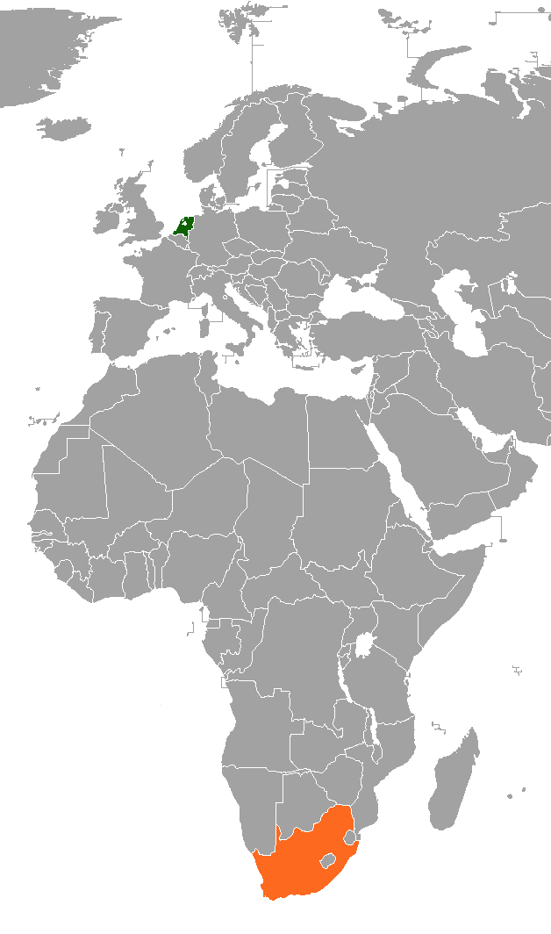
Members
+- 375 members
Ornamentals
Field Crops
Young plant propagation
Vegetables/Fruits
others

Slide 5
Members
+- 375 members
Ornamentals
Field Crops
Young plant propagation
Vegetables/Fruits
others
Sections that can make use of the Treaty

Slide 6
Members
Export to 170 countries & 4,2 billion euro export
Member distribution Export value

Slide 7
Members
Export to 170 countries & 4,2 billion euro export
This includes the smallest companies and the biggest multinationals
Member distribution Export value

Slide 8
Access to genetic resources
Access to PGR: A breeders perspective
Need for continuous access to cultivated and non-cultivated PGR for trait screening
Transparent process for legal certainty
Depending on the crop, mostly dependent on private collection or commercial varieties
Access to high quality collections from e.g. genebanks

Slide 9
Access to genetic resources
Access to PGR: A breeders perspective
Need for continuous access to cultivated and non-cultivated PGR for trait screening
Transparent process for legal certainty
Depending on the crop, mostly dependent on private collection or commercial varieties
Access to high quality collections from e.g. genebanks
How do breeders see when you ask about access to genetic resources?

Slide 10

Access to genetic resources
Nagoya Protocol &
International Treaty on Plant Genetic Resources for Food and Agriculture

Slide 11

Access to genetic resources
Nagoya Protocol &
International Treaty on Plant Genetic Resources for Food and Agriculture
National rules and regulations on Access and Benefit-sharing

Slide 12

Access to genetic resources
Nagoya Protocol &
International Treaty on Plant Genetic Resources for Food and Agriculture
National rules and regulations on Access and Benefit-sharing
Digital sequence information

Slide 13
Access to genetic resources
Breeders may stick to their own Breeding pools and not access new germplasm!
This especially hampers smaller breeding companies or starting companies

Slide 14
Access to genetic resources
The bottlenecks
Access is hampered by complexity and bureaucracy
Difficult to find and navigate PGR collections
Low quality of PGR collection annotation: phenotype and genotype
The positives
Companies value the approach of the ITPGRFA and the SMTA
What do breeders want?
More access to genetic resources (annex I currently only 64 species)
Clear expectations and affordable payments (for small and big companies)

Slide 15
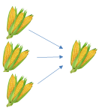
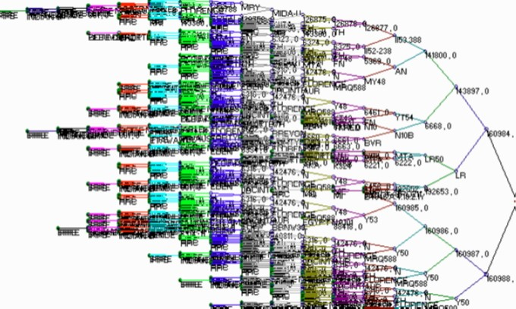
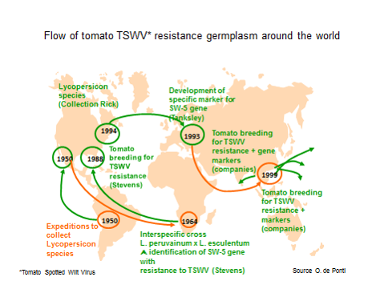
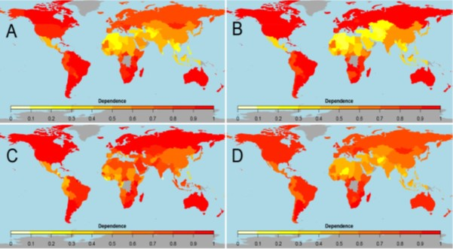
International interdependence
From GR to GR
Complex ancestry
Continuous flow of material
Interdependence

Slide 16
Future
The future:
Genetic diversity needs to be conserved!
The use of genetic resources ensures conservation
Plantum supports the principles of ABS and the ITPGRFA
Dutch private sector efforts:
Contribution 10 – 15% to CGN: seed multiplication and collection characterisation
Contribution of 1,3 million Euro for CGN expansion

Slide 17
Thank you!
i.gariboldi@plantum.nl

