Slide 1


Slide 2

The Role of Plant Variety Protection in Safeguarding Innovation and Combating Illegal Seed Practices
Harmonised Regional Protocols to Advance Plant Variety Protection in Africa – The Arusha Protocol
SAID RAMADHAN
HEAD SEARCH & EXAMINATION - ARIPO
Cape Town, South Africa, March 23-25, 2026.

Slide 3
Outline
Introduction – ARIPO
PVP as a Driver of Agricultural Innovation
The Arusha Protocol
  Adoption and Entry into Force
  Grant Requirements
  Scope of the Breeders’ Rights
  Legal Mechanisms for Discouraging Illegal Practices
Conclusion

Slide 4


Introduction - ARIPO
African Regional Intellectual Property Organization (ARIPO) was created on 9 December 1976.
ARIPO aims to harmonize IP protection systems to promote innovation and creativity and protect rights holders.
ARIPO Mandates Related to the Agriculture Sector
ARIPO Member States
Harare Protocol: Patent, Utility Model, and Design
  Inventions: Biotechnology advancements, Smart farming solutions, Automation and robotics, Sustainability-focused technologies
Banjul Protocol: Marks
  Branding
Arusha Protocol: Plant Varieties of Protection (PVP)

Slide 5

PVP as a Driver of Agricultural Innovation
Plant Variety Protection
    Protecting seed and plant varieties is crucial for food security
    PVP grants intellectual property rights to breeders, giving exclusive control over plant propagating materials for several years.
Incentivizing Breeders
    PVP encourages breeders to invest in new varieties by ensuring market exclusivity to recover development costs.
Supporting Innovation and Investment in the Seed Sector
Enhancing Sustainability, Competitiveness, and Trust
Protecting the Rights and Livelihoods of Breeders and Farmers
Incentivizing Public & Private Investment

Slide 6
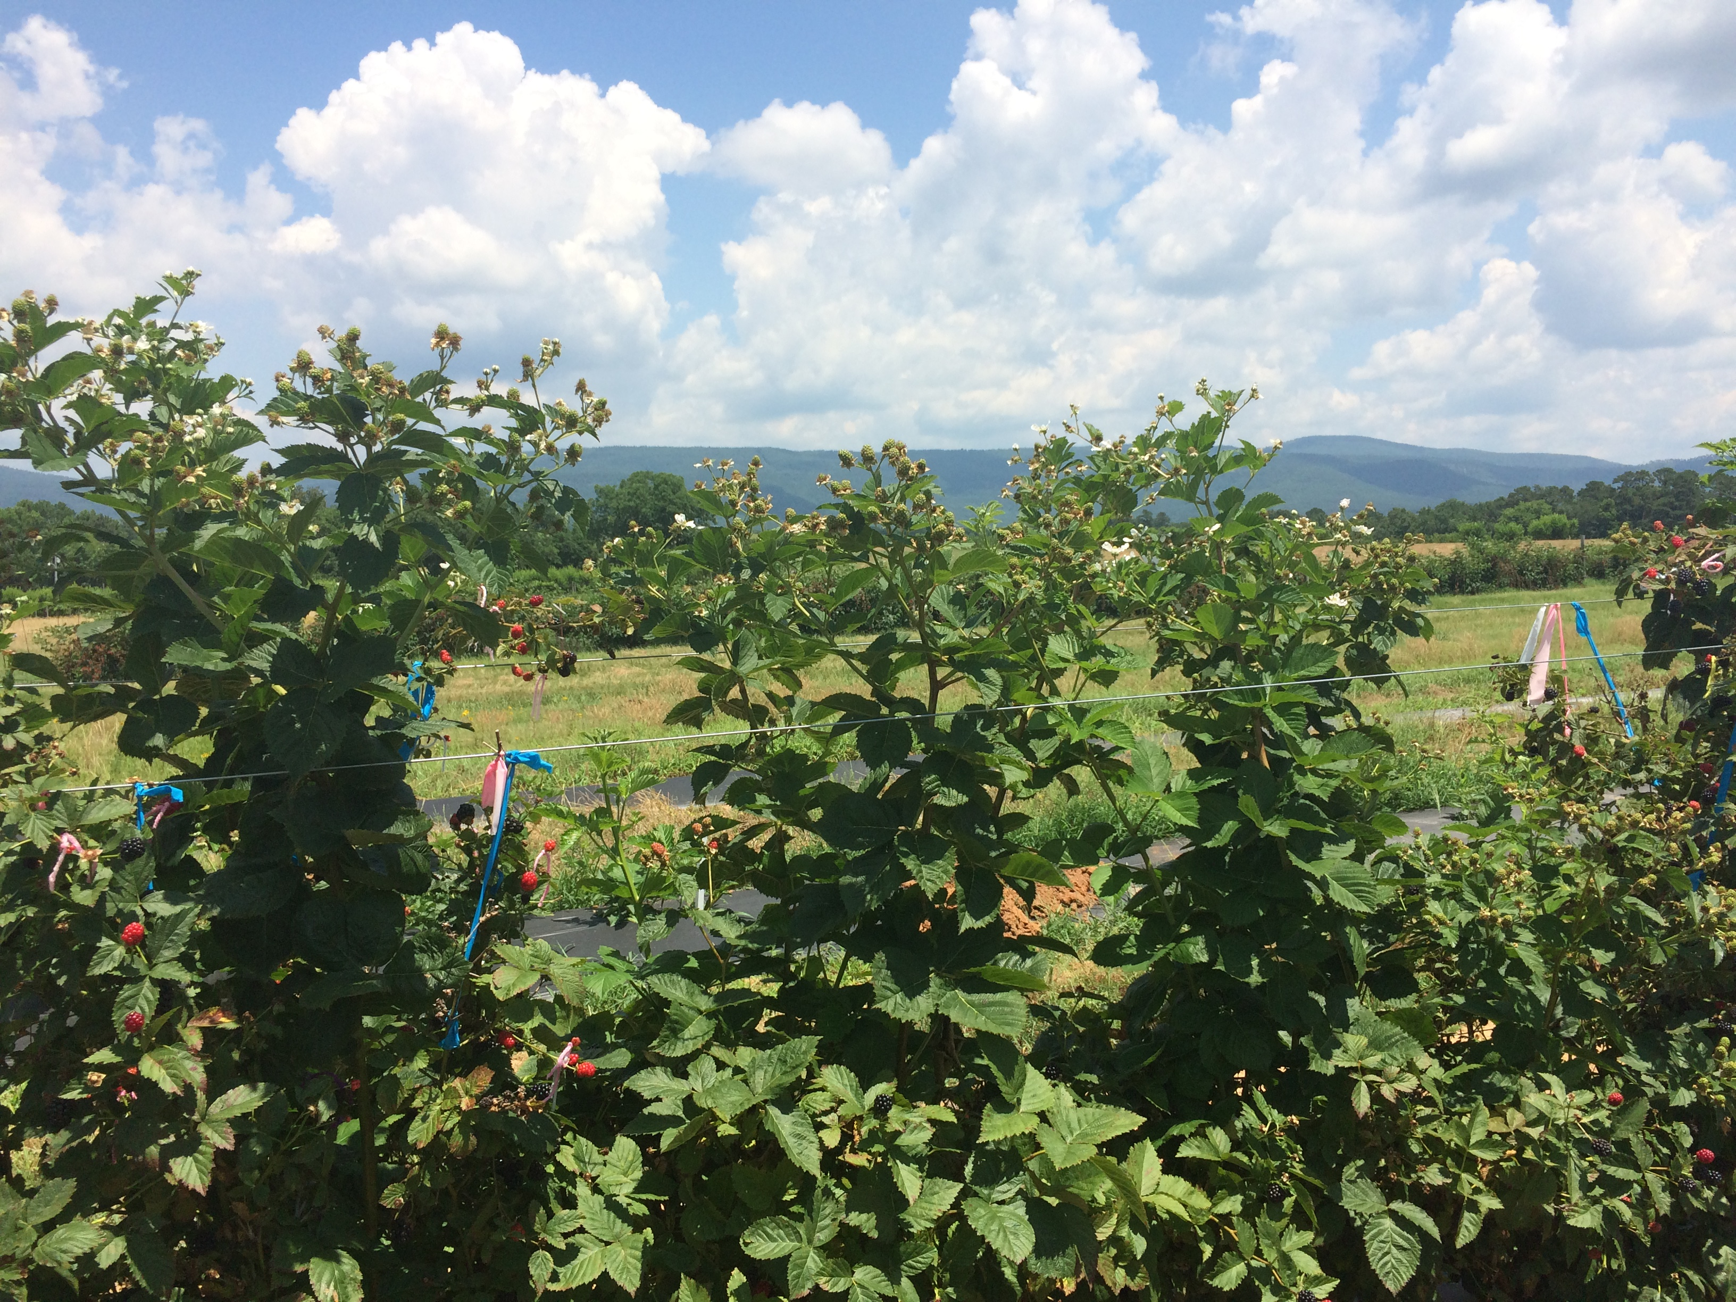
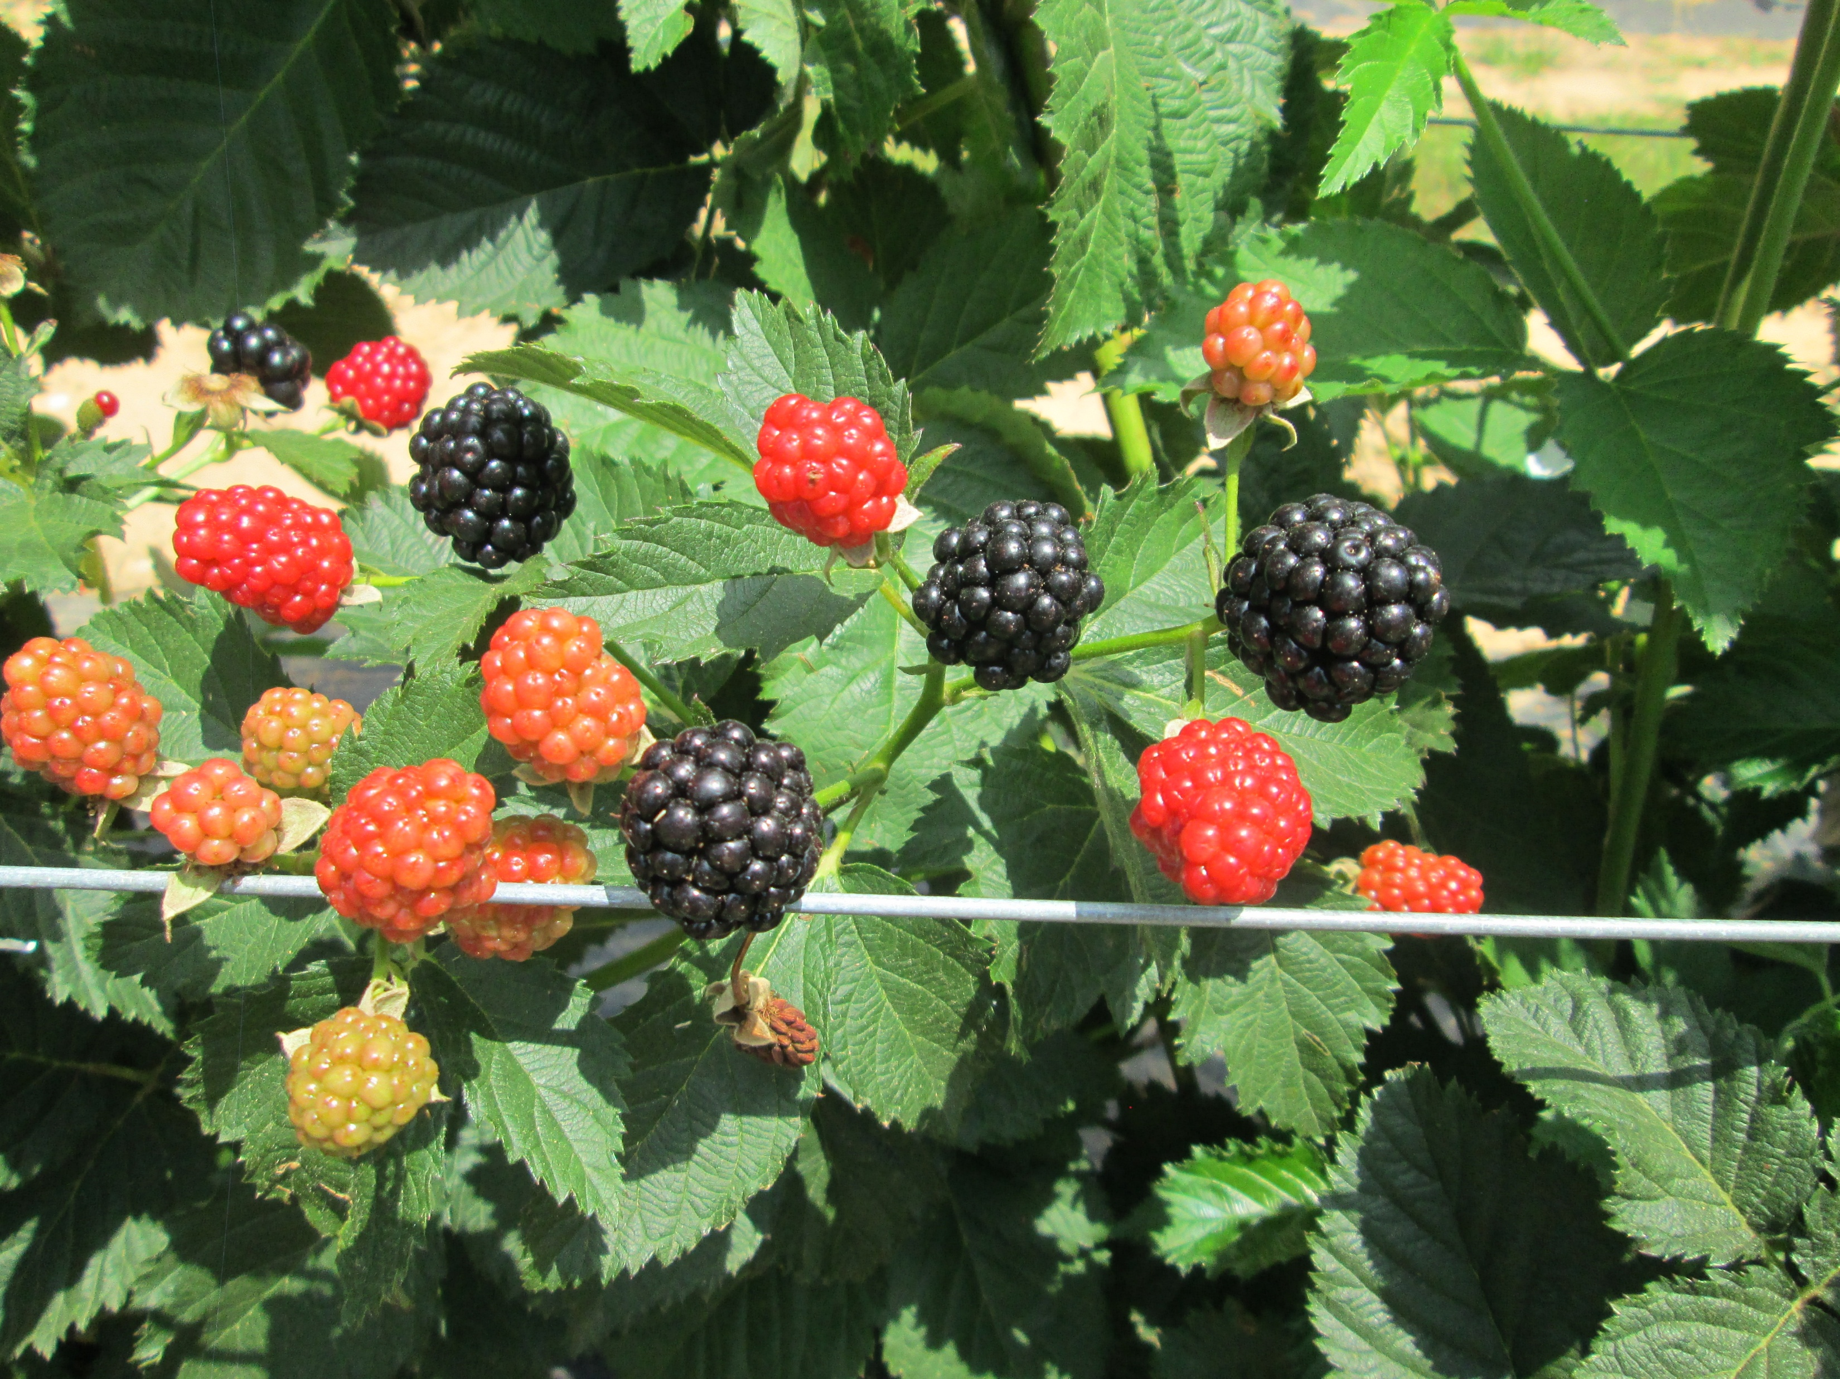
The Arusha Protocol
The Protocol empowers ARIPO to grant and administer breeders’ rights on behalf of the Contracting States.
It was adopted on July 6, 2015, in Arusha, Tanzania, and entered into force on 27 November 2024.
Contracting States: Cabo Verde, Ghana, São Tomé and Príncipe, and Rwanda.
Regional Application and Centralized Processing
  A single regional application process and centralized examination improve efficiency and reduce costs for breeders.
14 applications

Slide 7
Grant Requirements
The Plant Variety must comply with the following requirements
Novelty
The DUS Criteria
  Distinctness
  Uniformity
  Stability
Variety Denomination
Formalities & Payment of fees

Slide 8
Scope of Protection of Breeders’ Rights
The holder is entitled to prevent others from carrying out the following acts without the authorization of the holder:
  Production or reproduction, conditioning for the purpose of propagation, selling or offering for sale, marketing, exporting, and importing.
Exceptions to the Protection
The main exceptions to the breeders’ scope of rights are:
  Acts done privately and for non-commercial purposes, for experimental purposes, or for breeding other varieties.
The agricultural exemption (Farm-saved seed)
  A person (farmer) may save seeds for planting on the person’s land, but NO transfer to others for seed reproduction purposes.

Slide 9

Legal Mechanisms for Discouraging Illegal Practices
The PBR holders can enforce their rights on the grounds of infringing acts in relation to the variety within the Contracting States
The Protocol requires that each contracting State ensure that accessible and appropriate enforcement measures and dispute settlement mechanisms, sanctions, and remedies are available for the effective enforcement of breeders’ rights
The measure could be:
  Civil Measures (forfeiture, seizure, damages)
  Administrative Measures
  Customs Measures
  Criminal Measures (Willful violation on a commercial scale)
  Measures resulting from Alternative Dispute Resolution

Slide 10
Conclusion
Plant Variety Protection
Promotes innovation by Incentivizing Breeders, builds trust, and enhances competitiveness in the seed sector.
ARIPO Arusha Protocol
Provide harmonized legal frameworks enhancing enforcement across contracting States.
PVP legal mechanisms discourage illegal practices.
Support for the Agriculture Sector
PVP supports breeders, farmers, and the agricultural industry in promoting sustainable growth.

Slide 11

Address:11 Natal Road, Belgravia, Harare, Zimbabwe
Tel: +263 4 794 065 /6/8/54/74
Fax: +263 4 794 072
Email: sramadhan@aripo.org
mail@aripo.org
Website: www.aripo.org

