Slide 1


AFSTA Congress 2026 | Cape Town
Global perspective on
phytosanitary complexities
in the seed industry
What Africa can do now to move quality seed faster
Dr Rosineide Souza Richards
Director, Phytosanitary Affairs & Seed related Innovations
International Seed Federation (ISF)
Notes:
[Sources]
- Image: Cape Town city photo, Wikimedia Commons, https://commons.wikimedia.org/wiki/File:Cape_Town_City_DSC_3621.jpg
- Uploaded draft used as structural source: AFSTA_Phytosanitary_Complexities_Rose_Souza_Richards_v3 (1).pptx

Slide 2
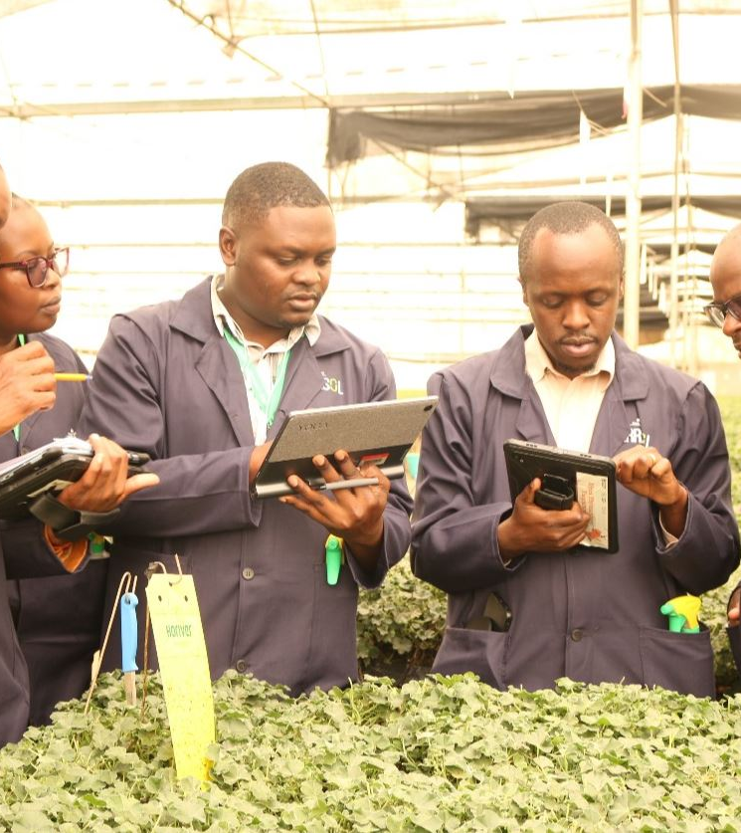
AFSTA Congress 2026 | Cape Town
Why phytosanitary complexity matters for seed movement in Africa
For seed, the policy challenge is not only pest risk. It is whether regulation protects plant health without creating avoidable procedural friction.
• Seed consignments are often small, high value, and linked to narrow planting windows.2
• The same lot may face different import conditions, testing demands, or declaration wording across markets.
• When requirements are unclear or change quickly, the burden shows up as delay, re-testing, re-routing, and missed seasons.
A stronger system protects plant health and keeps seed moving.
2
Notes:
[Sources]
- Image: Phytosanitary inspectors training with digital tools in Nairobi, FAO / KEPHIS, https://www.fao.org/africa/news-stories/news-detail/support-from-the-united-kingdom-enables-fao-to-scale-up-pest-monitoring-and-improve-food-security-in-africa/en
- Core framing adapted and refined from uploaded draft presentation.

Slide 3
AFSTA Congress 2026 | Cape Town
Where the friction enters the seed movement chain
In practice, delays usually come from the combination of divergence, opacity, and uneven implementation.
1
2
3
4
Requirements
Evidence
Documents
Border response
Import conditions are hard to locate, change quickly, or are not always seed-specific.
Countries differ on sampling, testing, pest freedom, or acceptance of systems approaches.
Paper steps, duplicate data entry, and inconsistent wording create avoidable delay.
Emergency measures and local interpretation create unpredictability in real shipments.
Bottom line: the issue is rarely one rule alone. It is the cumulative effect of mismatched steps.
3
Notes:
[Sources]
- Analytical synthesis adapted from uploaded draft and speaker framing; no new quantitative claims introduced on this slide.

Slide 4
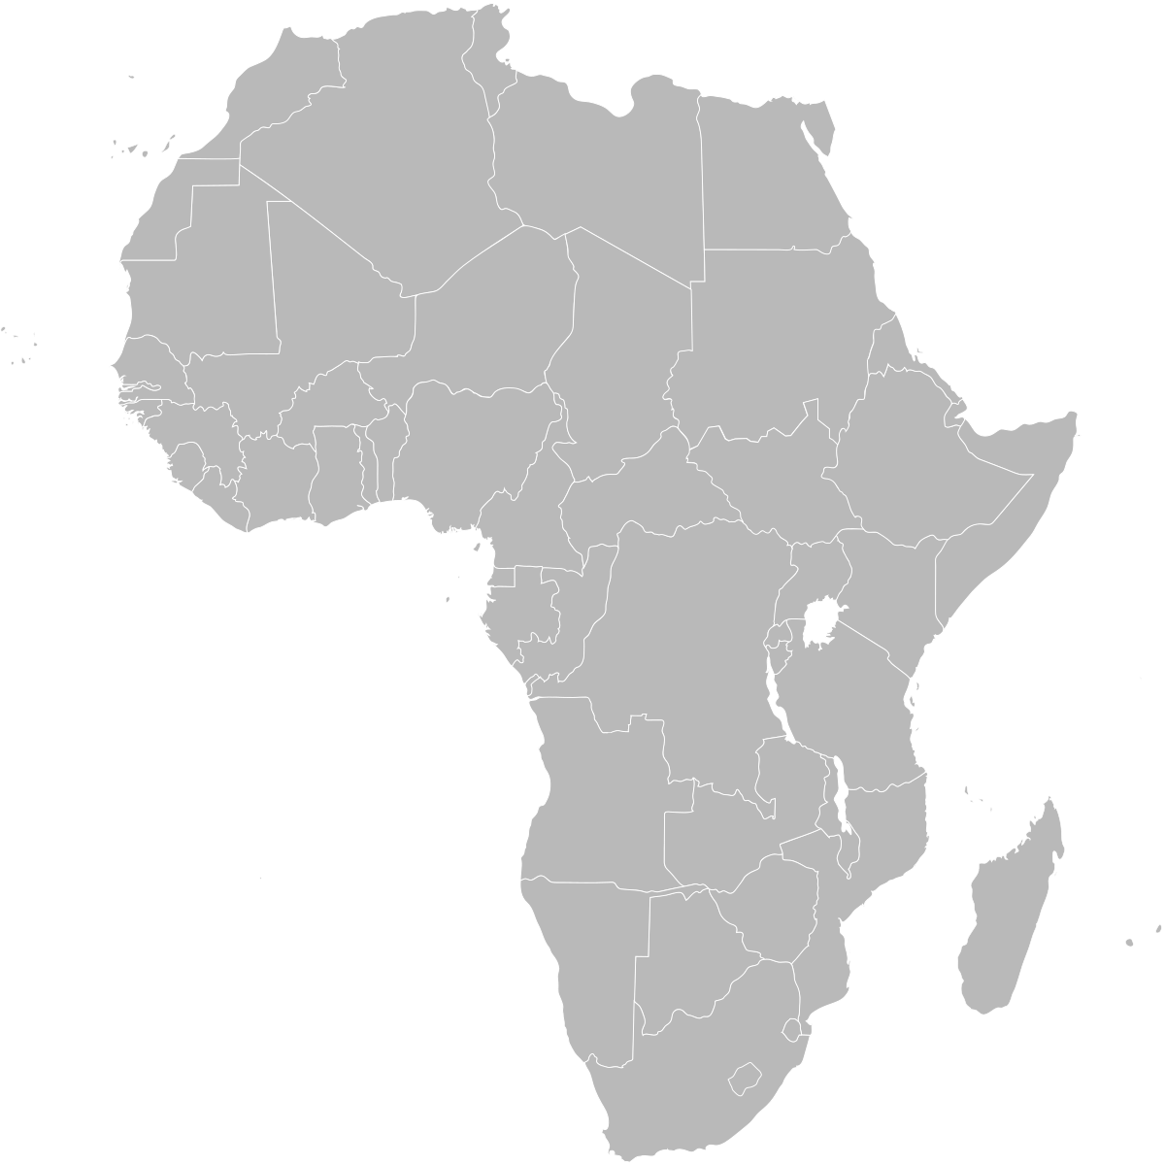
AFSTA Congress 2026 | Cape Town
Africa is not starting from zero
Regional seed and phytosanitary building blocks already exist. The next gains come from implementation discipline and interoperability.
1
COMESA - Common Market for Eastern and Southern Africa
COMSHIP (COMESA Seed Harmonisation Implementation Plan) provides an implementation framework for more consistent domestication, monitoring, and improvement across 21 member states.
COMESA
SADC
APP + ePhyto
2
SADC - Southern African Development Community
The HSRS (Harmonized Seed Regulatory System) establishes common rules, standards, and procedures for seed movement, including quarantine and phytosanitary measures.
3
APP / ePhyto
By 2026, APP is implemented in 20 African countries while ePhyto and digital surveillance tools continue to scale.
The issue is no longer lack of frameworks. It is execution.
4
Notes:
[Sources]
- COMSHIP scope and 21 member states: ACTESA, https://actesa.org/programme/comesa-seed-harmonisation-implementation-plan-comship/
- SADC HSRS purpose and phytosanitary scope: SADC Seed Centre, https://www.sadcseedcentre.com/policy-advocacy/sadc-harmonized-seed-regulatory-system-guidelines/
- APP in 20 African countries at CPM-20 side session: IPPC, https://www.ippc.int/en/commission/cpm/cpm-sessions/cpm-20-2026/cpm-20-side-session-app/
- Background map: Wikimedia Commons, https://commons.wikimedia.org/wiki/File:BlankMap-Africa.svg

Slide 5
AFSTA Congress 2026 | Cape Town
ePhyto momentum is real — but readiness is uneven
March 2026
100 countries are now exchanging phytosanitary certificates live through the ePhyto Hub.
13
/ 54
March 2026
Liberia and Sierra Leone are launching first implementations through the Africa ePhyto Initiative.
African countries fully integrated with ePhyto
as of July 2025
CPM-20
Egypt, Mali, South Africa, and Uganda presented APP progress, benefits, and lessons learned.
The baseline is still low, but the direction of travel is unmistakably digital.
More digital exchange is coming, but starting points, data quality, and institutional readiness still differ sharply across markets.
5
3
Notes:
[Sources]
- 13 of 54 African countries fully integrated as of July 2025: IPPC, https://www.ippc.int/en/news/landmark-ippc-project-put-african-countries-on-the-path-for-better-trade/
- 100 countries live and Liberia/Sierra Leone launch in March 2026: IPPC, https://www.ippc.int/en/news/ippc-ephyto-solution-march-2026-programme-update/
- CPM-20 APP country presentations: IPPC, https://www.ippc.int/en/commission/cpm/cpm-sessions/cpm-20-2026/cpm-20-side-session-app/

Slide 6
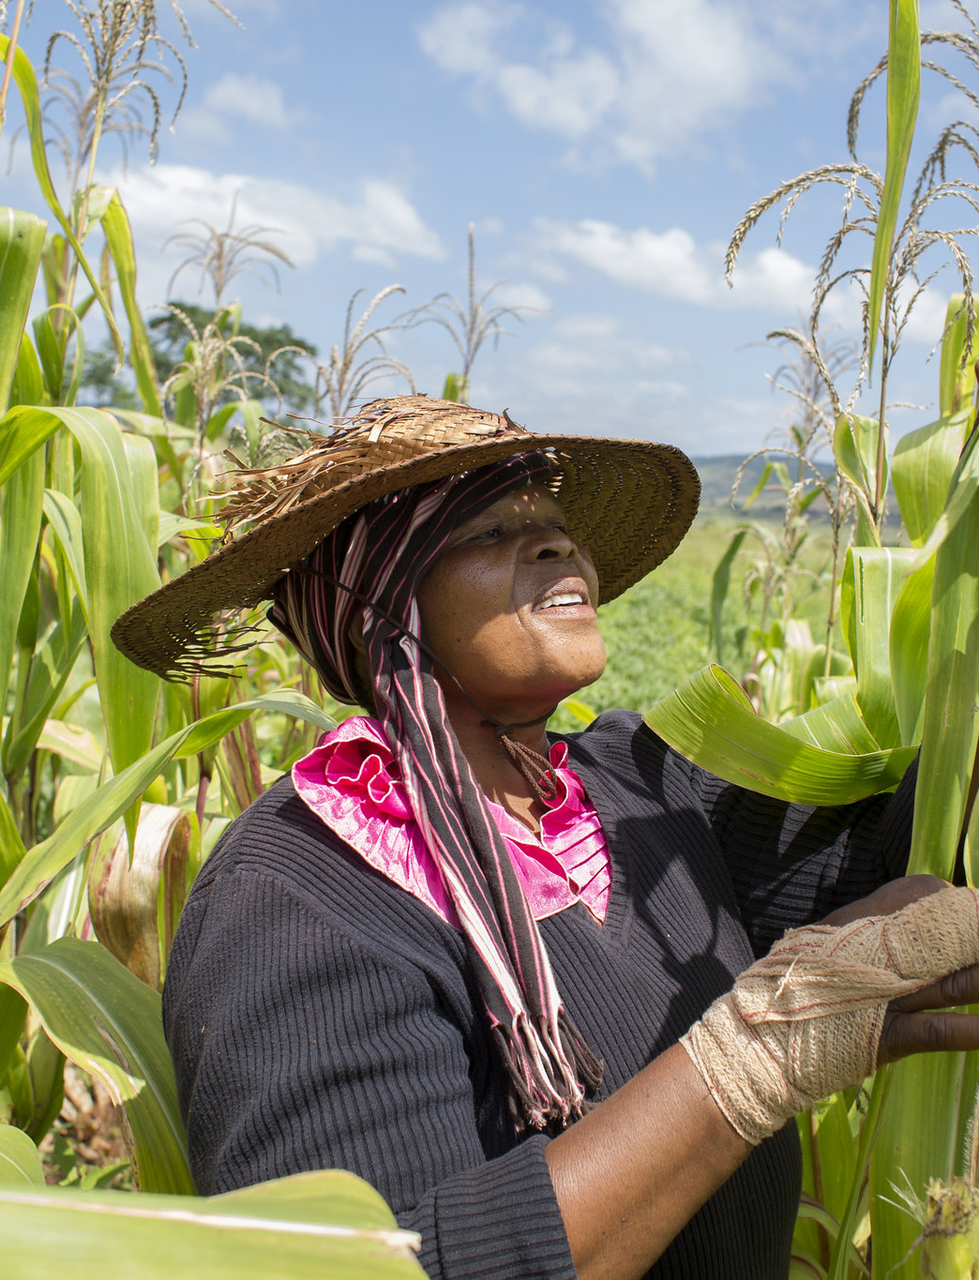
AFSTA Congress 2026 | Cape Town
What stronger systems have in common
Across regions, the strongest systems usually do five things well:
1
Publish import conditions, declarations, and permit rules — and keep them current.
2
Differentiate seed from other pathways where the biology and risk profile differ.
3
Use proportionate, comparable evidence rules instead of duplicating procedures by default.
4
Digitize certificates and core data flows to reduce re-keying, error, and avoidable hold-ups.
5
Create a rapid NPPO–industry problem-solving channel for live implementation issues.
This is not deregulation. It is better alignment around science, transparency, and implementation.
6
3
Notes:
[Sources]
- Image: FAO photo from Southern Africa maize context, https://www.fao.org/newsroom/detail/fao-warns-of-maize-shortfall-across-southern-africa/en
- Best-practice synthesis refined from uploaded draft and current policy framing.

Slide 7
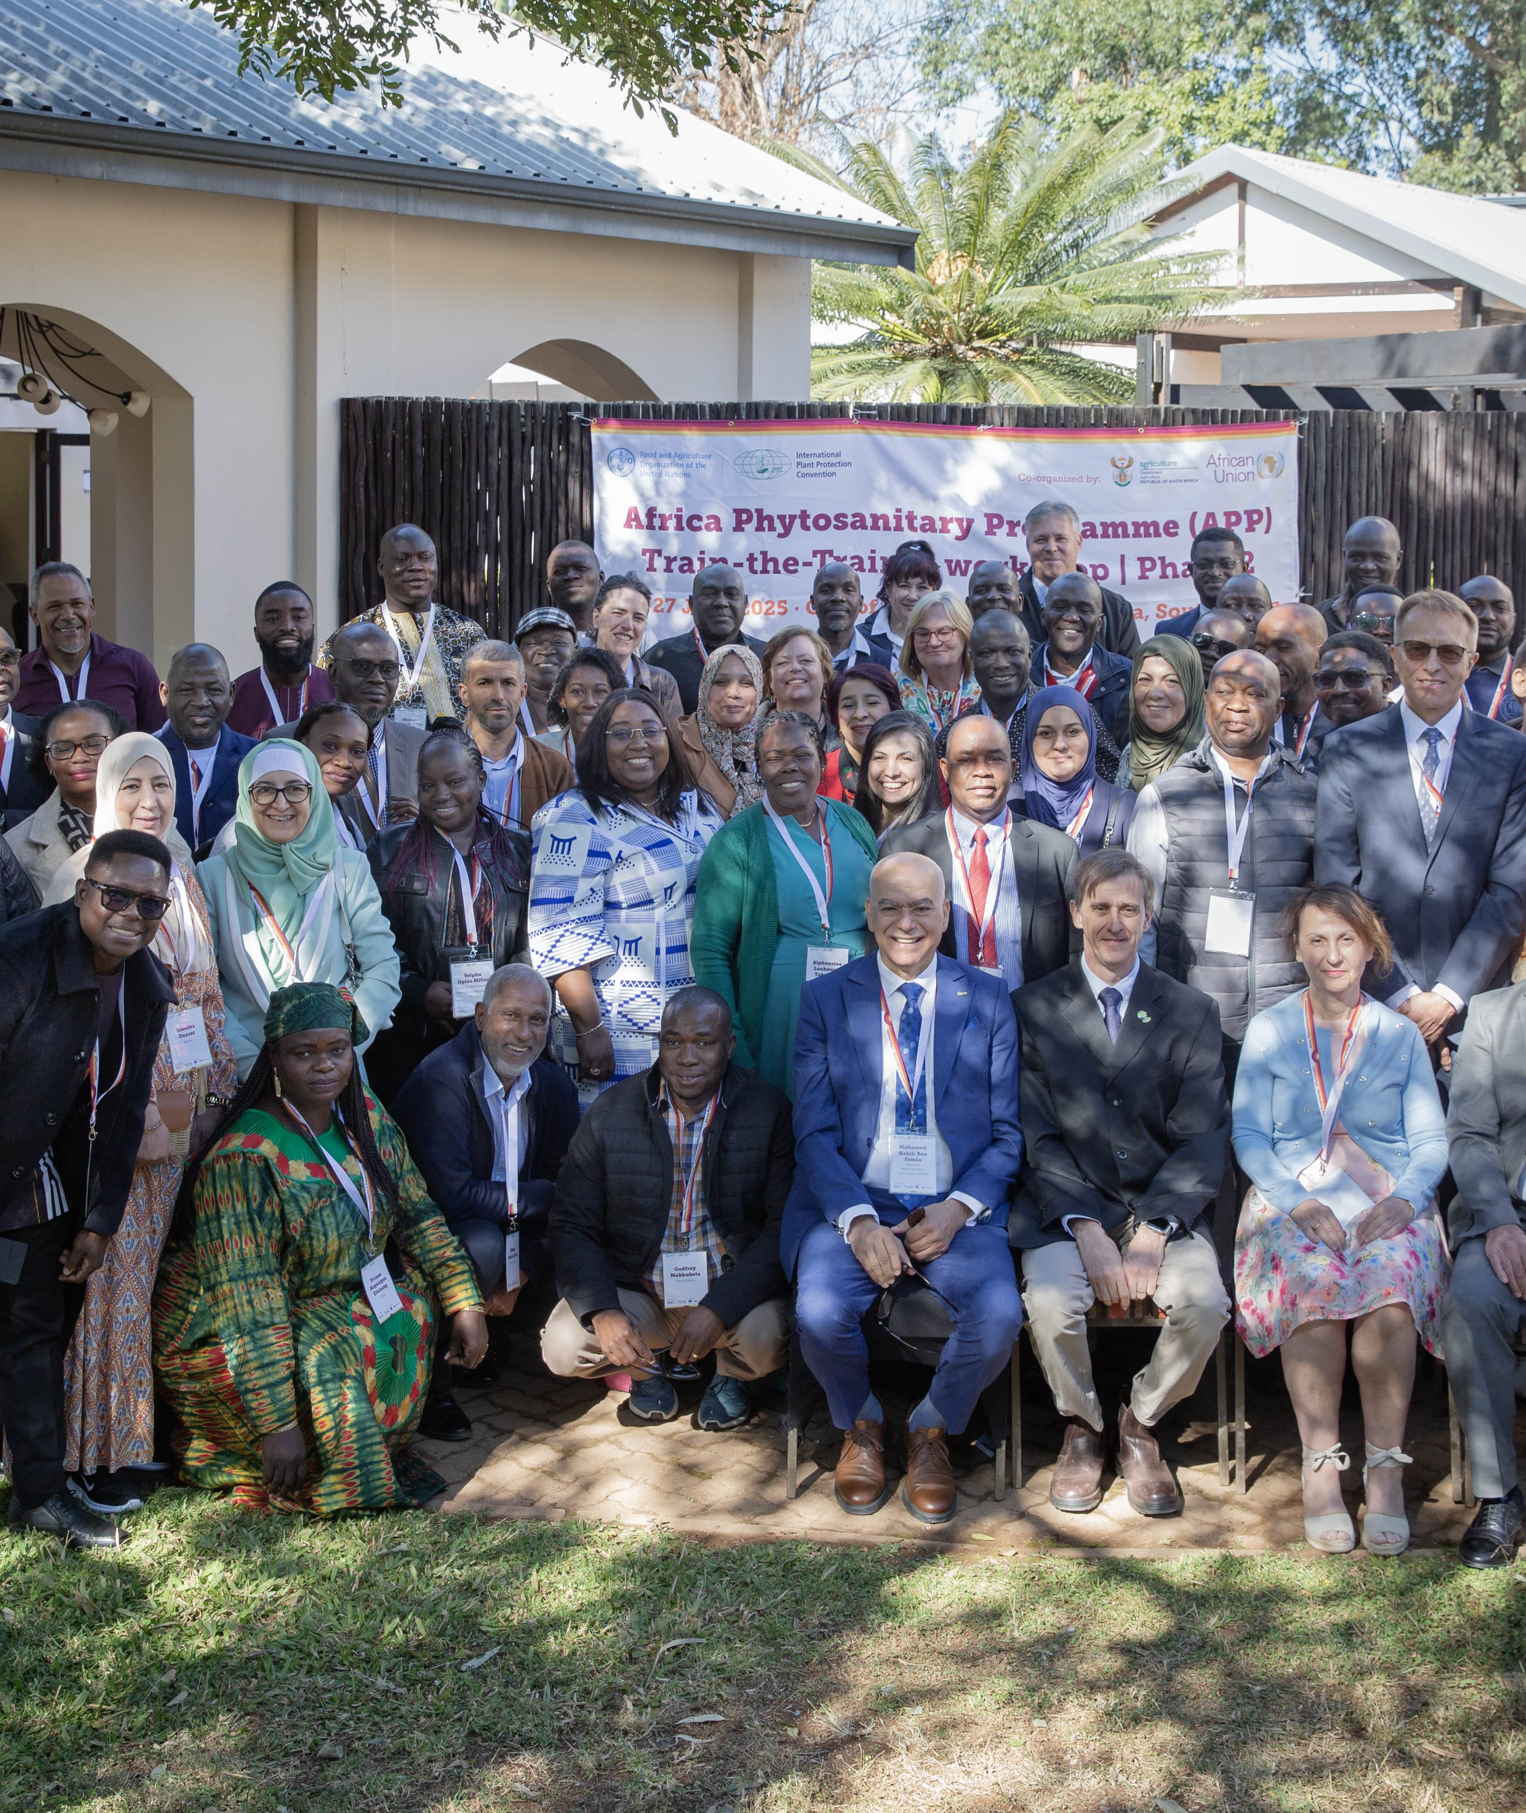
AFSTA Congress 2026 | Cape Town
Practical action agenda for Africa
Photo courtesy of FAO
1
Make requirements visible
Publish import conditions, pest lists, declaration wording, and permit steps in a format users can actually find.
2
Prioritize seed-specific work
Focus first on economically important, seed-borne, or seed-transmitted risks and the rules that drive the most friction.
3
Build trust in evidence
Accept comparable surveillance, testing, and systems-based evidence where outcomes are equivalent.
4
Scale digital certification
Expand ePhyto and interoperable data flows to reduce re-entry, manual checks, and inconsistency.
5
Institutionalize dialogue
Create routine NPPO–industry technical exchanges to resolve implementation issues before they escalate.
Judge harmonization by outcomes: seed moves faster, more predictably, and at lower compliance cost.
7
3
Notes:
[Sources]
- APP phase two launch photo and country context: FAO, https://www.fao.org/africa/news-stories/news-detail/fao-and-ippc-launch-second-phase-of-the-africa-phytosanitary-programme/
- Action priorities synthesized from uploaded draft plus COMESA / SADC / IPPC ePhyto sources cited earlier.

Slide 8

AFSTA Congress 2026 | Cape Town
Why seed needs a differentiated phytosanitary lens
Seed behaves differently from bulk commodities, so proportionate regulation matters.
Why this matters
Seed consignments are often small, high value, and linked to tight seasonal windows.
The same variety may move for multiplication, testing, trials, or commercial distribution, each with different operational realities.
A one-size-fits-all regulatory model can create cost and delay without improving the plant health outcome.
Better results come from requirements that reflect seed biology, seed use, and real trade pathways.
Photo courtesy of Rijk Zwaan
Good regulation protects plant health and remains workable for real seed movement.
8
3

Slide 9
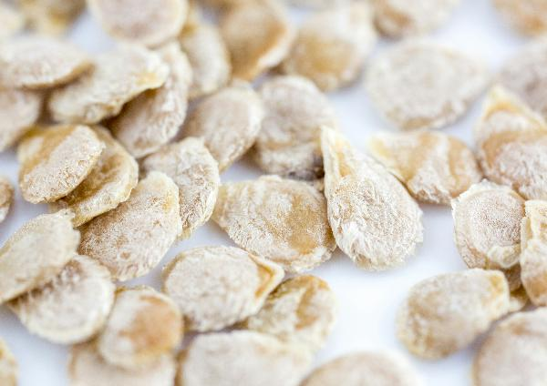
AFSTA Congress 2026 | Cape Town
Systems approaches can strengthen assurance without stopping trade
For seed, confidence often comes from a combination of measures rather than one control alone.
1
Production controls
Field inspection, approved production practices, and traceability from source.
2
Testing and verification
Sampling and testing targeted to priority pests and accepted evidence requirements.
3
Documentation and movement
Clear declarations, certificates, and consistent border interpretation.
4
Corrective action
Rapid communication if an issue emerges, so problems are managed early.
Photo courtesy of Rijk Zwaan
The objective is layered confidence: practical, science-based, and easier to implement.
9
3

Slide 10
AFSTA Congress 2026 | Cape Town
Digitalization creates value when the surrounding system is ready
ePhyto is powerful, but it works best when requirements, data, and institutional practice are aligned.
Clear requirements
Import conditions and declaration wording need to be easy to find and kept current.
Seed-specific instructions should be visible before a shipment moves.
Usable data
Digital exchange depends on standardized information and fewer manual workarounds.
Poor source data still creates delay, even in a digital system.
Operational readiness
Border agencies, NPPOs, and industry need consistent interpretation and response channels.
Implementation discipline matters as much as the platform itself.
Digitalization removes friction best when it sits on top of transparent rules and trusted workflows.
10
3

Slide 11
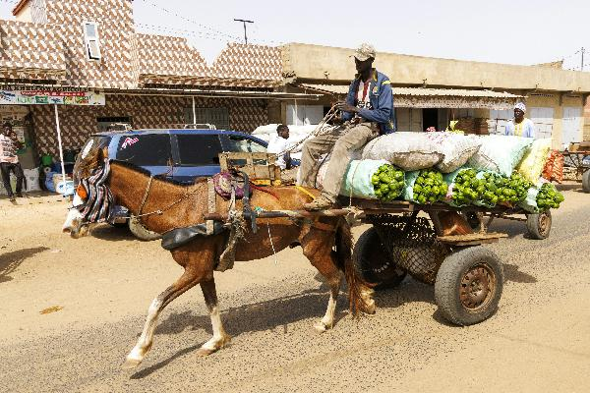
AFSTA Congress 2026 | Cape Town
Regional cooperation can reduce duplication and improve predictability
The next gains come from aligning how frameworks are applied in day-to-day seed movement.
1
Share model approaches
Use regional guidance, model declarations, and common implementation examples.
2
Focus on priority crops and pests
Start where friction is highest and the economic value of improvement is immediate.
3
Build comparable evidence rules
Increase confidence in equivalent testing, surveillance, and systems-based assurance.
4
Escalate implementation issues early
Resolve shipment-level friction through technical dialogue before it becomes policy conflict.
Photo courtesy of Rijk Zwaan
Regional alignment is not about identical systems - it is about fewer surprises and more consistency.
11
3

Slide 12
AFSTA Congress 2026 | Cape Town
What AFSTA members can help move forward now
Industry can support faster progress by bringing practical evidence, implementation feedback, and partnership.
Share live friction points
Document where delays arise: visibility of rules, wording, permits, testing, or border interpretation.
Support practical pilots
Participate in targeted pilots on ePhyto, digital workflows, model declarations, and systems approaches.
Bring technical evidence
Help focus attention on seed-borne and seed-transmitted risks that matter most for priority crops.
Keep dialogue routine
Use structured engagement with NPPOs and regional bodies to solve implementation issues before they escalate.
The most credible voice for change combines policy dialogue with concrete shipment experience.
12
3

Slide 13
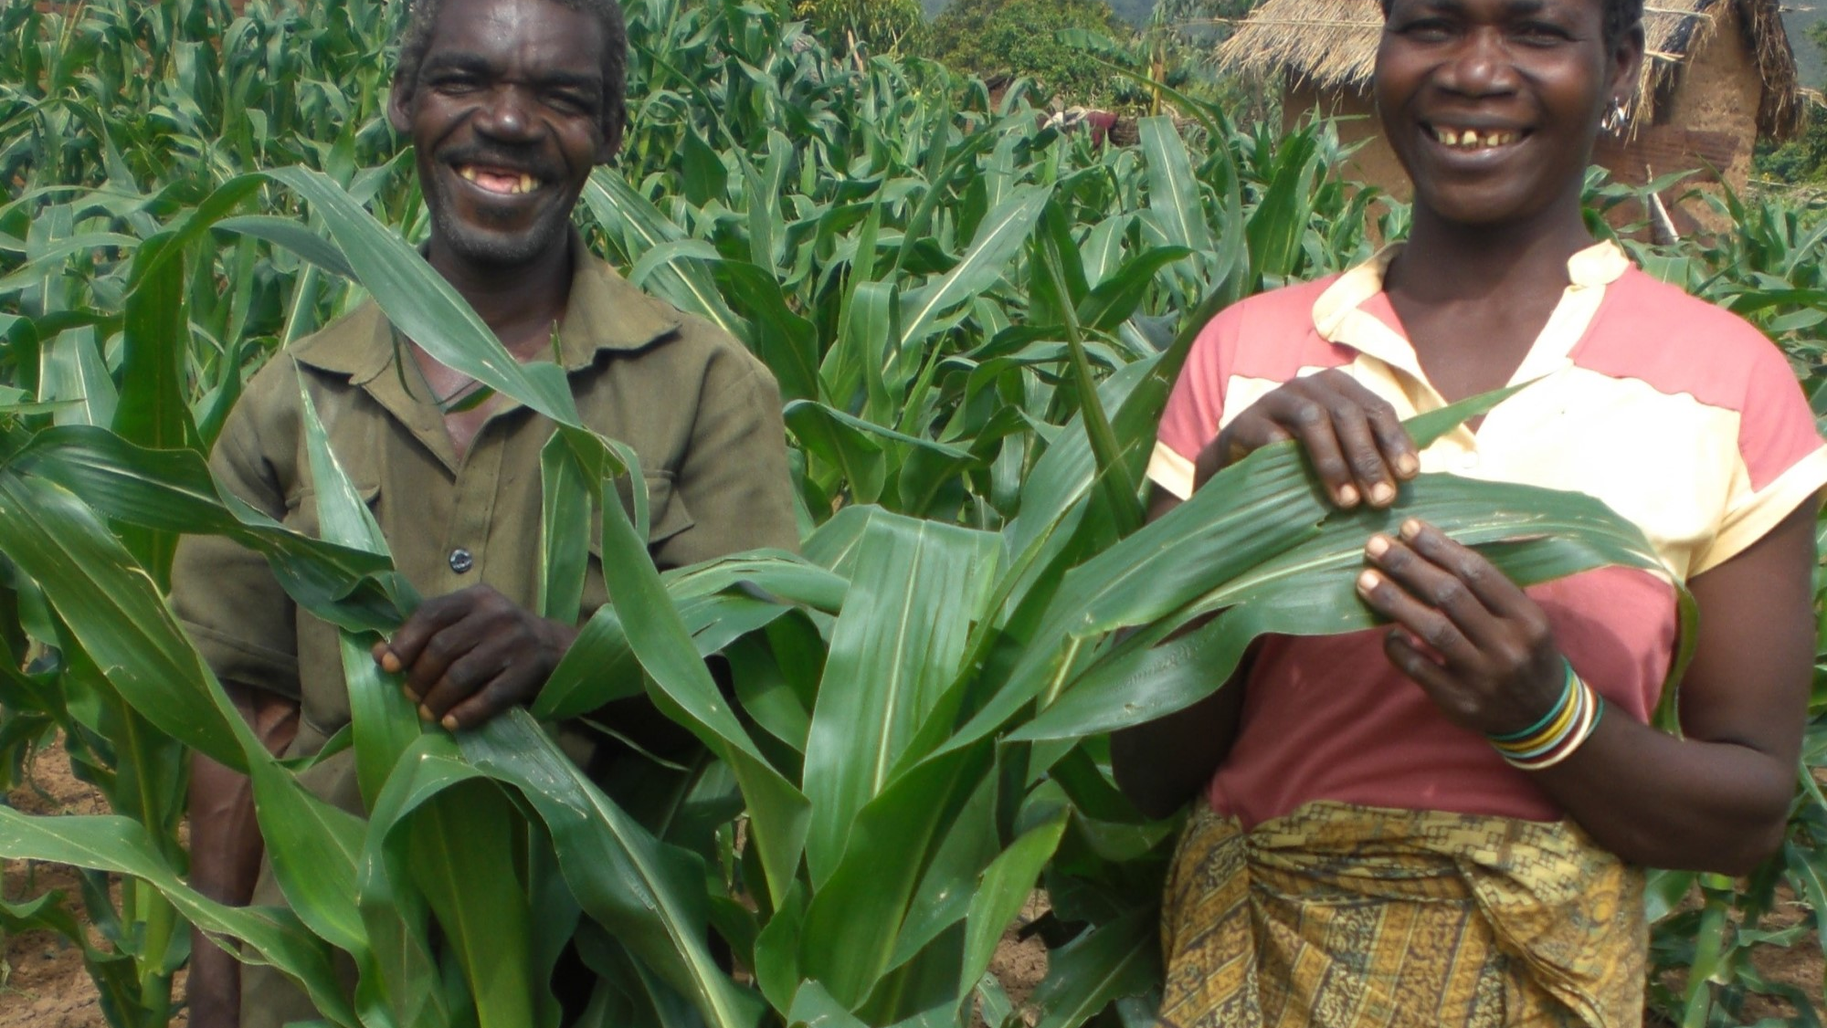
Key message
Protect plant health.
Reduce avoidable friction.
Move quality seed faster.
• Africa already has meaningful frameworks and modernization initiatives to build on.
• The next step is better visibility, interoperability, and practical coordination.
• The strongest results will come from partnership between NPPOs, regional bodies, and the seed sector.
AFSTA Congress 2026 | Cape Town
3
Notes:
[Sources]
- Image: CGIAR farmers in maize field, https://www.cgiar.org/news-events/news/hybrid-and-opv-maize-market-segments-in-western-and-central-africa/
- Closing synthesis based on the uploaded draft and cited policy sources in this presentation.

Slide 14



Dr Souza Richards
r.souzarichards@worldseed.org

