Slide 1
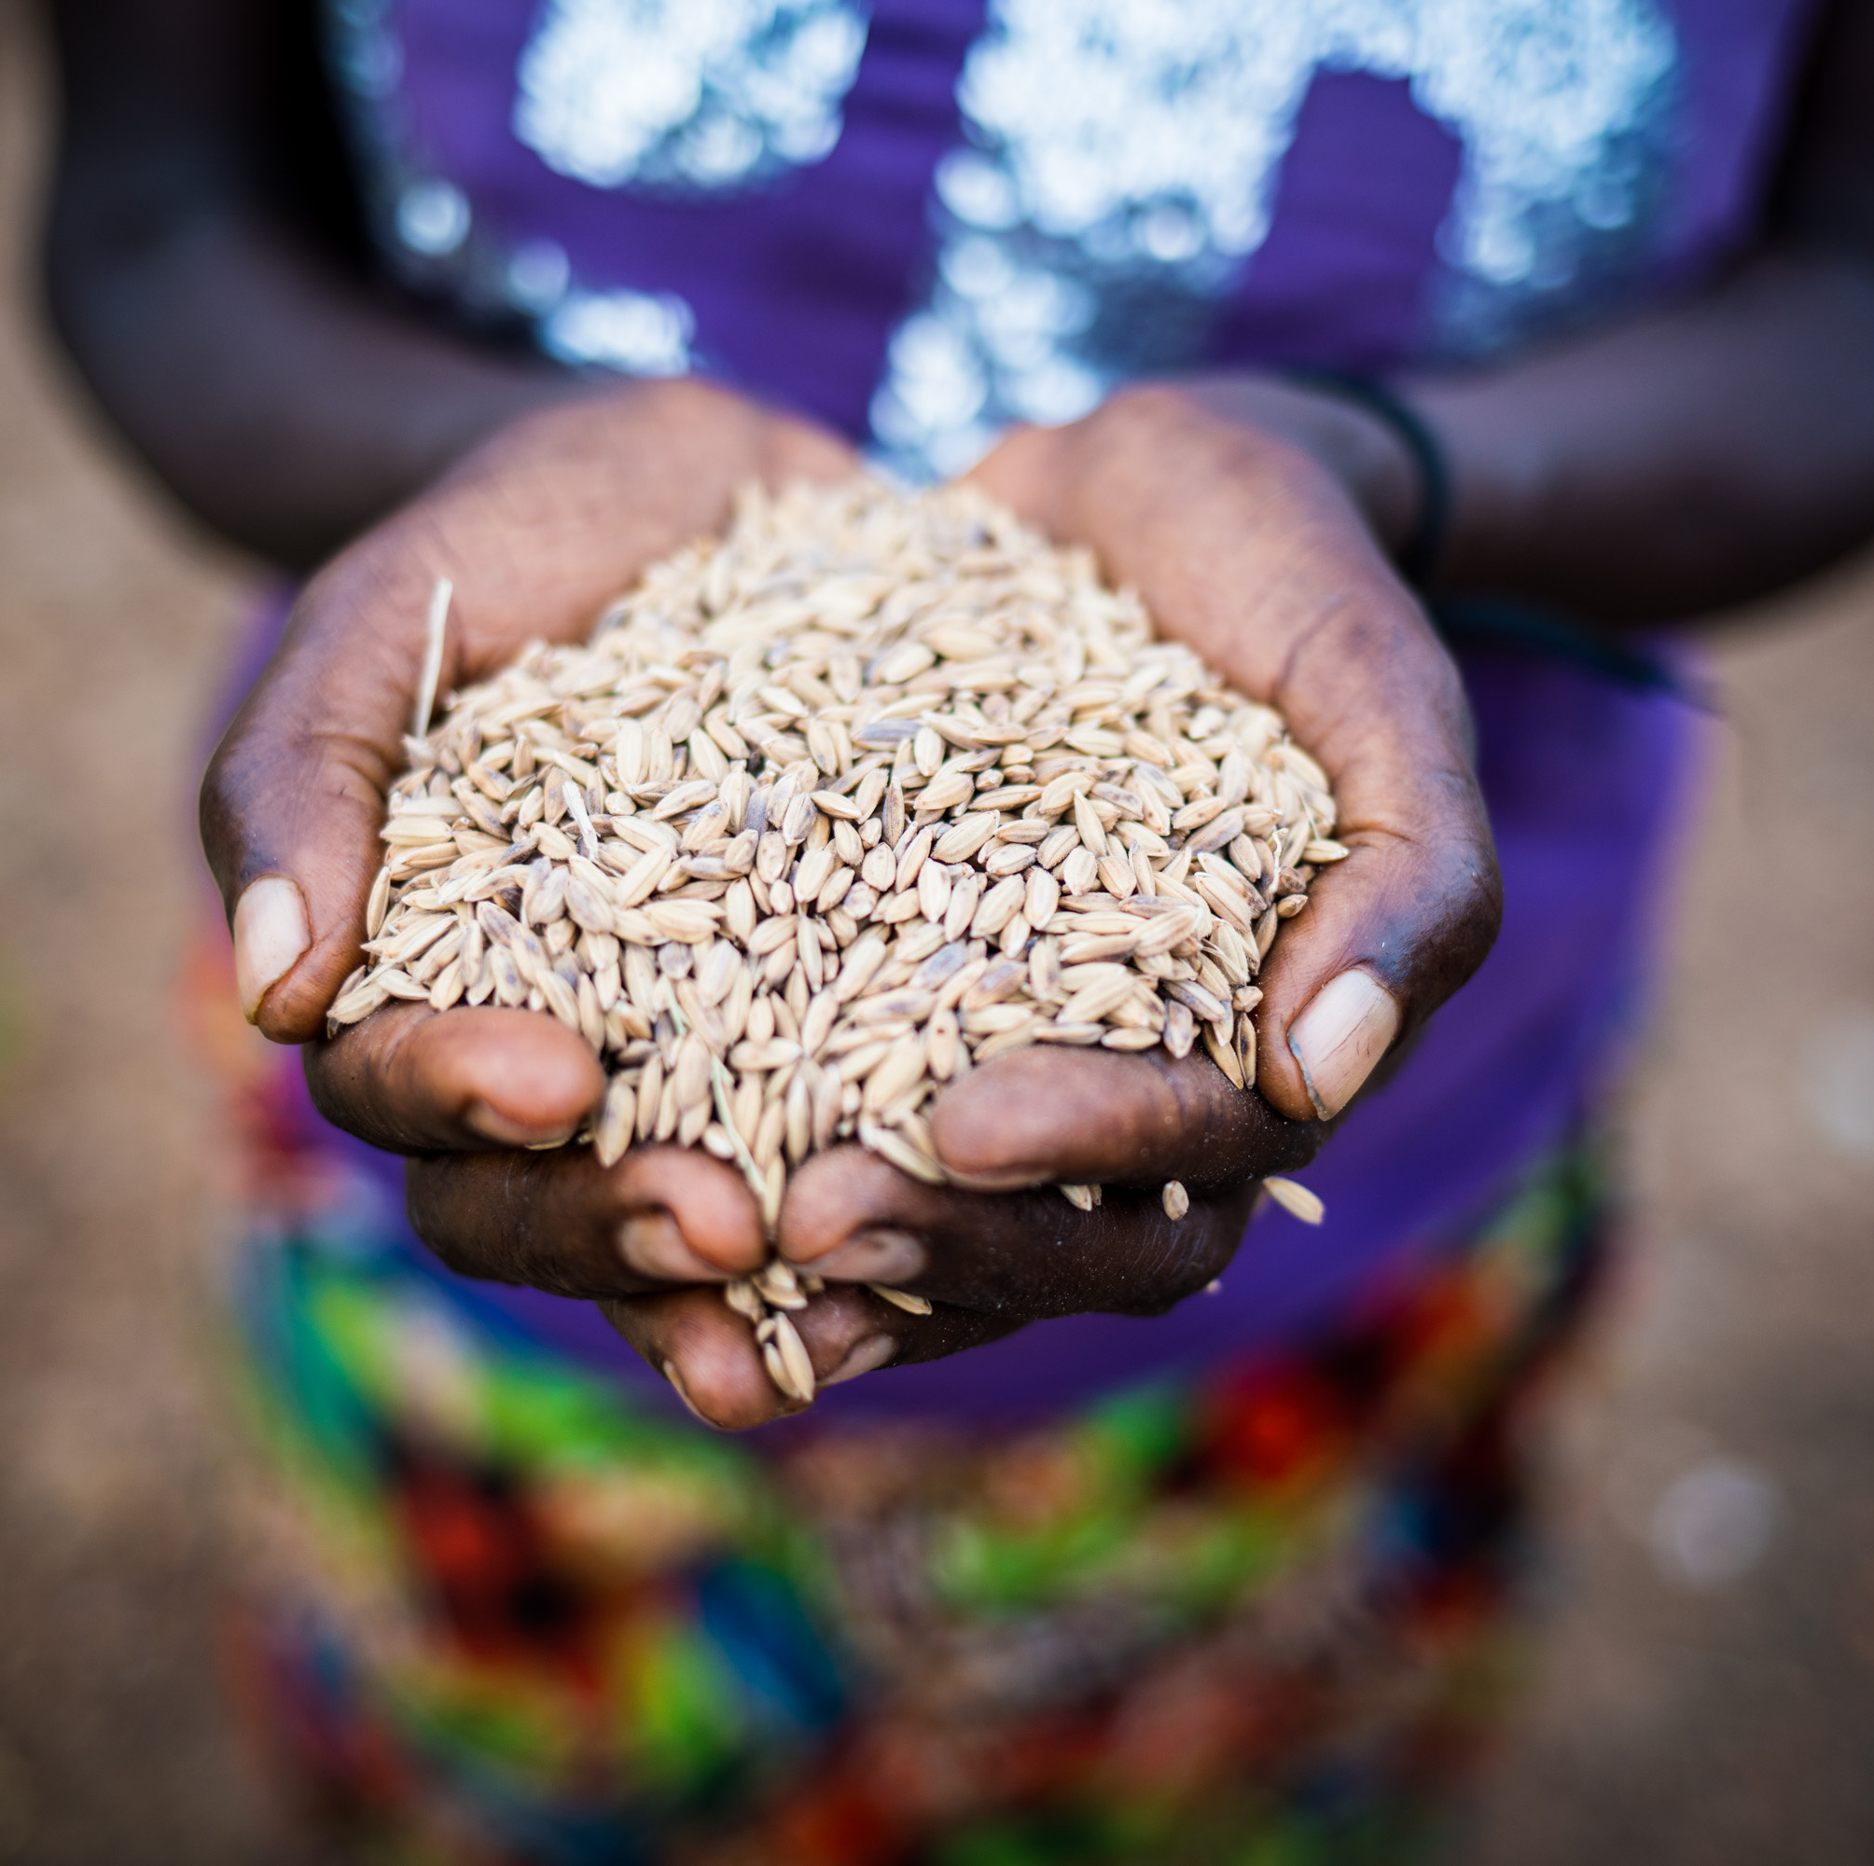



Seed Sector Performance Index (SSPI)
2025 Status Report
for Africa: Highlights
Prof. Ed Mabaya
Cornell University / TASAI

Slide 2
Overview of Seed Sector Performance Index
What is SSPI? An analytical tool that provides a “bird’s eye” view of the health of the seed system in African countries.
17 indicators which measure seed sector performance
Source of data: African Union member states; Data also serves as the seed sector indicator in the CAADP Biennial Review (BR) process
Pilot in 2023: Piloted in 47 countries in 2023 for 4th AU Biennial Review
SSPI 2025: data collected between June and September 2025
SSPI ownership: Anchored under the African Seed and Biotechnology Program (ASBP)
Currently supported by the African Union Commission and AGRA

Slide 3
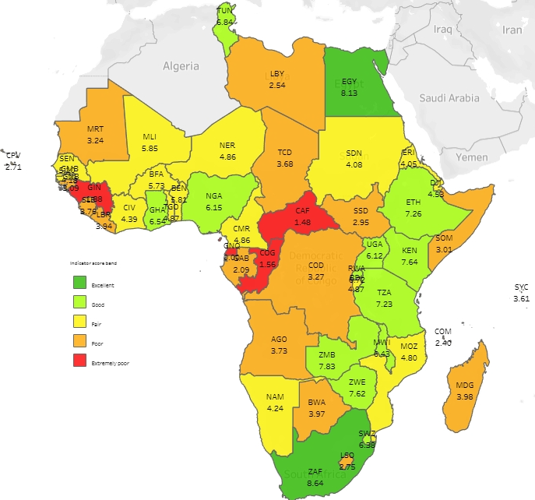
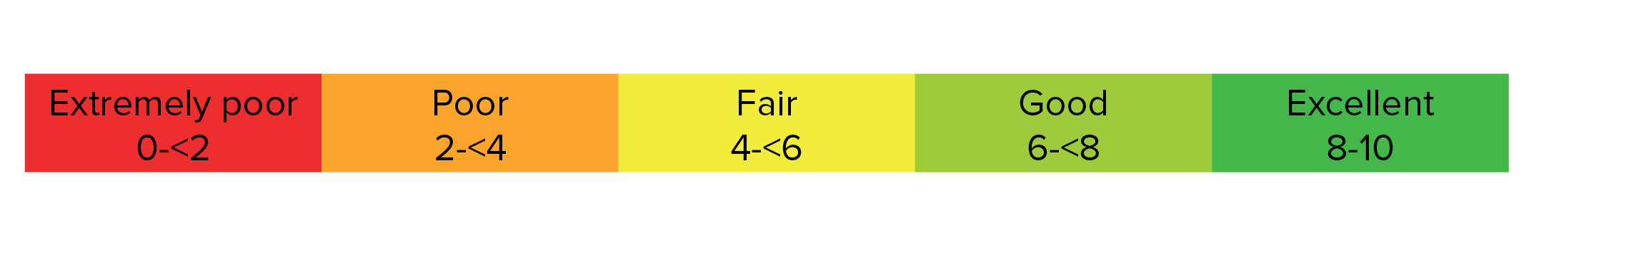
SSPI 2025 country scores
Data from 50 countries
5 missing countries: Algeria, Mauritius, Morocco, Sahrawi Republic, and Sao Tome and Principe
SSPI scores
Scores out of 10
Country score is average of 17 indicator scores
Both quantitative & qualitative data
Scores color-coded:
Average for continent: 4.63

Slide 4
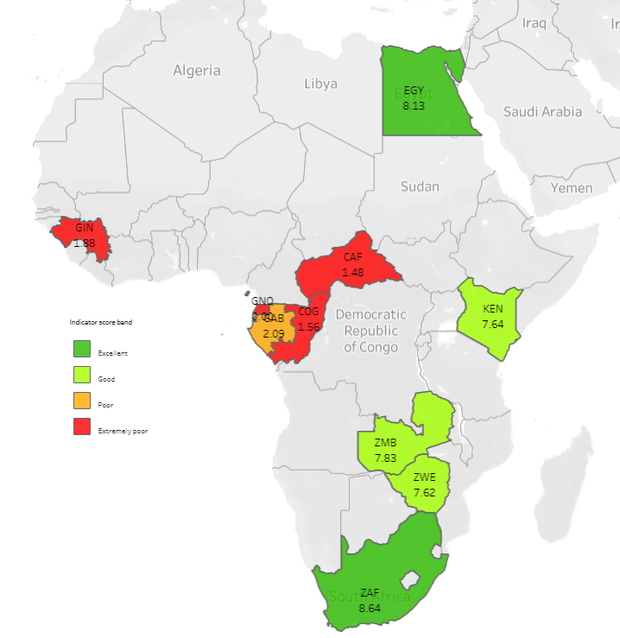
Highlight 1: Five high and low scoring countries
South Africa and Egypt scored excellent (> 8.0)
Highest overall scores:
South Africa 8.64
Egypt 8.13
Zambia 7.83
Kenya 7.64
Zimbabwe 7.62
Lowest overall scores:
Gabon 2.09
Guinea (Conakry) 1.88
Congo Republic 1.56
Central Afr. Rep. 1.48
Equatorial Guinea 0.00

Slide 5
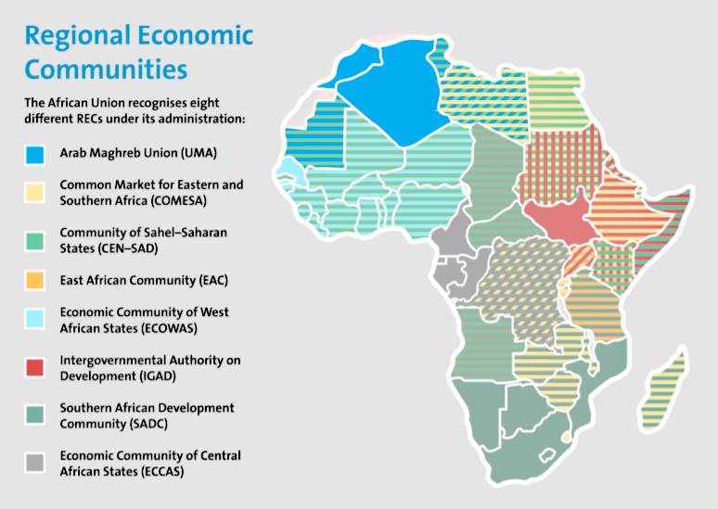
Highlight 2: Scores by Regional Economic Bloc
COMESA (East/Southern Africa) - 5.25
SADC (Southern Africa) - 5.05
ECOWAS (West Africa) - 4.51
UMA (Northern Africa/Maghreb) - 4.21
ECCAS (Central Africa) - 2.26
Notes:
COMESA region performs strongly on seed policy instruments and seed import regulations but shows weaknesses in small package seed availability, farmer-managed seed system recognition, and seed utilization. SADC ranks second - performs well on seed import regulations, seed policy instruments, and small package availability, but the regional mean is substantially influenced by South Africa. ECOWAS stands out for the highest scores on seed policy instruments and REC policy harmonization among all RECs, but consistently underperforms on demand-side indicators including seed utilization, farmer-managed seed systems, and small package seed availability. ECCAS scores below 2.0 on varieties released, seed utilization, and plant genetic resources, and no indicator averages above 6.0.
UMA countries are Algeria, Libya, Mauritania, Morocco, and Tunisia. Those in bold participated in SSPI.

Slide 6
Highlight 3: Notable improvement (2023->2025)
Somalia (1.56 in 2023 to 3.01 in 2025):
Passed SARIS Act and Seed and Plant Variety Act
Established SARIS as seed regulatory agency
Increased in volume of seed produced
Improved seed import processes
Ethiopia (6.08, in 2023 to 7.26 in 2025):
Improved variety release process: Plant Variety Release Directive is operational, started DUS & VCU tests
Increased number of varieties (from 41 to 79 in 2025)
Improved quality control: Ethiopia has joined ISTA
Notes:
SOM and ETH are two examples of notable improvements, due to the reasons above. Note that there were other significant score changes, but some are due to methods changes – improvements from pilot through use of sub-indicators, refinements in scoring, etc.

Slide 7
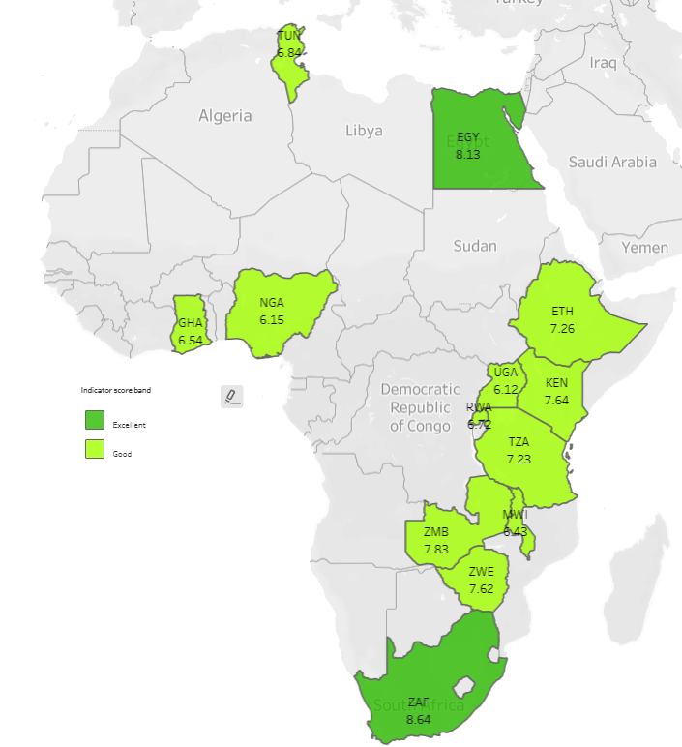
Highlight 4: Features of high performing countries
13 countries that scored 6/10 or above have:
Robust private sector involved in variety development,
Functional variety release system,
Private sector involvement in selected seed certification activities (in some countries)
High production volumes of certified seed
Active and functional national seed trade association.
Notes:
They are mostly in East and Southern Africa, with a few exceptions elsewhere – EGY, GHA, NRA, and TUN

Slide 8
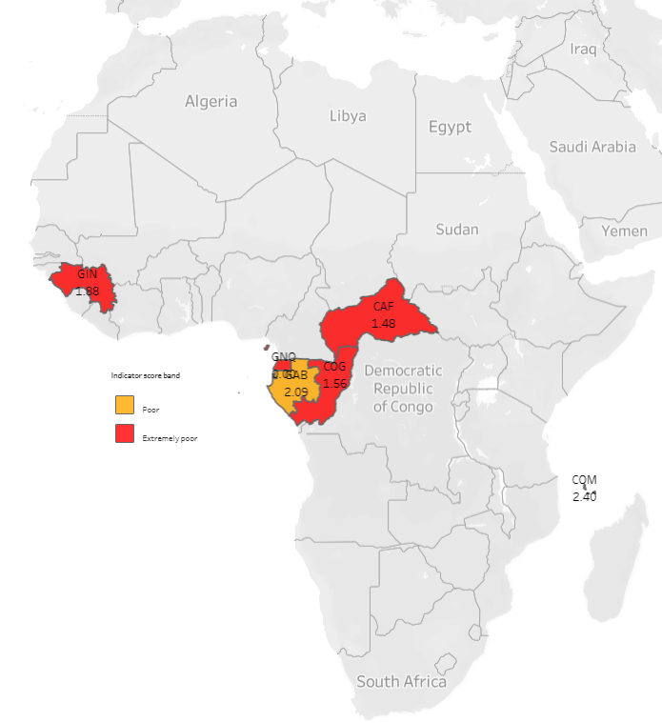
Highlight 5: Features of low performing countries
6 countries that scored 3.0 or below have:
Formal seed systems that are non-existent or nascent
No-to-minimal private sector activity
Breeding and variety development only in the public sector
Non-existent or nascent variety release and registration systems
Very low seed production volumes
Absence of national seed trade associations
Notes:
Almost all countries in Central Africa – this also contributes to low REC score for ECCAS.

Slide 9
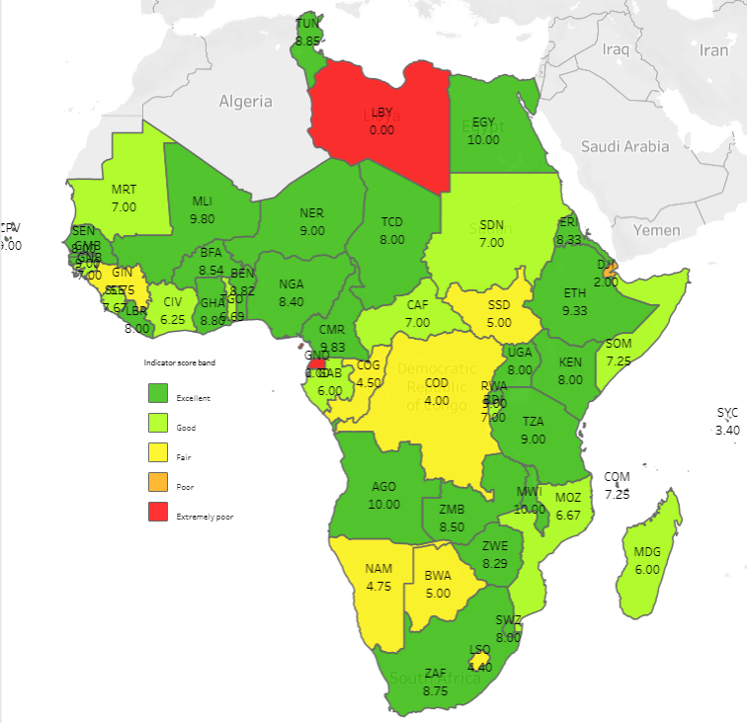
Highlight 6: Best performing indicator – policy instruments
Status of national seed policy instruments – highest score, with continental avg: 7.14
Nearly all countries have seed policies; challenge is implementation
4 countries with no seed policy instruments: Djibouti, DRC, Equatorial Guinea, Libya.
Notes:
Draft instruments exist in Djibouti (seed policy) and DRC (seed law). In Libya, the status of the instruments in unknown. We don't track implementation under this indicator but across most of the others, e.g., variety release process, import regulations, seed inspection, and tracking of efforts to combat counterfeit seed.
Ind 11

Slide 10
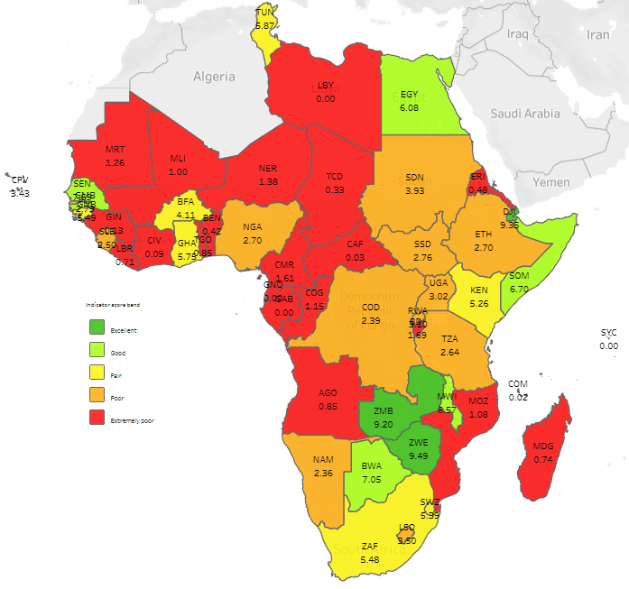
Highlight 7: Widespread unmet demand for certified seed
Utilization of commercial seed by farmers – lowest score, with continental average of 3.02
Only 14 countries met 50% or more of national seed requirement for any of the four priority crops.
Significant variation by crop
Measurement challenges
Notes:
Ind 7 Data issues include unrecorded seed production and trade data, incomplete data on land under cultivation

Slide 11
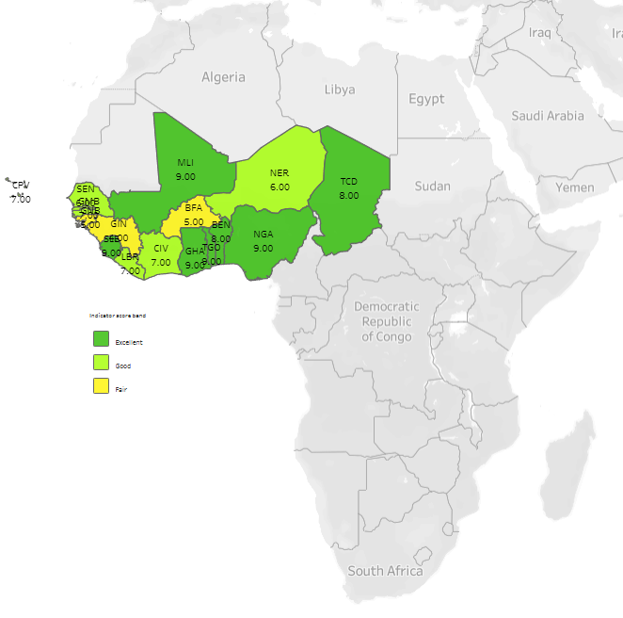
Highlight 8: ECOWAS ranks highest in regional harmonization
ECOWAS on top in 2025 (and 2023); however, scores for all RECs have decreased since 2023.
ECOWAS 6.94
SADC 6.44
COMESA 5.76
ECCAS 3.33
Continent average: 5.94
Notes:
ECOWAS Regional Seed Regulations have been adopted by nearly all member states of the ECOWAS-UEMOA-CILLS region;
In contrast, the ECCAS/CEMAC Regional Seed Regulations are yet to be fully adopted by any of the ECCAS member states. Overall trend – all down from 2023, continental avg is also down from 6.55 to 5.94. Indicator 12.

Slide 12
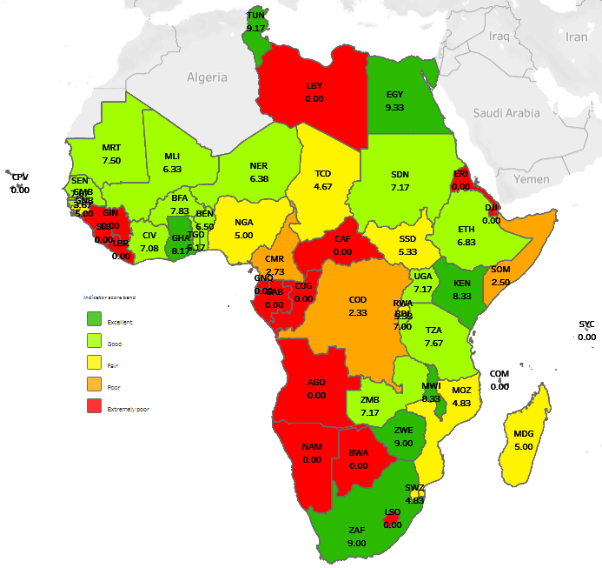
Highlight 9: Seed trade associations matter!
National seed trade associations are important vehicles for private sector development
Data shows correlation between functional seed association and good overall scores (r = 0.78)
17 countries without national seed association
Notes:
Ind 17 – measures 6 aspects of functioning of seed associations.

Slide 13
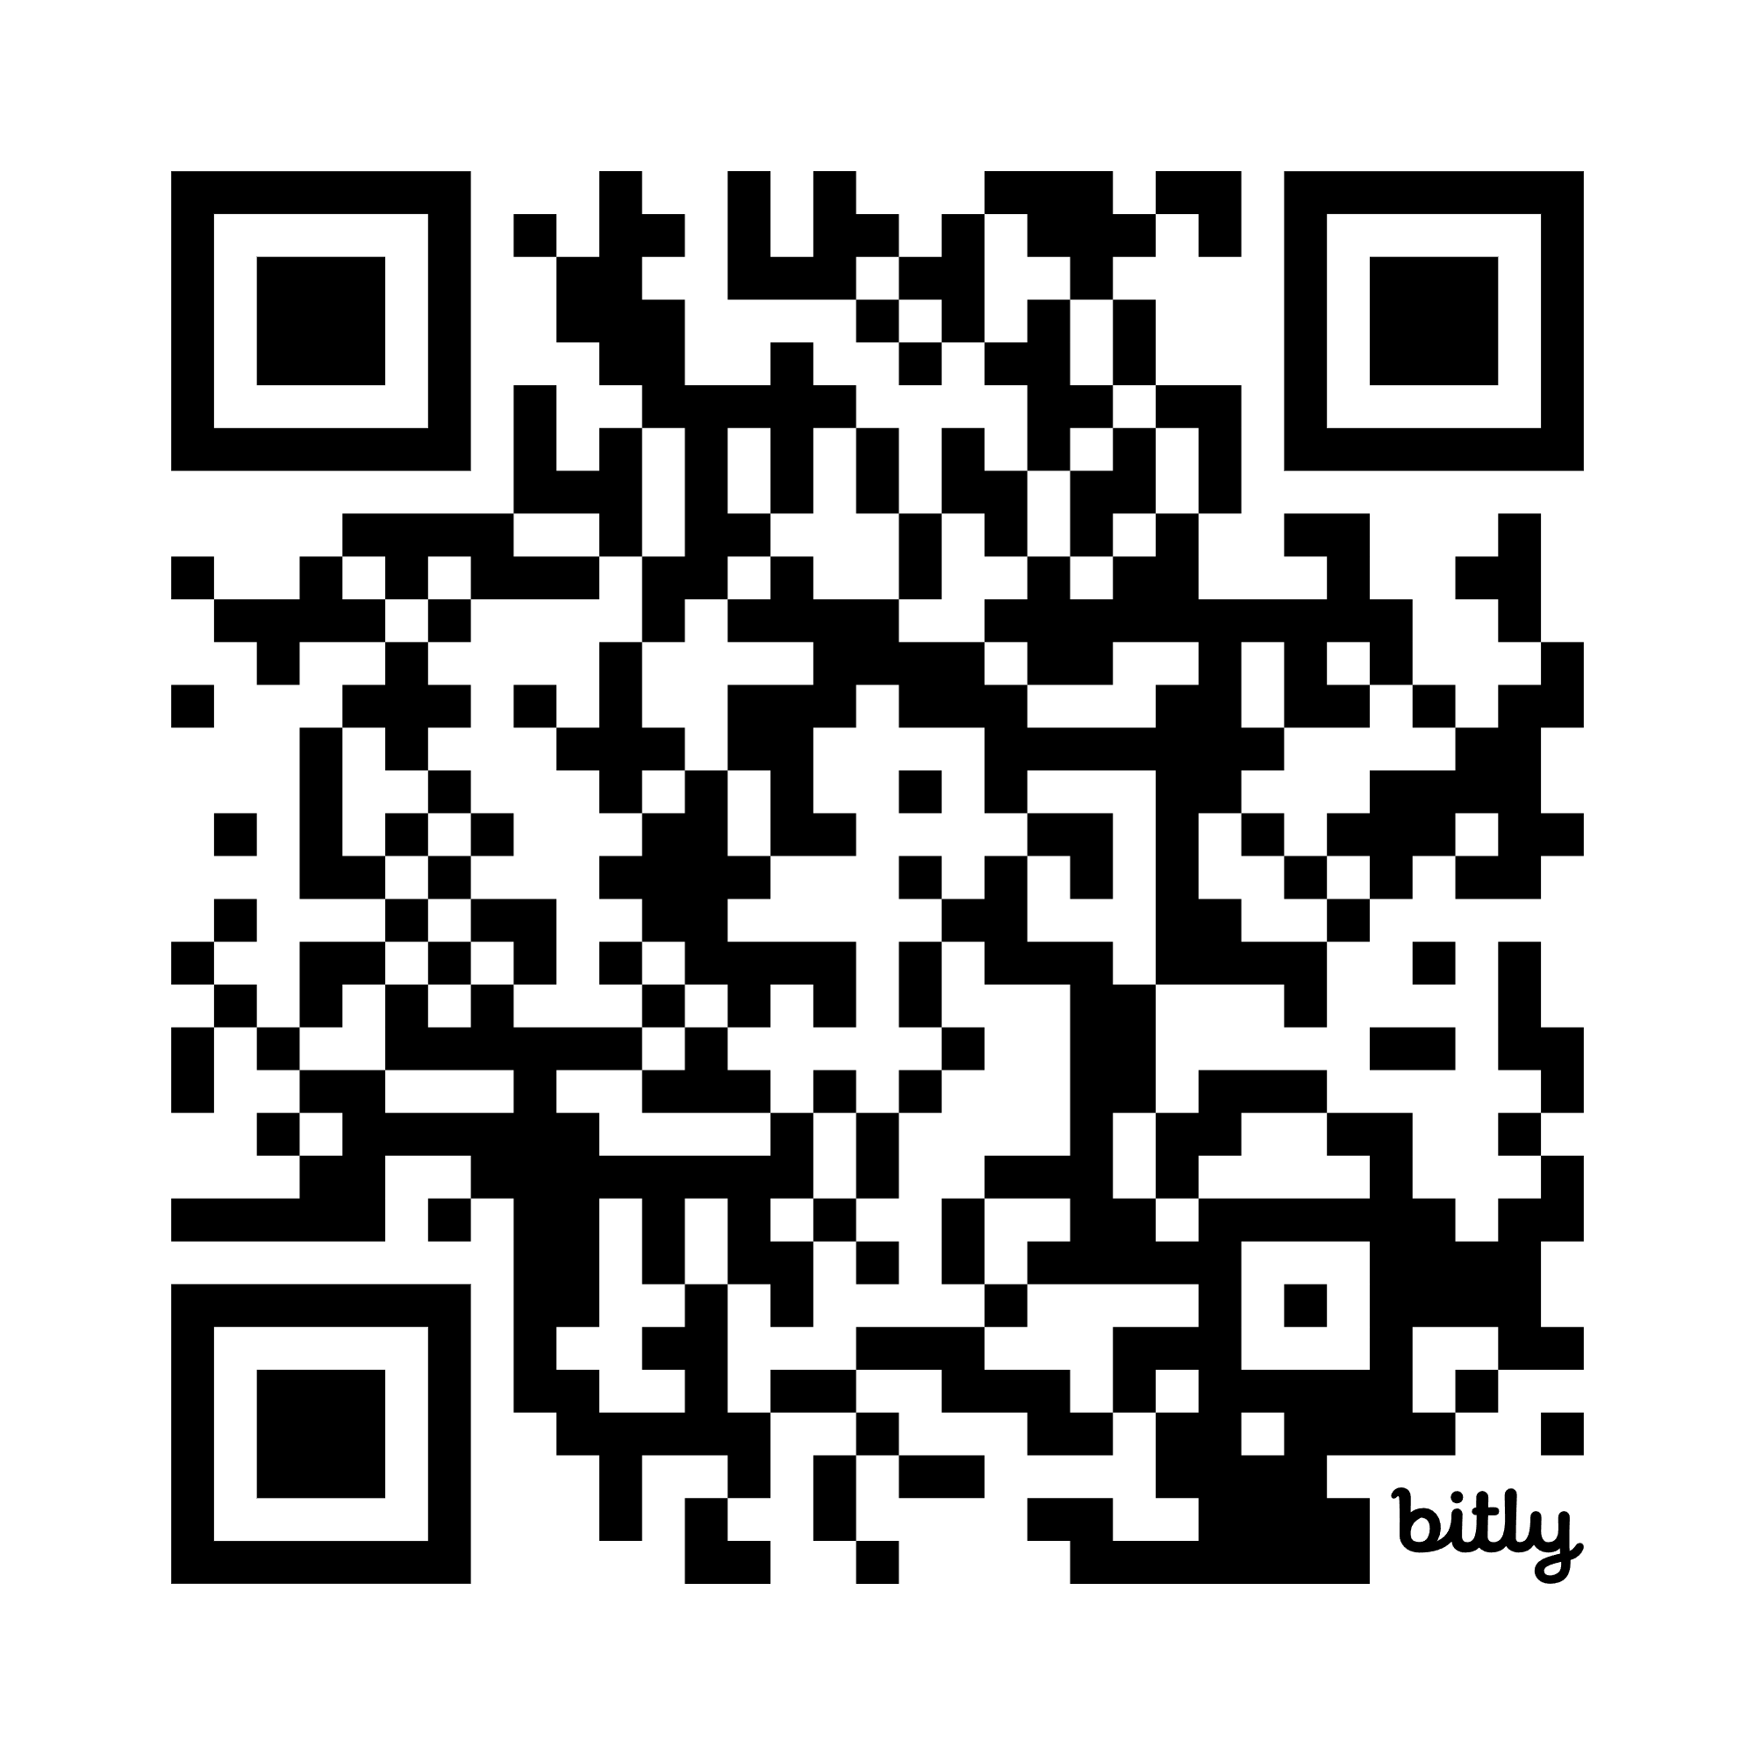
How to access SSPI?
Report & online dashboard will launch later this year.
Report includes country briefs
Online interactive dashboard, with filters by country, REC, year.
Validation ongoing – link to online form to review country brief(s):
Notes:
Tentative launch date is Oct – stay tuned for details.

Slide 14
Side event invitation
Data validation for SSPI 2025
Wednesday, March 25, 2026
16:00 to 18:00 hours
Following the AFSTA
Annual General Meeting
Venue: Room 10 (first floor)

