Slide 1


E-Phyto: Africa’s Digital Key to Faster and Cheaper Seed Trade
Kennedy Mangwana – Technical Manager, AFSTA
2026 AFSTA Congress
23rd - 25th March 2026
Century City Hotel, Cape Town, S. Africa
Notes:
Dear participants, we are replacing paper with speed, security and savings.
And so, today we will explore how digitizing phytosanitary certificates impacts seed trade costs and efficiency which is a critical drive for AfCFTA success

Slide 2
Outline
Introduction
Phyto issues in Regional Seed Trade
What is E-Phyto
Why E-Phyto for Africa?
E-Phyto Implementation Roadmap
Succes Stories in Africa
Call to Action and Conclusion

Slide 3
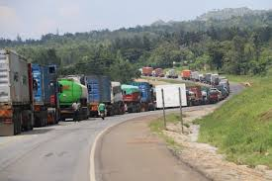
Challenges in Seed Trade
🚛 Border Delays: 3-7 days for SPS checks
Paper certificates = Costly delays + Losses
National and regional pests and disease quarantine list
Policy inconsistencies are not aligned to international rules and standards
Competent and sufficient staff handling phytosanitary (i.e. limited labs at border points)
Border delays: 3 – 7 days for sanitary and phytosanitary checks at border points are critical for safe agriculture trade
High cost of certificate printing and courier ($50-$200)
Risk of fraud (15% paper certificate are forged globally)
Risk of loosing information on the certificate paper
Notes:
These barriers hurt farmers and Africa’s competitiveness in seed trade

Slide 4
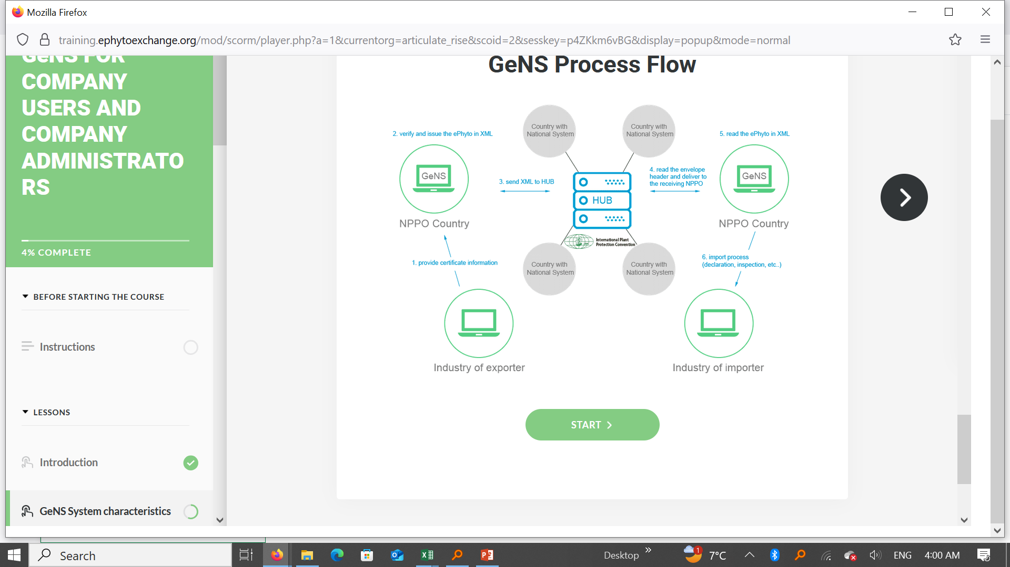
What is E-Phyto?
Courtesy of KEPHIS, Kenya
Notes:
They are legally equivalent to paper but transmitted electronically with built-in security features
These are electronic phytosanitary certificates exchanged between countries as per IPPC Global practice.
The digital solution implies security and instant certificates

Slide 5
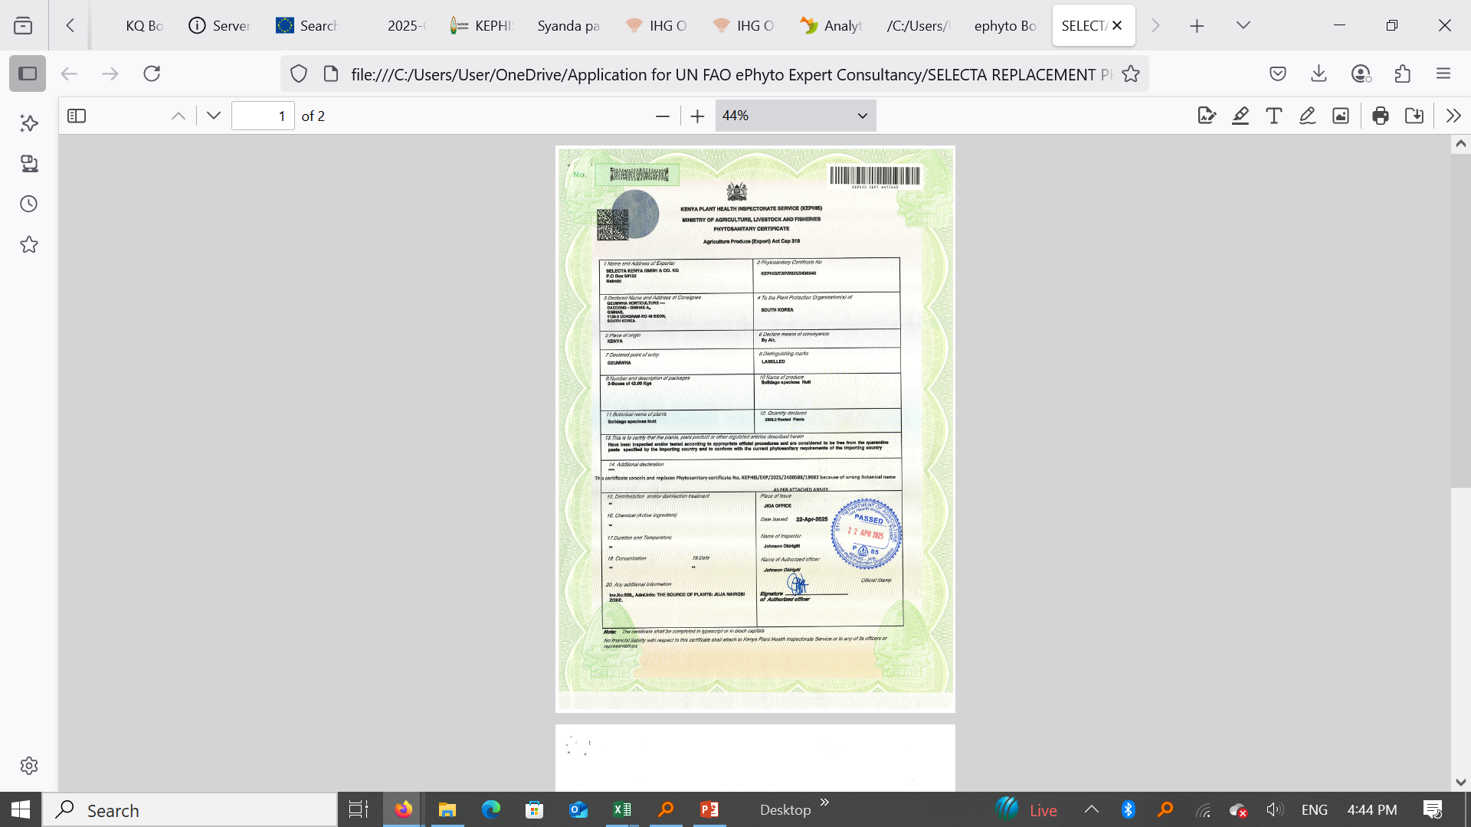
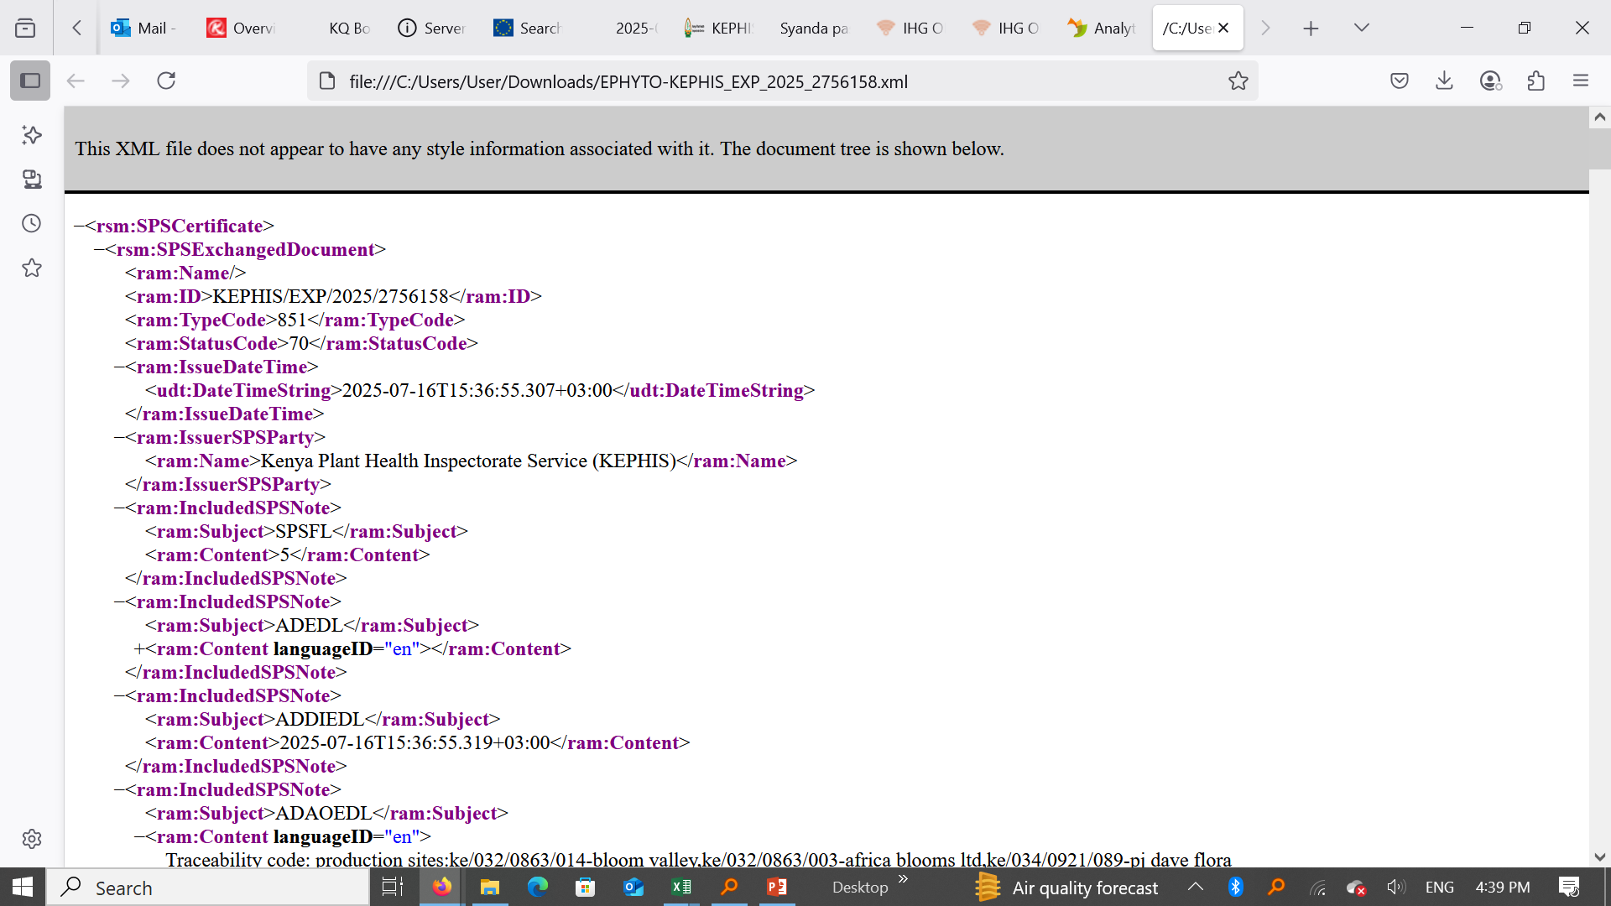
Why E-Phyto for Africa
Courtesy of KEPHIS, Kenya
Notes:
E-phyto slashes time and cost while eliminating fraud
E-Phyto is essential in attaining >50% intra-trade growth
Regional hubs like COMESA and ECOWAS are driving the rolling out

Slide 6
Why E-Phyto for Africa
Metric | Paper | E-Phyto
Issuance | 3-5 days | <24h
Transmission | Courier (days) | Seconds
Border Time | Hours/ Days | Pre-cleared
Cost/ Certificate | $50 - $200 | <$10
Why Africa Needs E-Phytos in Seed Trade?
Speed: It is >90% faster border clearance e.g. in Kenya-EU used take 5days & now <24h
Savings: In Senegal in 2024, >$2M saved on logistics
Competitiveness: Boost exports (e.g. Ke to EU, Arge, US, Aust, SA), digital storage of information
Trust: Tamper proof certificates (alteration, verification)
Transmission: No physical documents (intermediaries)
Notes:
E-phyto slashes time and cost while eliminating fraud…benefits fo the seed companies
E-Phyto is essential in attaining >50% intra-trade growth
Regional hubs like COMESA and ECOWAS are driving the rolling out

Slide 7
Implementation Road Map
Momentum in seed trade is building up!!
Live in Ghana, Kenya, Morocco and Senegal
Under implementation in Nigeria, Zambia & Cote d’Voire
IPPC Hub Connection is >40 African Countries
How do we scale E-Phyto across Africa?
1 | Country commitment | Enabling policy environment Experience sharing and capacity building among countries Upgrading NPPOs ICT systems, legal frameworks
2 | Collaboration/ Partnership | IPPC, ISTA, OECD Seed Schemes, ECOWAS, COMESA, SADC……..
3 | Advocacy and capacity building | Trade associations, government and government agencies, international and regional partners
Notes:
Phased adoption reduces associated risks
It also allows starting with key trade partners

Slide 8
Country | Advances | Sector
Kenya | 87% increase in exports to EU, US, Australia $1.2M/year saved on certificate logistics 15% exports growth since roll-out of E-Phyto in 2018 | Agriculture
Ghana | 1st country to link national system to the global IPPC Hub (currently has >125 countries) Reduced processing times by about 25% since roll-out of E-Phyto in 2018 | Agriculture
Senegal | Supports MSMEs which are 90% of agric industrial sector Reduced time of certification by 39% Cost and time savings of USD57/certificate & 3h/certificate printed, respectively Expanded EU exports (10% total exports) Faster border clearance times | Agriculture
Morocco | Among 1st country to connect to IPPC e-phyto hub >80% agric exports under e-phyto Time for processing certificates reduced by 82% Cost savings of USD283/container Currently 100% shipment to EU & USA requiring E-phyto handled via the digital hub | Agriculture
Numbers Do Not Lie!
Notes:
This proves that E-phyto works for Africa exports

Slide 9

Call to Action & Conclusion
E-Phytos will guarantee efficiency, security and competitive seed trade.
Let’s commit to digitize Africa’s seed trade for future through:-
Enhancing Government support to NPPOs including national trade strategies
Harmonizing digital SPS rules (COMESA, SADC…
Private sector actively participating in training of exporters as we advocate for enhanced adoption
International organizations collaborations
Notes:
With collaboration, we can cut trade costs in Africa by about $400M per year.

Slide 10
THANK YOU
MERCI

Slide 11
E-Phyto: Africa’s Digital Key to Faster and Cheaper Seed Trade
Comments/ Questions
kennedy@afsta.org
Notes:
Dear participants, we are replacing paper with speed, security and savings.
And so, today we will explore how digitizing phytosanitary certificates impacts seed trade costs and efficiency which is a critical drive for AfCFTA success

