Slide 1



AFSTA Communications & Advocacy Committee
(ACAC)

Slide 2

Newly formed AFSTA Committee
One Voice, Stronger Impact.

Slide 3
What We Do
Strategic direction and oversight for all communication, public relations and policy advocacy efforts of the Association.
By communicating the value of the private seed sector to members, policymakers, and the public.

Slide 4










Who We Are
The committee consists of diverse experts
(Communication leads, Policy advisors, Legal minds, etc.)
All members of AFSTA are welcome to join

Slide 5
Key Pillars- by AFSTA Secretariat:
Visibility & Branding
Internal Communication
AFSTA as go-to representative of Africa’s seed industry
Support and strengthen information flow among Members & NSTAs
External outreach
Policy & Advocacy
Educate stakeholders on the benefits of quality seed & agricultural technologies
Drive evidence-based advocacy for policy and regulatory harmonization

Slide 6

Progress Update
So far:
● Strategy outline draft ready
● Member recruitment (now 10 Members strong)
● 5 online meetings held outlining activities & direction
● Shared objectives & activities document
● 5 Advocacy-focussed LinkedIn posts by ACAC Members (PPP, Seed Certification, etc).
● Farmer Consent Form drafted for AFSTA
● 4 articles for AFSTA Magazine
● Digital farmer campaign ready
● What next?
a) Ongoing (live) AFSTA Congress promotion in collaboration with SeedWorld
b) Invite more members to ACAC
c) Develop action plan with key priorities including advocacy focus areas

Slide 7
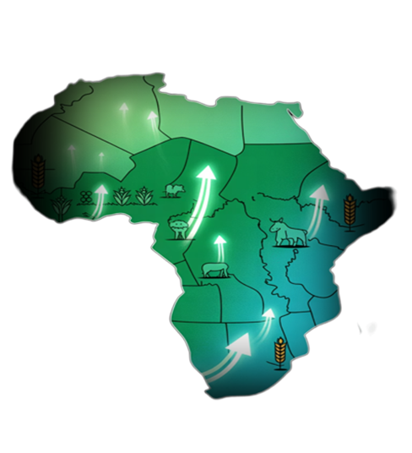
Why this Committee Matters
“Empowering Africa’s future, one seed at a time”
Visibility: Boost visibility & recognition of AFSTA as apex body and authoritative voice of the seed industry in Africa.
Influence where it counts: Drive evidence-based advocacy for policy & regulatory harmonization, by linking national, regional, and continental advocacy efforts.
Work better together: Strengthen seed sector’s ability to speak clearly, act collectively, and influence effectively.

Slide 8
ACAC Performance Indicators
👥
📰
📋
Media Presence
Message Penetration
Member Satisfaction
Increase in favorable media coverage and mentions of AFSTA and the seed industry in key regional publications.
Successful adoption of AFSTA's key advocacy messages in policy and regulatory frameworks.
Increased membership and improved member perception of AFSTA's communication and advocacy efforts, reflected in satisfaction surveys.
⚖️
📱
Advocacy Outcomes
Digital Reach
Quantifiable policy or regulatory changes influenced by AFSTA's advocacy, such as regional alignment of seed laws.
Growth in followers and engagement on AFSTA digital platforms.

Slide 9
Call to Action
Strong advocacy is fuelled by data and stories.
Send us your stories!
Strategic communication comes from strong Member engagement.
Partner with us: we are here to make our lovely sector more visible!

Slide 10
Let’s Talk
Contact us: maya.muller@eastwestseed.com

