Slide 1




Tackling Counterfeit Seed:
Case Study from a Kenyan Seed Company.

Slide 2
The Role of Plant Variety Protection in Protecting Innovation and Combatting Illegal Seed Practices
24th March 2026
Presented by : David Tum
Simlaw Seeds Company Limited
Notes:
Good morning, everyone.
Seed is the most fundamental input in agriculture. Every planting season, millions of farmers rely on seed companies to provide improved varieties that increase productivity and resilience.
However, counterfeit seed is becoming a major threat to farmers, innovation, and food security.
Today, I will share a case study from a Kenyan seed company, highlighting the challenges posed by counterfeit seed and how plant variety protection and other strategies can help address this problem.

Slide 3
Situation in Kenya:
Definition of Counterfeiting: Counterfeit good are items that imitate genuine products, infringing on trademarks or intellectual property, including fake packaging and labels.
In Kenya, the law on counterfeiting is primarily governed by the Anti-Counterfeit Act, 2008, which was enacted to prohibit trade in counterfeit goods and protect intellectual property rights (IPR).
Seed Industry in Kenya is regulated by Kenya Plant Health Inspectorate Service (KEPHIS) under The Seeds and Plant Variety Act CHAPTER 326.
Under the Seeds and Plant Varieties Act (Cap 326), the law does not use the specific word "counterfeit" in its primary text, but it strictly prohibits the sale of uncertified, fake, or misrepresented seeds. This Act is the primary framework for ensuring seed quality and protecting the rights of plant breeders.
Notes:
Counterfeit seed remains a persistent challenge in Kenya’s seed system. During planting seasons, farmers may unknowingly buy fake seed that looks identical to genuine products.

Slide 4
Kenyan Seed Market outlook
Situation in Kenya:
Key statistics:
Kenya’s agriculture sector is a vital contributor to the country’s economy, accounting for 26% of the GDP and providing employment to over 40% of the population (KNBS, 2020).
A recent study by the Kenya Association of Manufacturers (KAM) and the Anti-Counterfeit Agency (ACA) revealed that up to 30% of seeds and fertilizers in the Kenyan market are counterfeit (KAM, 2021).
A 2018 report by the Overseas Development Institute (ODI) estimates that the annual cost of counterfeit inputs to Kenya’s agriculture sector is approximately USD 80 Million (ODI, 2018).
Notes:
Counterfeit seed remains a persistent challenge in Kenya’s seed system. During planting seasons, farmers may unknowingly buy fake seed that looks identical to genuine products.

Slide 5
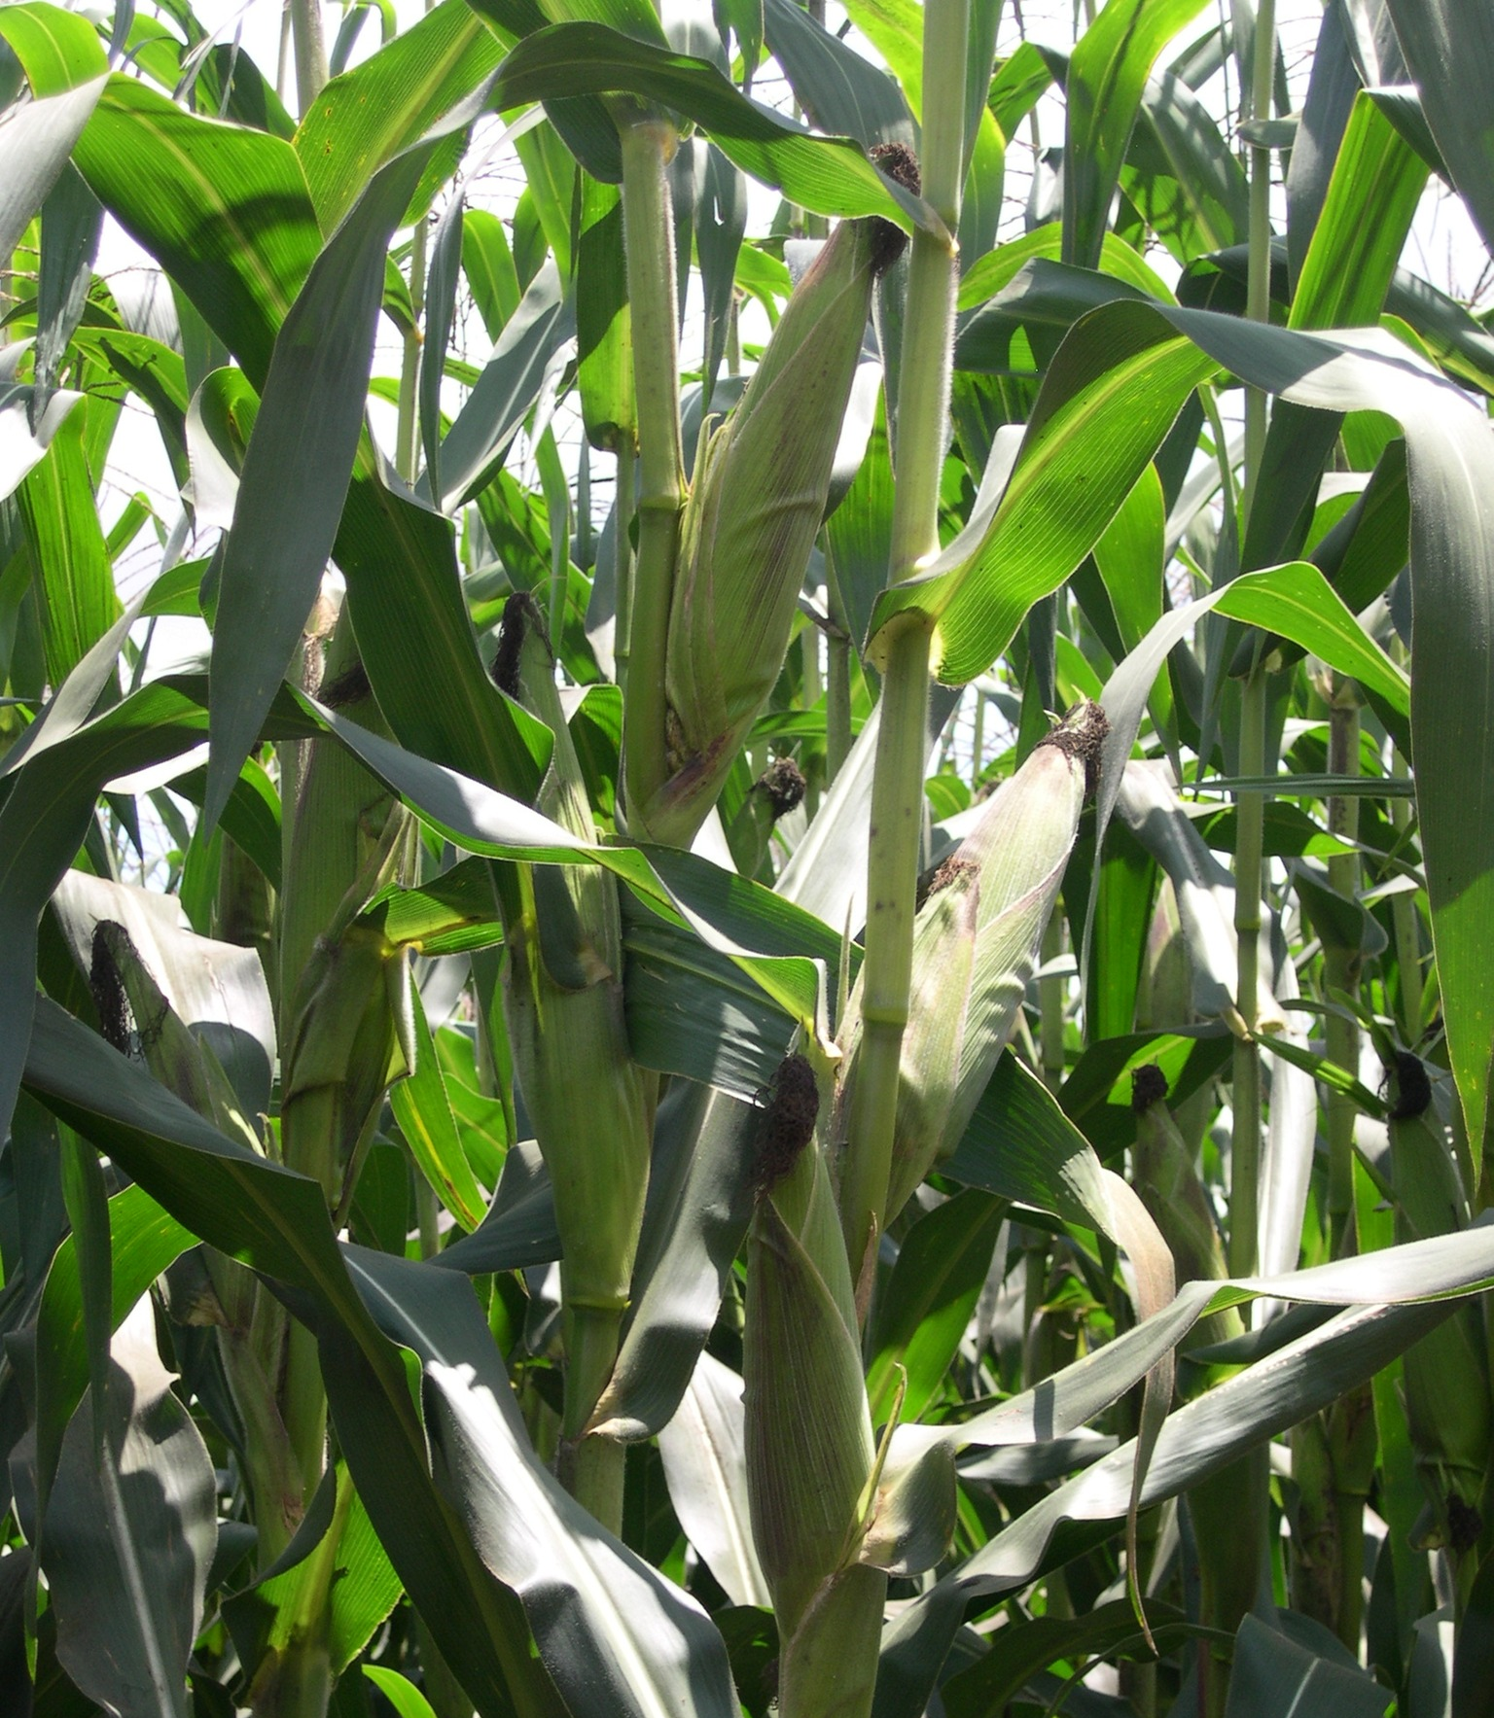
What are we protecting
By Fighting Counterfeit?
Consumer Assurance.
Variety attributes:
  Higher yields
  Climate resilience
  Disease resistance
Economic Sabotage.
  Food Insecurity
  Reduced GDP
  Profitability Decline(Company & Farmer).
  Integrity of the Seed Sector
Innovation.
  Infringements of plant Breeders Rights
  Incentive to Innovate
  Brand Reputation
Notes:
Improved seed varieties developed by breeders play a critical role in agricultural productivity. In crops like maize, improved hybrids can increase yields significantly compared to recycled grain. However, when farmers unknowingly purchase counterfeit seed, they lose these benefits.

Slide 6
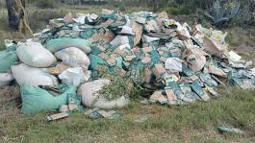

Recent Major Cases and Seizures (2024–2026)
Nakuru (2025): Authorities seized and destroyed 30 tons of uncertified seeds and packaging materials after successful prosecutions in court valued at over USD 77, 000.
Busia (2025): A seizure of 160 bags of fake bean seeds and unmarked cotton seeds was reported in September valued at over USD 33, 000.
Narok (2025): Detectives arrested two traders and a supervisor for selling fake Hybrid 6213 maize seeds. They recovered 1,700 bales (10 tonnes) of stolen and counterfeit seeds valued at over USD 50, 000.
Nakuru/Njoro (2024): In March, 13,000 packets of counterfeit maize seeds were confiscated. The raid recovered 18 bags of raw maize, 34,708 fake Kenya Seed Company stickers, and sewing machines used for illegal packaging valued over USD 74,000.
Kisii and Nyamira (2024): Seven traders were arrested in January for selling roughly 310kg of uncertified seeds without licenses during a two-week surveillance operation value over USD 23,000.
Kericho (2023/2024): Four traders were arrested across various trading centres for using red oxide to dye ordinary grains and selling them as certified seeds.
Notes:
In this case study, the company discovered counterfeit seed being sold under its brand name. Farmers who purchased these products reported poor crop performance.
In 2018, Freshco Seeds was accused of packaging and distributing over 13,200 kg of fake seeds in Nakuru, Kenya, including maize, green grams, soybeans, and sorghum. KEPHIS shut down their godown at NCPB Nakuru after finding uncertified seeds with fake lot numbers. These seeds had failed germination tests, posing significant risks to food security.
Githunguri Agent. Other areas of concern Export market

Slide 7
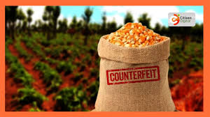
Factors influencing Counterfeit Seeds
Popular Seed Variety unavailability.
Quick returns.
Unhealthy competition.
Lack of coordinated enforcement.
Lack of market intelligence/Surveys.

Slide 8
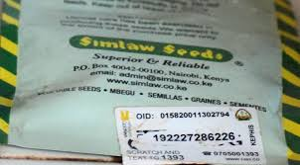
Measures to Combat Counterfeit Seed
Company Strategies
Collaborations: Seed Companies(STAK), Anti Counterfeit Authority & Seed Regulators.
Tamper-proof packaging materials.
Authentication labels/QR Codes
KEPHIS verification sticker labels.
Distribution through Authorized & vetted Agro-dealers
Notes:
In this case study, the company discovered counterfeit seed being sold under its brand name. Farmers who purchased these products reported poor crop performance.

Slide 9
Measures to Combat Counterfeit Seed
Preventative Measures-Internal
Lot Numbers on the Packages
Unique Packaging materials .
Contracting trusted Seed Growers/Suppliers.
Staff Integrity & Security Intelligence
Market Intelligent and periodic Surveys
Notes:
In this case study, the company discovered counterfeit seed being sold under its brand name. Farmers who purchased these products reported poor crop performance.

Slide 10
Kenya’s Seed Verification System
Digital Seed Verification
Kenya introduced verification sticker labels.
Farmers can:
Scratch the label
Send the code via SMS
Receive confirmation that the seed is genuine
This system significantly reduced counterfeit seed cases.
Notes:
Digital verification systems have become an important tool for combating counterfeit seed in Kenya.

Slide 11

Limitations of the Law in Fighting Counterfeit
•Lenient Fines and sentencing.
According to The Seed and Plant Varieties Act Cap 326 , Individuals convicted of dealing in fake seeds face:
- Fine upto1 Million or Jail Term up to 2 Years or Forfeiture of the seized seeds.
Underfunding of Enforcement Agencies.
  Monitoring gaps
Multi Agencies Operating in Silos.
Porous Boarders
Notes:
Combating counterfeit seed requires a combination of legal, technological, and educational approaches.

Slide 12
Closing Statement
Counterfeit seed is not only a business problem.
It is a farmer livelihood problem, a food security problem, and an innovation problem.
By strengthening plant variety protection, improving traceability systems, and empowering farmers with information, we can build a seed system that rewards innovation and protects farmers.

Slide 13
THANK YOU
“One fake friend can do more harm than 10 enemies…be smart choosing your friends”.
(Ziad Abdelnour)

