Slide 1
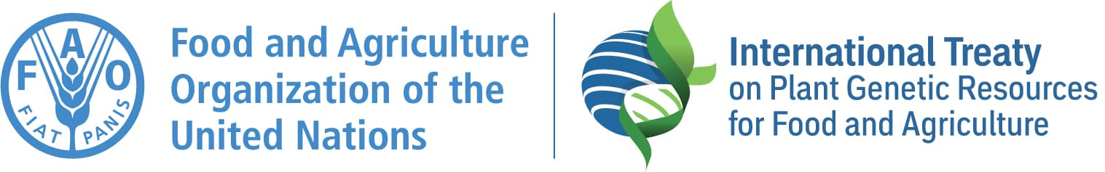
The International Treaty – 20 years later: Where are we now and what are the implications for Africa?
Dr. Kent Nnadozie
Secretary, FAO International Treaty on Plant Genetic Resources for Food and Agriculture
26th AFSTA Annual Congress| Cape Town | 23 March 2026
Notes:
During this period, the Secretariat has been reviewing all the information available about the MLS and the SMTA in different online platforms and has developed a new website section for the Multilateral System.
The new section improves the way in which the information and resources are presented. All the texts that were already published, have been reviewed, updated and supplemented as needed by an editorial group at the Secretariat. They are under translation and will be available in all the official languages very soon.

Slide 2
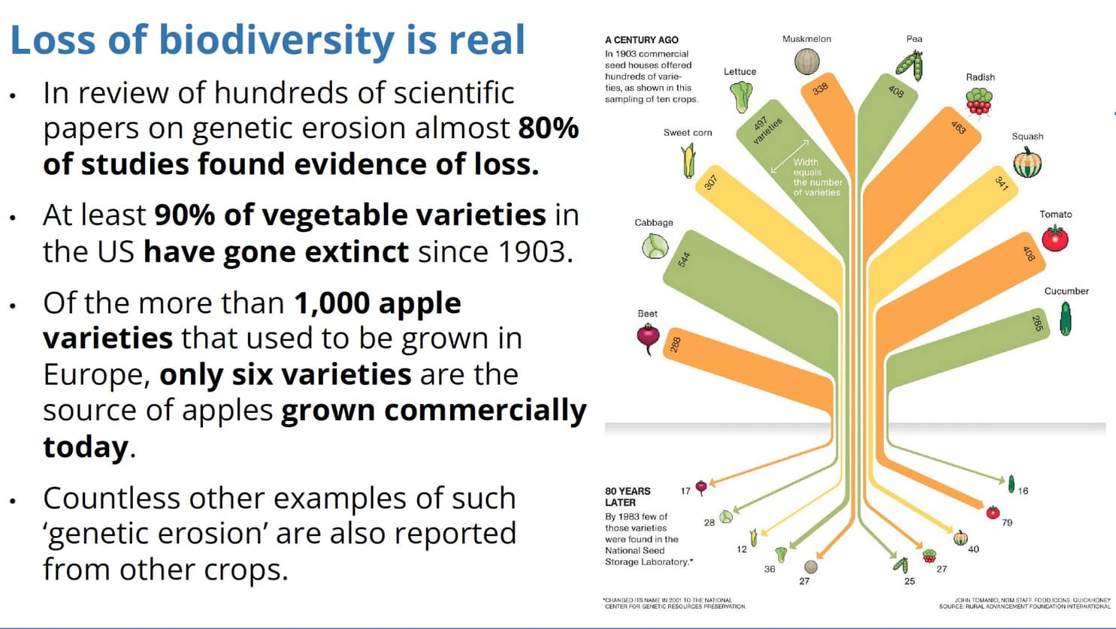

Slide 3
The Background
Seed systems and crop diversity are under pressure;
Innovation depends on genetic resources;
No country or region is self-sufficient in GR;
Continuous international exchange is critical;
The challenges are cross-boundary and require multilateral approach;
Hence the International Plant Treaty

Slide 4
The Plant Treaty at a glance
Legally binding global agreement in force since 2004 with 155 countries as Contracting Parties
Supports the conservation of crop diversity, promotes sustainable use, and fosters fair benefit-sharing
Key mechanisms: Multilateral System, Global Information System, Funding Strategy and Benefit‑sharing Fund
Recognizes Farmers’ Rights and supports conservation and sustainable use worldwide

Slide 5
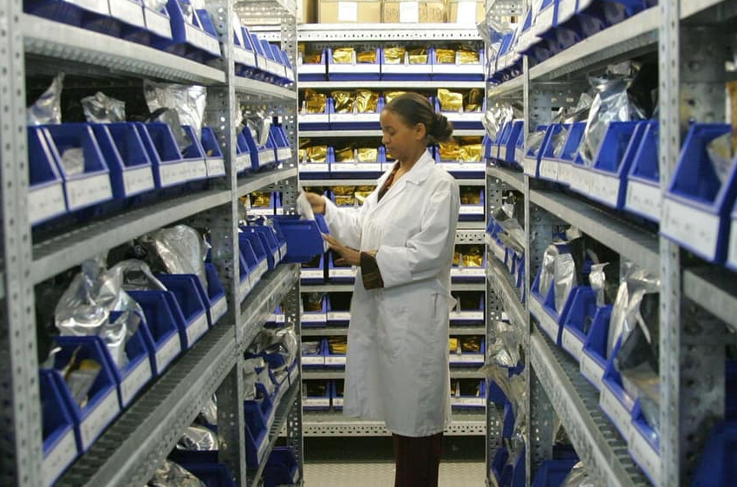
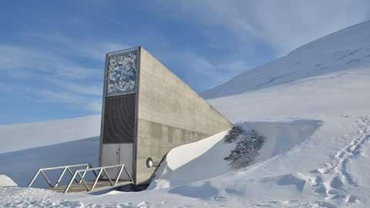

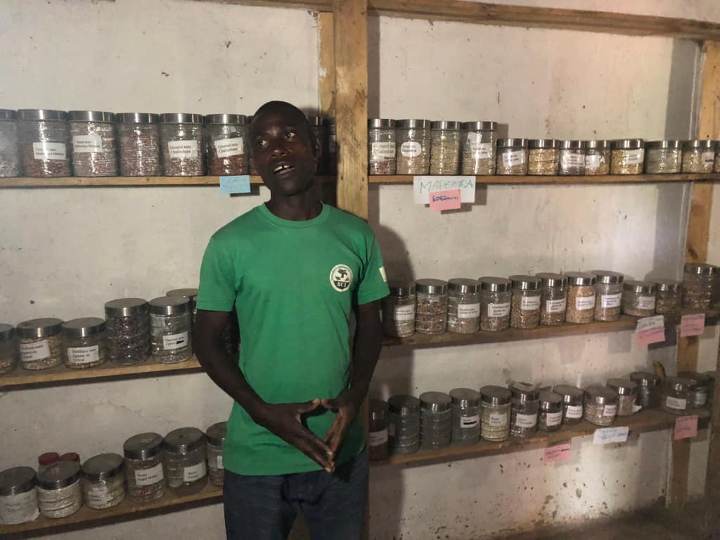
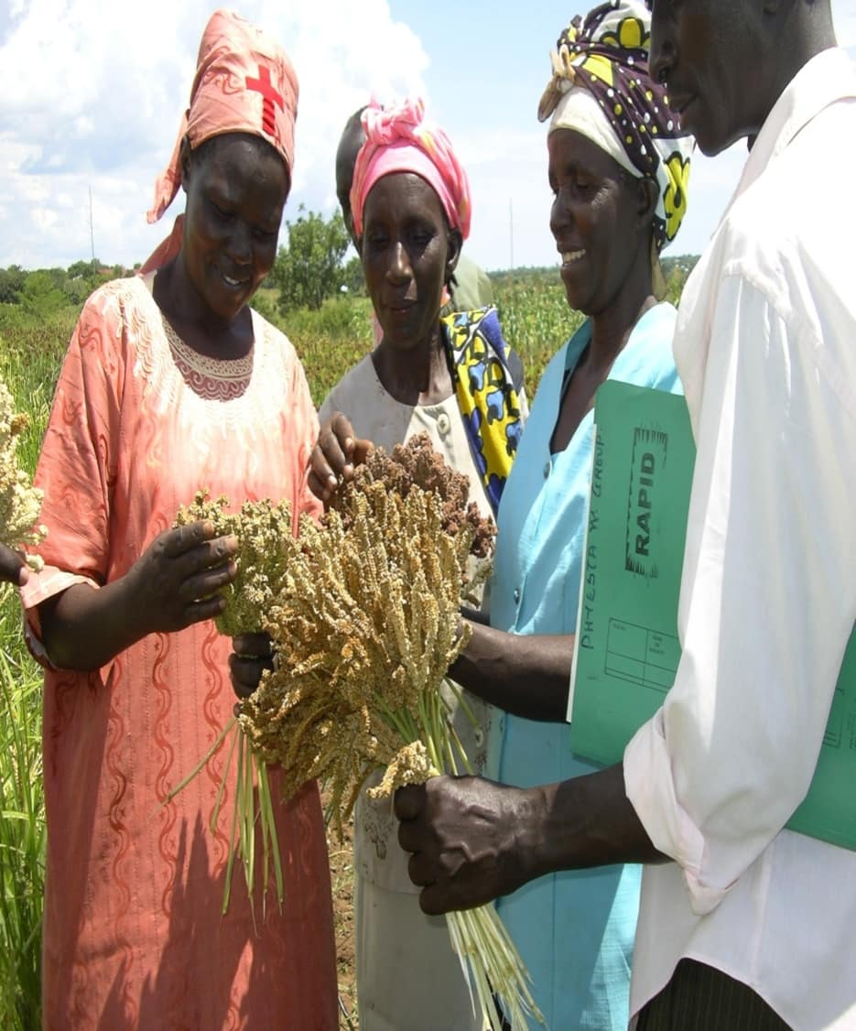
ILRI Genebank
Svalbard Global Seed Vault, Norway
International Legal Framework connecting the local to the global
Community Seed Bank, Malawi

Slide 6
From Conservation to Use
Genebanks safeguard diversity
Community seed banks strengthen local systems
Svalbard Global Seed Vault provides backup
Benefit-sharing fund supports local projects
Multilateral System supports global breeding systems

Slide 7
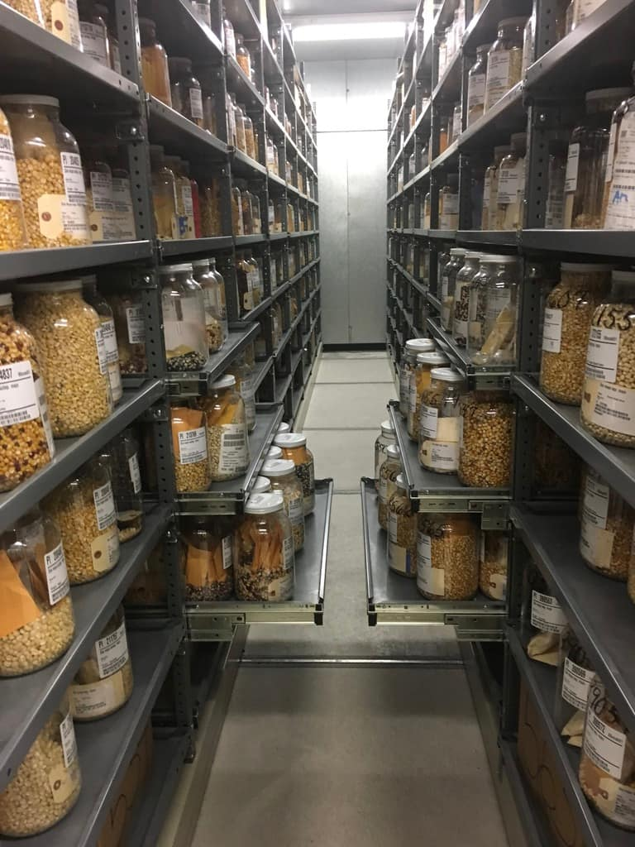


FROM FRIDGE TO FRIDGE
Notes:
Alongside the official International Treaty text, this first deposit to the Arctic World Archive also preserves four testimonial stories showing how the International Treaty works in practice.
- In Peru, Indigenous farmers conserve the world’s potato diversity through community seed banks that bring together ancestral knowledge and scientific conservation.
- In India, farming communities are reviving millets and other underused crops, strengthening nutrition, resilience, and local food cultures.
- In Serbia, researchers and farmers are rediscovering traditional cereals and using them to develop new climate‑resilient varieties for the future.
- And in Pacific Island countries, regional cooperation helps conserve and share staple crops that are vital for food security across isolated islands.
These stories remind us that plant genetic resources are inseparable from the knowledge, practices, and people who sustain them.

Slide 8
20 Years Later: Reality Check
Access system works, but needs expansion;
Conservation efforts significantly enhanced;
Benefit-sharing remains very limited;
Private sector engagement uneven, esp. from Africa;
Still many outstanding issues + existing tensions;
GB-11 outcomes/non-outcomes;
New and emerging issues.
Notes:
Alongside the official International Treaty text, this first deposit to the Arctic World Archive also preserves four testimonial stories showing how the International Treaty works in practice.
- In Peru, Indigenous farmers conserve the world’s potato diversity through community seed banks that bring together ancestral knowledge and scientific conservation.
- In India, farming communities are reviving millets and other underused crops, strengthening nutrition, resilience, and local food cultures.
- In Serbia, researchers and farmers are rediscovering traditional cereals and using them to develop new climate‑resilient varieties for the future.
- And in Pacific Island countries, regional cooperation helps conserve and share staple crops that are vital for food security across isolated islands.
These stories remind us that plant genetic resources are inseparable from the knowledge, practices, and people who sustain them.

Slide 9
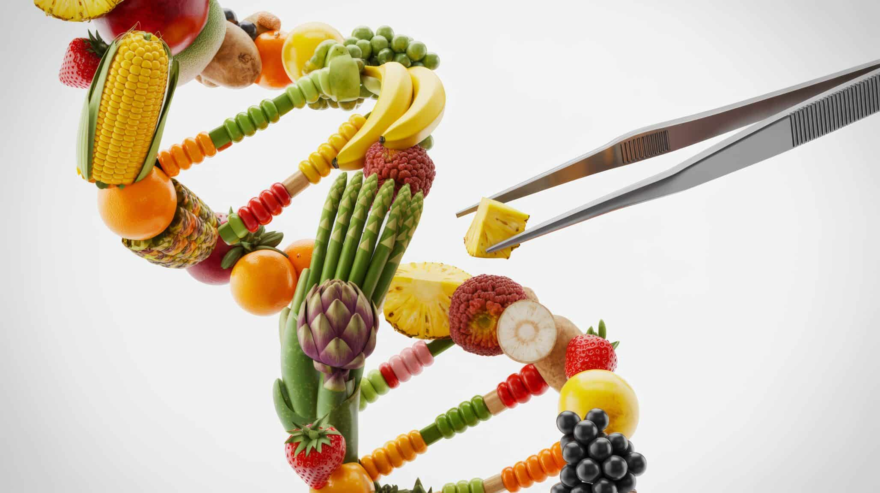
All biological material is encoded information:
genetic sequence data in DNA

Slide 10

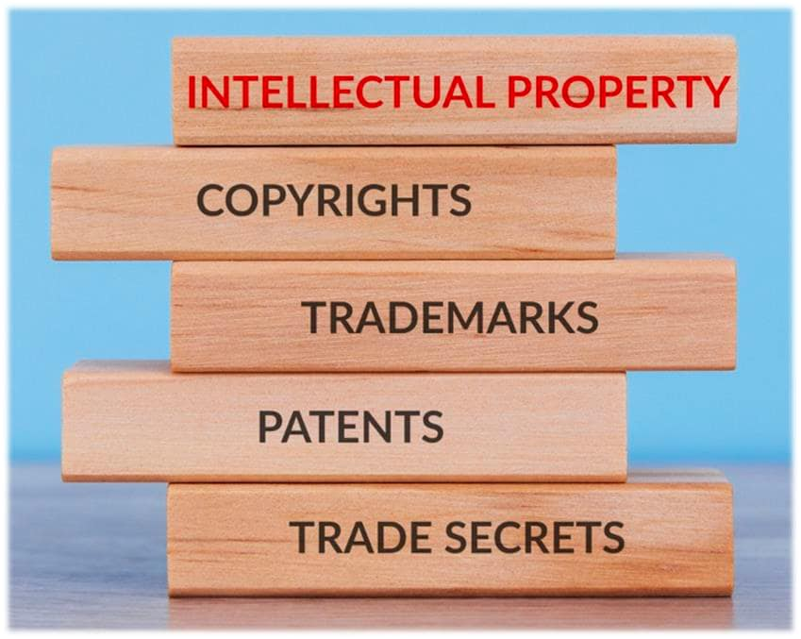
Data Ownership and Governance
Benefit-sharing related to digital sequence information.
Open science vs proprietary genomic databases.
Intellectual property around new genomic technologies.
Benefit-sharing in the emerging era of agentic AI-driven breeding.

Slide 11
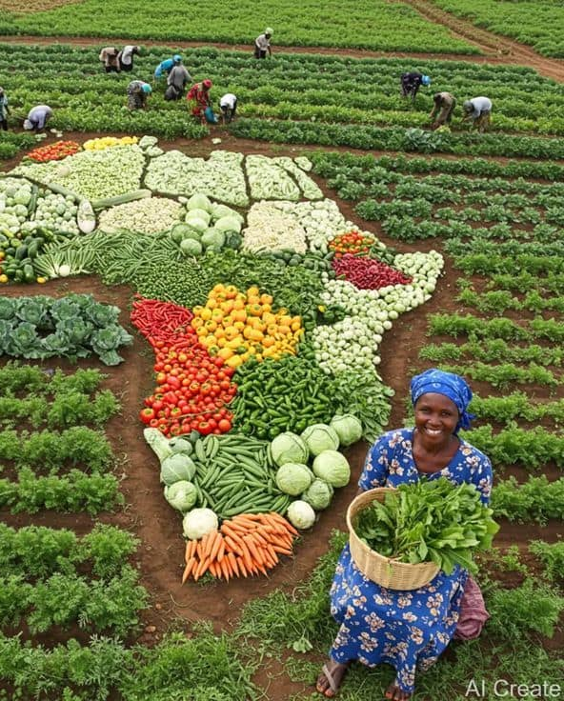
What Does it all mean for Africa?
The Paradox:
Africa: 7,000+ edible plant species;
Yet, 4 crops (maize, rice, cassava & wheat) = nearly 60% of calories intake (FAO);
Still, Africa spends US$75B/year on food imports (AfDB).
Notes:
Alongside the official International Treaty text, this first deposit to the Arctic World Archive also preserves four testimonial stories showing how the International Treaty works in practice.
- In Peru, Indigenous farmers conserve the world’s potato diversity through community seed banks that bring together ancestral knowledge and scientific conservation.
- In India, farming communities are reviving millets and other underused crops, strengthening nutrition, resilience, and local food cultures.
- In Serbia, researchers and farmers are rediscovering traditional cereals and using them to develop new climate‑resilient varieties for the future.
- And in Pacific Island countries, regional cooperation helps conserve and share staple crops that are vital for food security across isolated islands.
These stories remind us that plant genetic resources are inseparable from the knowledge, practices, and people who sustain them.

Slide 12
The Barriers
Underinvestment in research & breeding
Market neglect
Policy blind spots
Notes:
Alongside the official International Treaty text, this first deposit to the Arctic World Archive also preserves four testimonial stories showing how the International Treaty works in practice.
- In Peru, Indigenous farmers conserve the world’s potato diversity through community seed banks that bring together ancestral knowledge and scientific conservation.
- In India, farming communities are reviving millets and other underused crops, strengthening nutrition, resilience, and local food cultures.
- In Serbia, researchers and farmers are rediscovering traditional cereals and using them to develop new climate‑resilient varieties for the future.
- And in Pacific Island countries, regional cooperation helps conserve and share staple crops that are vital for food security across isolated islands.
These stories remind us that plant genetic resources are inseparable from the knowledge, practices, and people who sustain them.

Slide 13
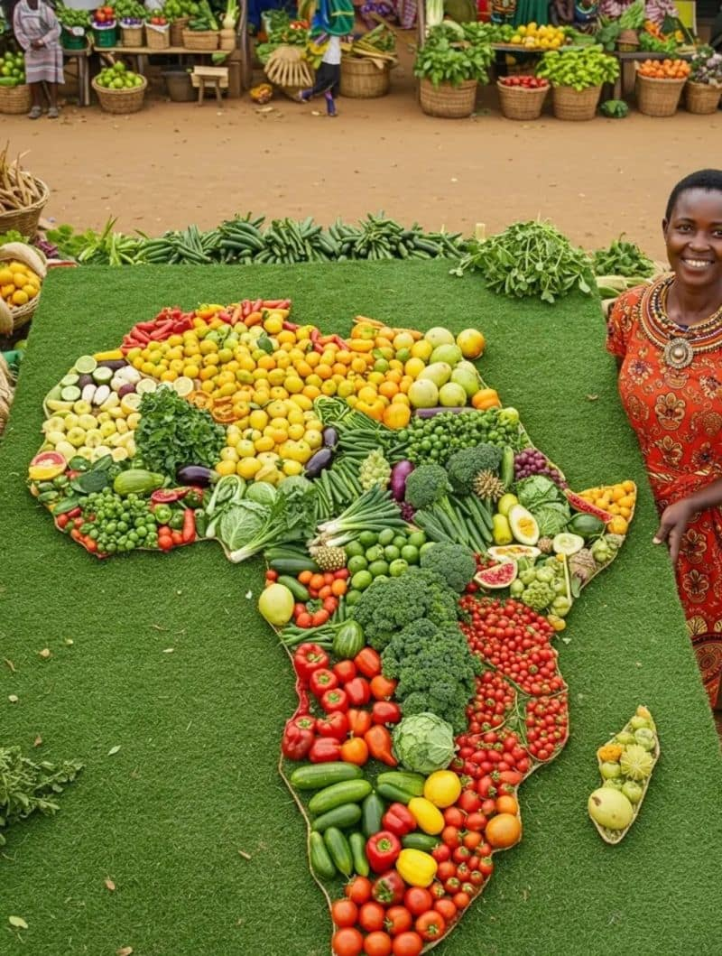
Africa’s Strategic Position & Opportunity
Centre of Crop Diversity
Growing Seed Markets & Demand
Notes:
Alongside the official International Treaty text, this first deposit to the Arctic World Archive also preserves four testimonial stories showing how the International Treaty works in practice.
- In Peru, Indigenous farmers conserve the world’s potato diversity through community seed banks that bring together ancestral knowledge and scientific conservation.
- In India, farming communities are reviving millets and other underused crops, strengthening nutrition, resilience, and local food cultures.
- In Serbia, researchers and farmers are rediscovering traditional cereals and using them to develop new climate‑resilient varieties for the future.
- And in Pacific Island countries, regional cooperation helps conserve and share staple crops that are vital for food security across isolated islands.
These stories remind us that plant genetic resources are inseparable from the knowledge, practices, and people who sustain them.

Slide 14
3 Shifts required for Change
Policy: mainstream crops in national strategies;
Investment: fund conservation & breeding;
Mindset: Seeds are more than “inputs”.
Notes:
Alongside the official International Treaty text, this first deposit to the Arctic World Archive also preserves four testimonial stories showing how the International Treaty works in practice.
- In Peru, Indigenous farmers conserve the world’s potato diversity through community seed banks that bring together ancestral knowledge and scientific conservation.
- In India, farming communities are reviving millets and other underused crops, strengthening nutrition, resilience, and local food cultures.
- In Serbia, researchers and farmers are rediscovering traditional cereals and using them to develop new climate‑resilient varieties for the future.
- And in Pacific Island countries, regional cooperation helps conserve and share staple crops that are vital for food security across isolated islands.
These stories remind us that plant genetic resources are inseparable from the knowledge, practices, and people who sustain them.

Slide 15
Call to the African Seed Industry
Engage more actively in the Plant Treaty and other international policy forums;
Partner more/better with the public sector;
Invest in African breeding pipelines.
Notes:
Alongside the official International Treaty text, this first deposit to the Arctic World Archive also preserves four testimonial stories showing how the International Treaty works in practice.
- In Peru, Indigenous farmers conserve the world’s potato diversity through community seed banks that bring together ancestral knowledge and scientific conservation.
- In India, farming communities are reviving millets and other underused crops, strengthening nutrition, resilience, and local food cultures.
- In Serbia, researchers and farmers are rediscovering traditional cereals and using them to develop new climate‑resilient varieties for the future.
- And in Pacific Island countries, regional cooperation helps conserve and share staple crops that are vital for food security across isolated islands.
These stories remind us that plant genetic resources are inseparable from the knowledge, practices, and people who sustain them.

Slide 16
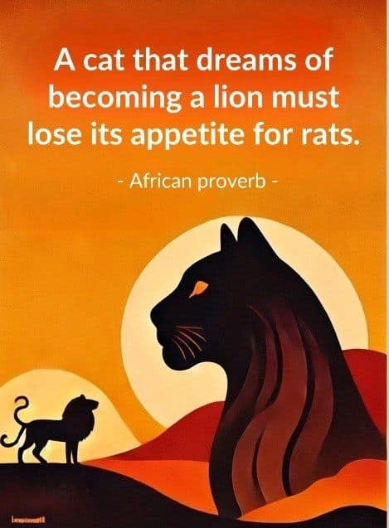
Final Message
The system exists
The opportunity is clear
The question is: will you participate in shaping the future?
Notes:
Alongside the official International Treaty text, this first deposit to the Arctic World Archive also preserves four testimonial stories showing how the International Treaty works in practice.
- In Peru, Indigenous farmers conserve the world’s potato diversity through community seed banks that bring together ancestral knowledge and scientific conservation.
- In India, farming communities are reviving millets and other underused crops, strengthening nutrition, resilience, and local food cultures.
- In Serbia, researchers and farmers are rediscovering traditional cereals and using them to develop new climate‑resilient varieties for the future.
- And in Pacific Island countries, regional cooperation helps conserve and share staple crops that are vital for food security across isolated islands.
These stories remind us that plant genetic resources are inseparable from the knowledge, practices, and people who sustain them.

