Slide 1
Thanks to MATEXIL for organizing &
members for attending
Manmade Fibre Textiles & Technical Textile
Market access techniques
Market dynamics, change in fashion trends & demand, consumer behaviour, global ecosystem, sustainability issues, ESG Regulations and other regulatory compliances,

Slide 2
Global trade data
World economy : US$ 112 trillion
USA : US$ 27.2 trillion
China : US$ 19.3 trillion
Germany : US$ 4.4 trillion
(EU : US$ 18.1 trillion )
Japan : US$ 4.3 trillion
India : US$ 4.0 trillion
US$ 5 trillion economy
Developed country by 2047
India exports for 2020-21 was US$499B
India exports for 2021-22 was US$676B, a 36 % increase from 2021.
India exports for 2022-23 was US$760B, a 12.5% increase from 2022.
India exports for 2023-24 was US$ 778B, a 2.4% growth.
Merchandise exports was US$ 437
billion, while services exports rose to
US$ 341 billion. ( 3380 - 25 )
US$2000 Billion by 2030.

Slide 3
Innovation
Exports
Equity
Eco Friendly - ESG

Slide 4
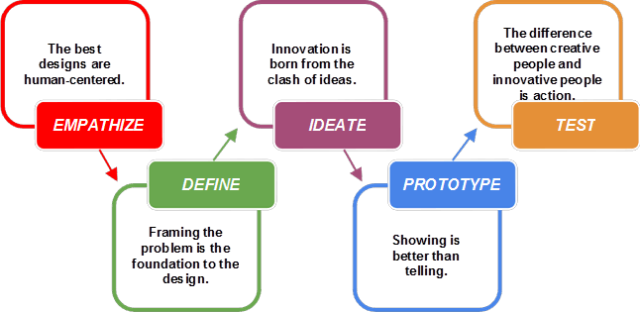
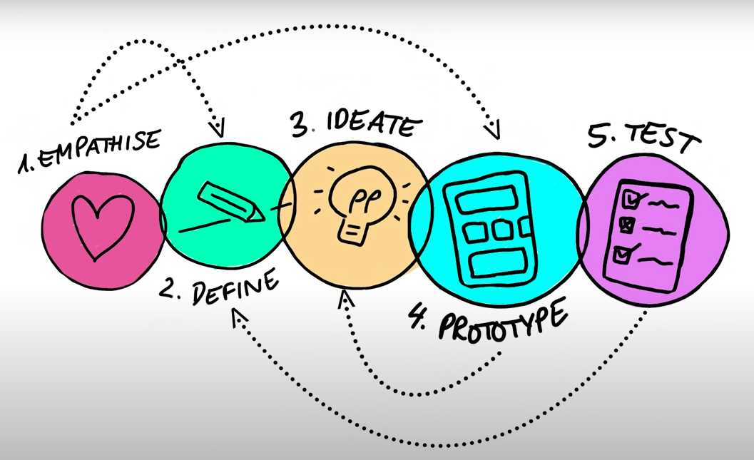
Design thinking for innovation & competitiveness A philosophy or mindset with a set of tools having human centred approach
Ideas / Solutions
Real time with real users : Feedback
Interview people
Needs / Challenges
Select few ideas

Slide 5
Now permanent constant is change
Either be an agent of change
or a victim of change
KEY-DW

Slide 6
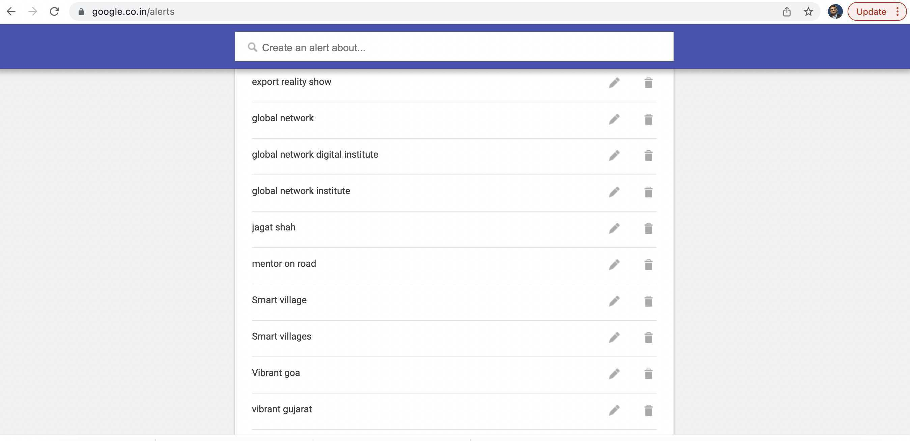
www.google.com/alerts

Slide 7
Market dynamics, change in fashion trends & demand, consumer behaviour
https://www.lloydsbanktrade.com
https://www.matexil.org/HSCODE

Slide 8
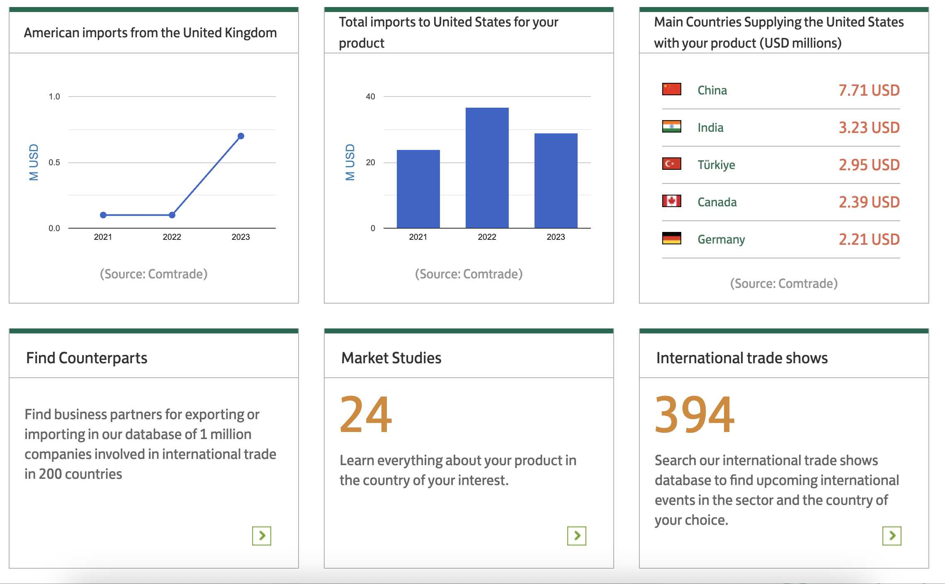
https://www.lloydsbanktrade.com

Slide 9
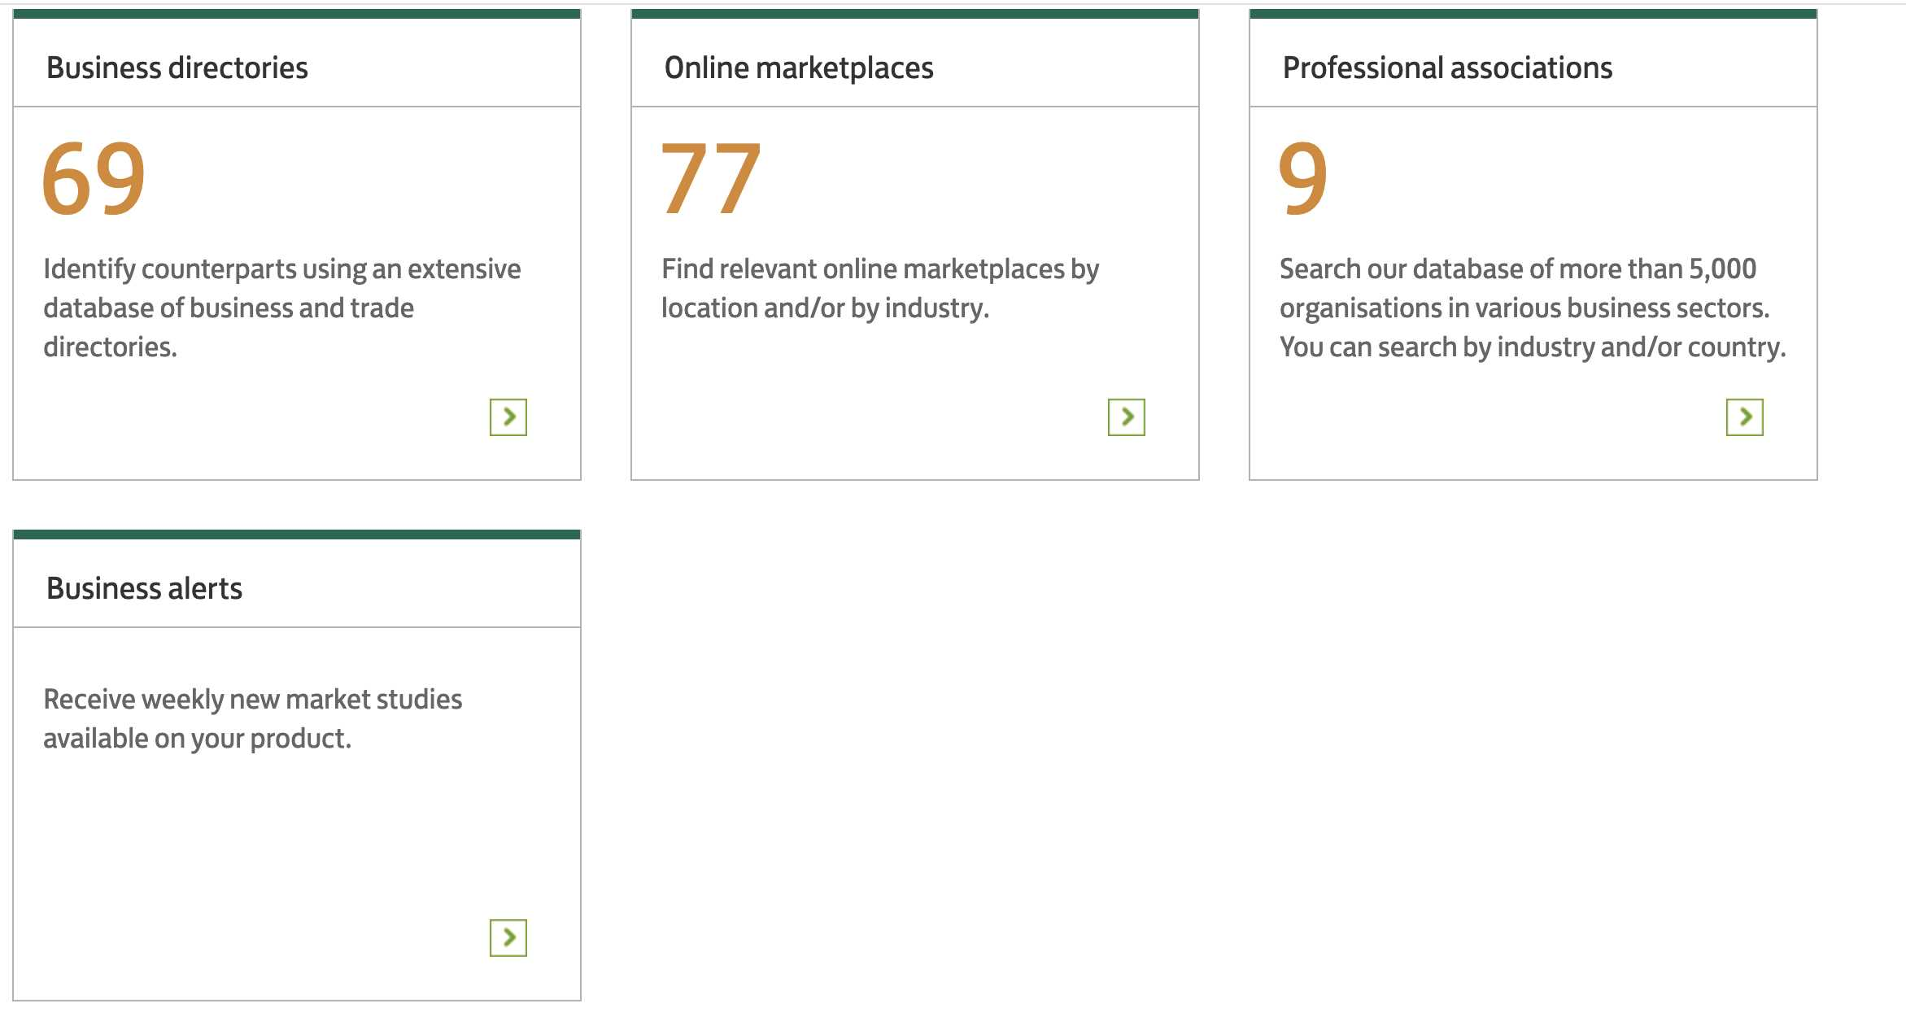
https://www.lloydsbanktrade.com

Slide 10
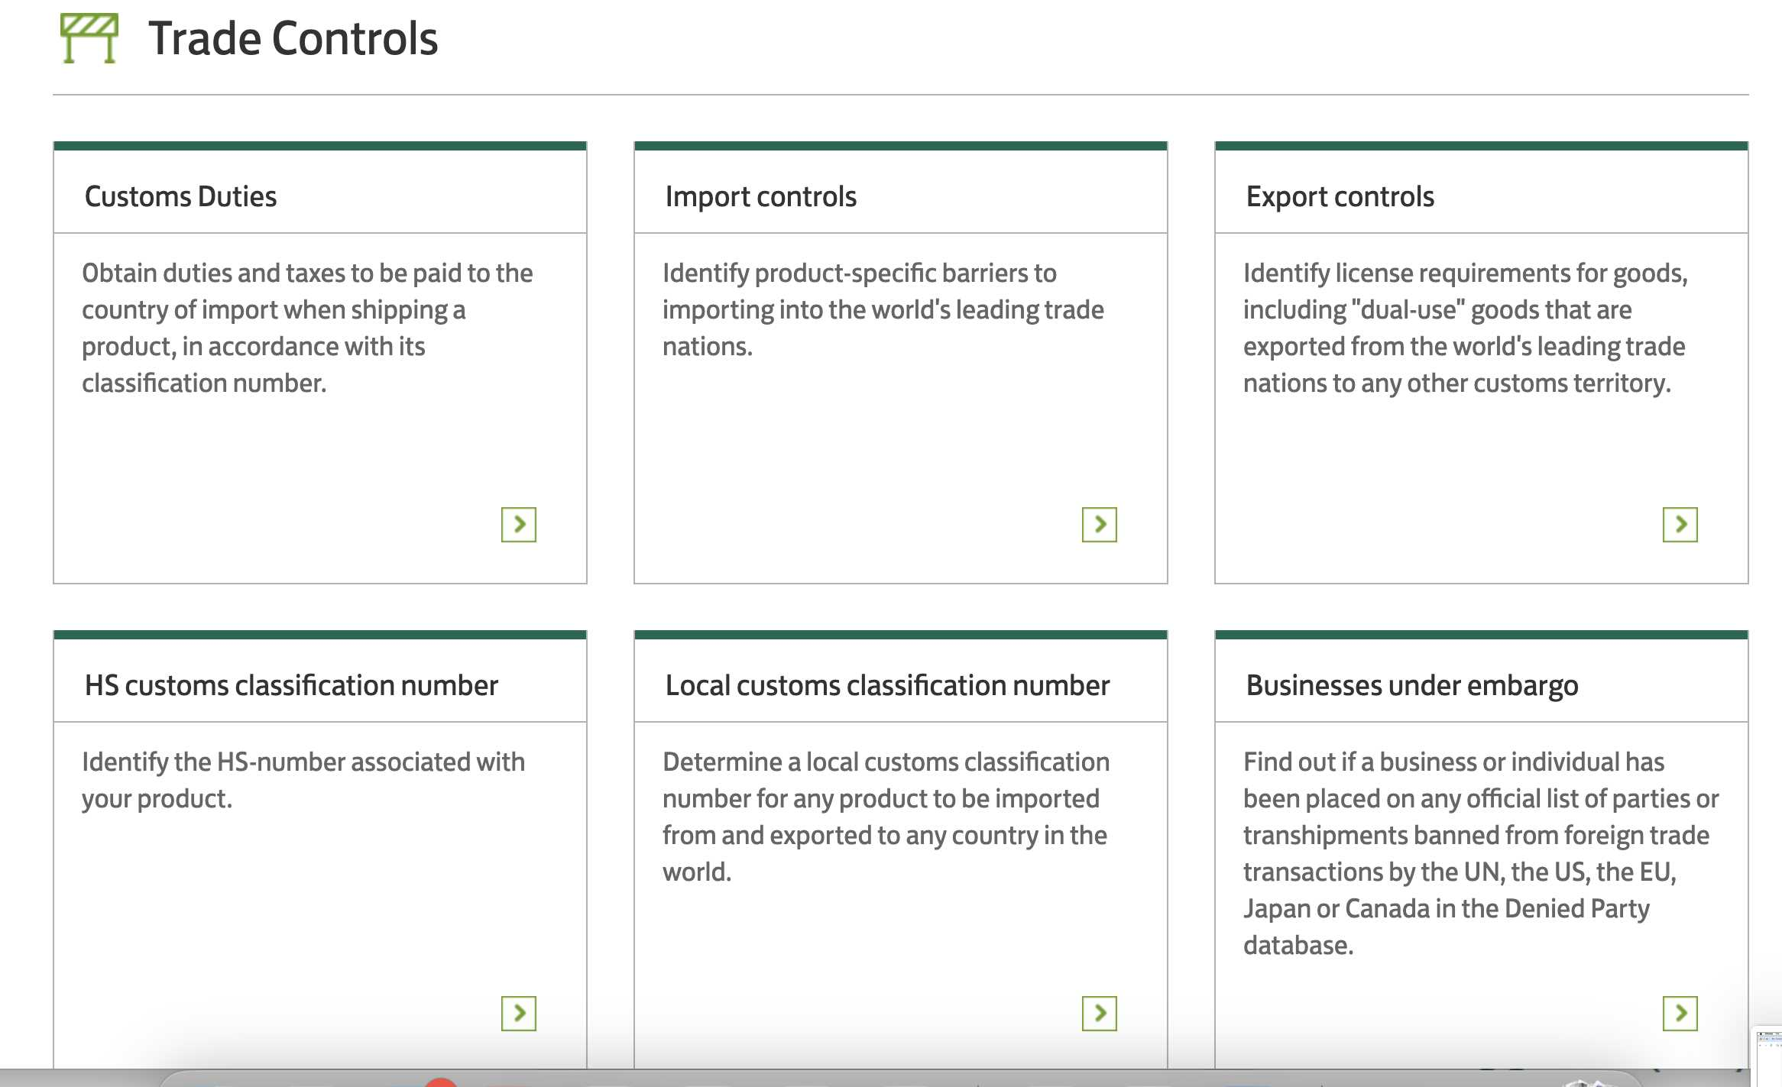
https://www.lloydsbanktrade.com

Slide 11
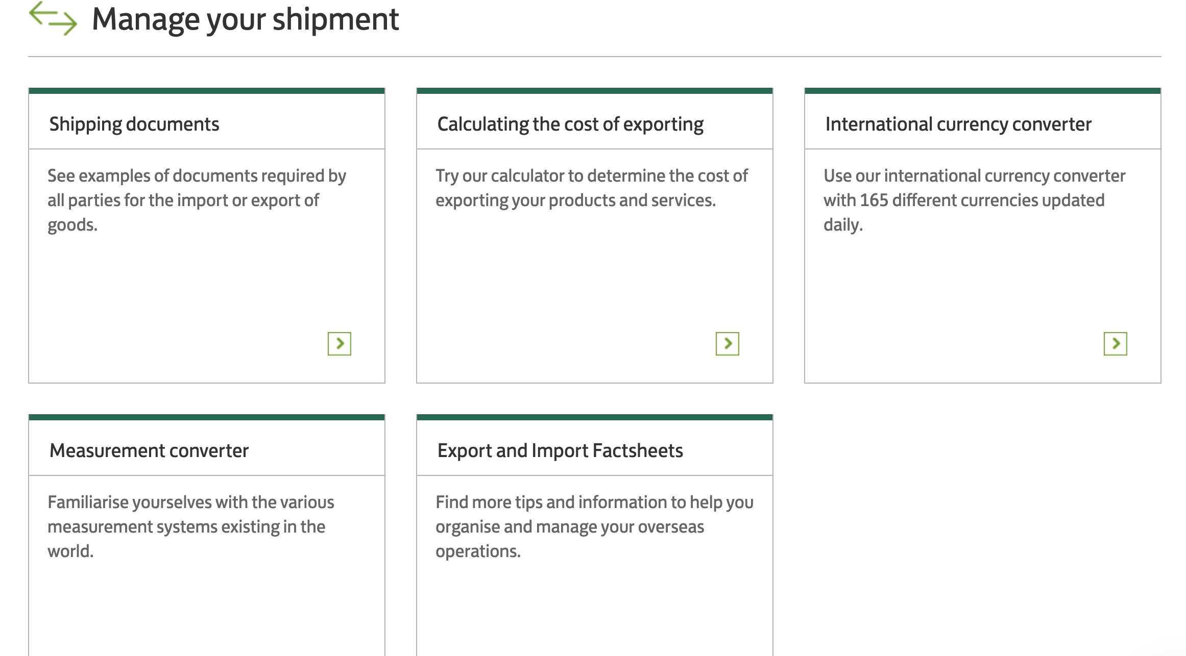
https://www.lloydsbanktrade.com

Slide 12
What is innovation
T Shirt
Doing one thing better than anyone else in your business or profession.

Slide 13
2 main factors in Exports
Preparation 50%
Market 50%

Slide 14
10 Approaches of entering export markets
Generating Importer leads - SPANCO ( HS Code )
Strategic institutional sales – US & EU Tenders, UN
Opening office or warehouse abroad
Online E Comm Sales approach as a tool of Global business
Visit abroad with a B2B meeting plan ( 2 Months plan in advance )
Agent appointment abroad
Participating in an overseas expo / Virtual EXPO / Webinar
Joint venture route with overseas companies (Importers)
Exporting through merchant exporters
Franchise / Brand approach

Slide 17
ART & SCIENCE OF EXPORTS Data based HS Code
S – SUSPECT ( COUNTRY ) Countries 5
https://commerce.gov.in/
P – PROSPECT ( IMPORTER ) Companies 10
A – APPROACH ( CONTACT )
People MAN ( She \ He ) Linkedin / Sales navigator / Apollo.io / Dripify
N – NEGOTIATE ( What ? )
C – CLOSE ( ART FORM )
Reliability, competency, integrity, vulnerability, lead with empathy
O – ORDER ( FORMAT ) PI / PO

Slide 18
SPANCO approach of exports HS code
DEMO

Slide 20
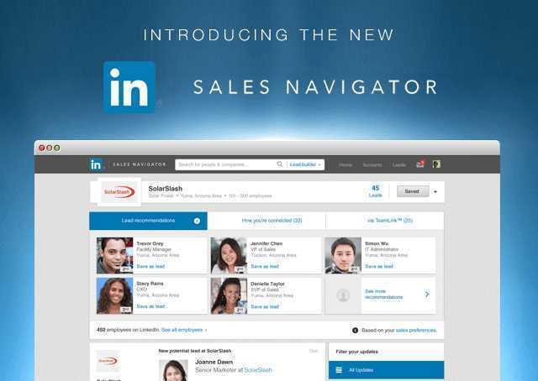
Linkedin & Sales navigator

Slide 21
www.apollo.io

Slide 22
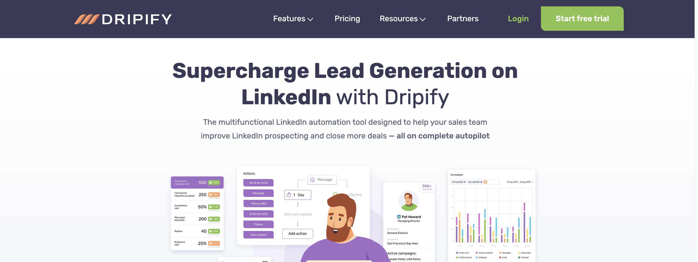
https://dripify.io/

Slide 23
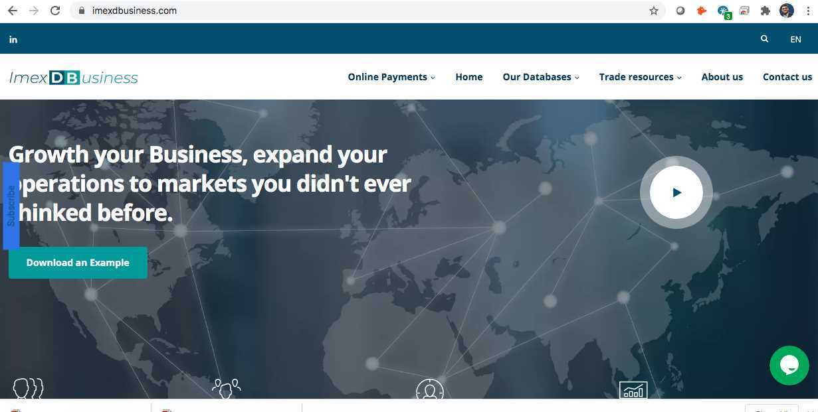
1 HS code exports of one year from India www.imexdbusiness.com Email : jtautiva@imexdbusiness.com

Slide 24
For US customs www.importgenius.com

Slide 25
https://www.europages.co.uk/

Slide 26
10 Approaches of entering export markets
Generating Importer leads - SPANCO ( HS Code )
Strategic institutional sales – US & EU Tenders, UN
Opening office or warehouse abroad
Online E Comm Sales approach as a tool of Global business
Visit abroad with a B2B meeting plan ( 2 Months plan in advance )
Agent appointment abroad
Participating in an overseas expo / Virtual EXPO / Webinar
Joint venture route with overseas companies (Importers)
Exporting through merchant exporters
Franchise / Brand approach

Slide 27
UNGM – 30 Supporting Agencies https://www.youtube.com/watch?v=wBM_F-TS9a0
AfDB African Development Bank
ADB Asian Development Bank
FAO Food and Agriculture Organization of the United Nations
IAEA International Atomic Energy Agency
IFAD The International Fund for Agricultural Development
ILO International Labour Organization
ITU International Telecommunication Union
ITC International Trade Centre UNCTAD/WTO
UNAIDS Joint United Nations Programme on HIV/AIDS
OPCW Organisation for the Prohibition of Chemical Weapons
PAHO Pan American Health Organization
CTBTO The Preparatory Commission for the Comprehensive Nuclear-Test-Ban Treaty Organization
UN Secretariat United Nations Secretariat (including UN/PD)
UNICEF United Nations Children’s Fund
UNDP United Nations Development Programme
UNECA United Nations Economic Commission for Africa
UNESCO United Nations Educational, Scientific and Cultural Organization
UNWOMEN United Nations Entity for Gender Equality and the Empowerment of Women
UNHCR United Nations High Commissioner for Refugees
UNIDO United Nations Industrial Development Organization
UNOG United Nations Office at Geneva
UNOV United Nations Office at Vienna
UNOPS United Nations Office for Project Services
UNFPA United Nations Population Fund
UN/PD United Nations Procurement Division
UNRWA United Nations Relief and Works Agency
WFP World Food Programme
WHO World Health Organization
WIPO World Intellectual Property Organization
WMO World Meteorological Organization

Slide 28
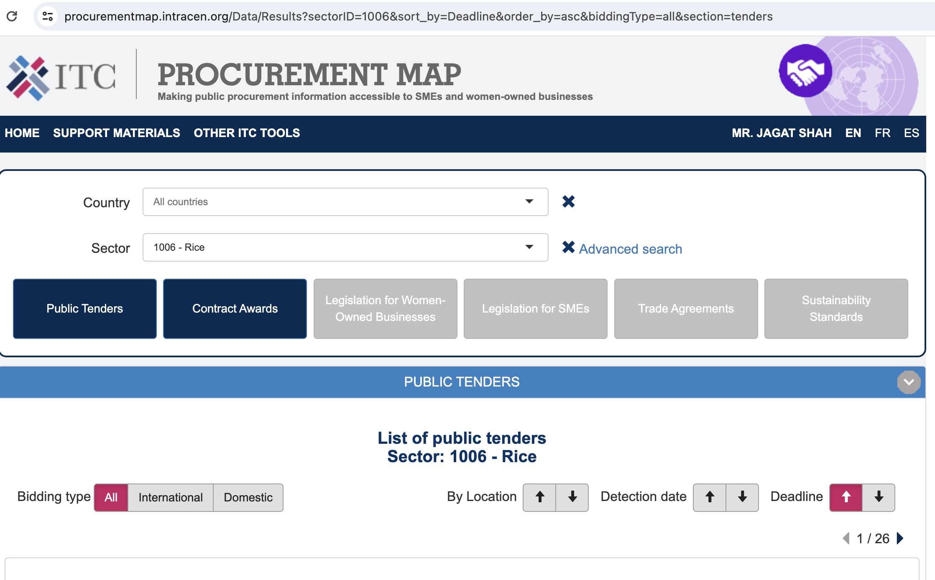
https://procurementmap.intracen.org/

Slide 29
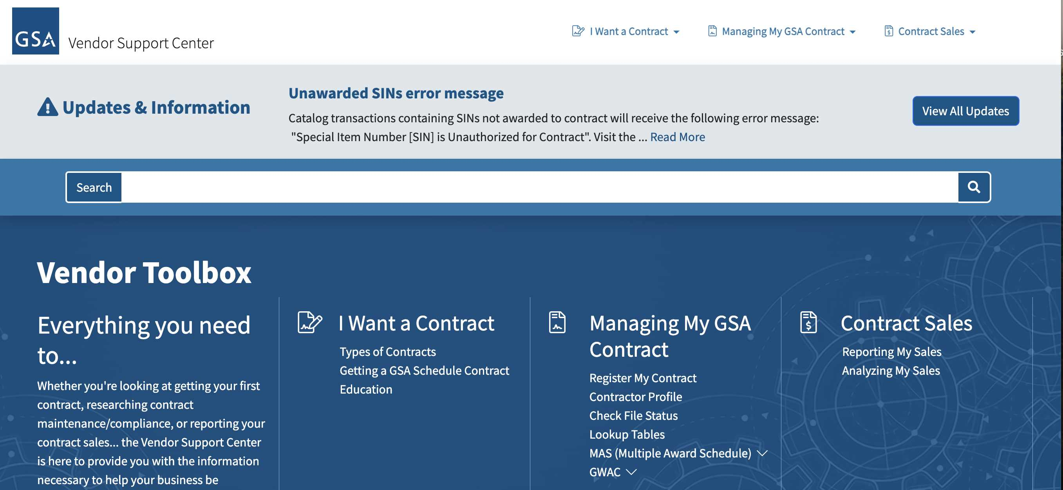
Pre-requisites to Federal Contracting in USA
GET TRAINED
Training 1: Pathways to Success
Pathways to Success is an online webinar on the Vendor Education Center (https://vsc.gsa.gov/vsc/). This webinar explains how GSA Schedule contracts work, how to succeed as a contractor, what you need to do to get and administer a GSA Schedule contract. After successful completion of the webinar, you will receive a Pathway to Success Certificate which is valid for one year from the completion of the webinar. You must submit two copies of a valid certificate with any GSA Schedules' offer.
https://www.youtube.com/watch?v=h2Mj_4jtL7g – 59 min

Slide 30
Pre-requisites to Federal Contracting in USA
GET TRAINED
Training 2: Readiness Assessment
Log in to the GSA Vendor Education Center. After you log in, choose the Vendor Toolbox from the main menu. It is mandatory that this assessment is completed and signed by an officer of your company before submitting an offer. https://www.gsa.gov/about-us/events-and-training/gsa-events
Once you have completed the Readiness Assessment, and you have decided to submit an offer, load the Readiness Assessment as an attachment to your offer in the e-Offer system. eOffer/eMod is a tool to submit Contract Offers and Contract Modification requests to GSA Federal Acquisition Service online. (https://eoffer.gsa.gov/)

Slide 31
10 Approaches of entering export markets
Generating Importer leads - SPANCO ( HS Code )
Strategic institutional sales – US & EU Tenders, UN
Opening office or warehouse abroad
Online E Comm Sales approach as a tool of Global business
Visit abroad with a B2B meeting plan ( 2 Months plan in advance )
Agent appointment abroad
Participating in an overseas expo / Virtual EXPO / Webinar
Joint venture route with overseas companies (Importers)
Exporting through merchant exporters
Franchise / Brand approach

Slide 32
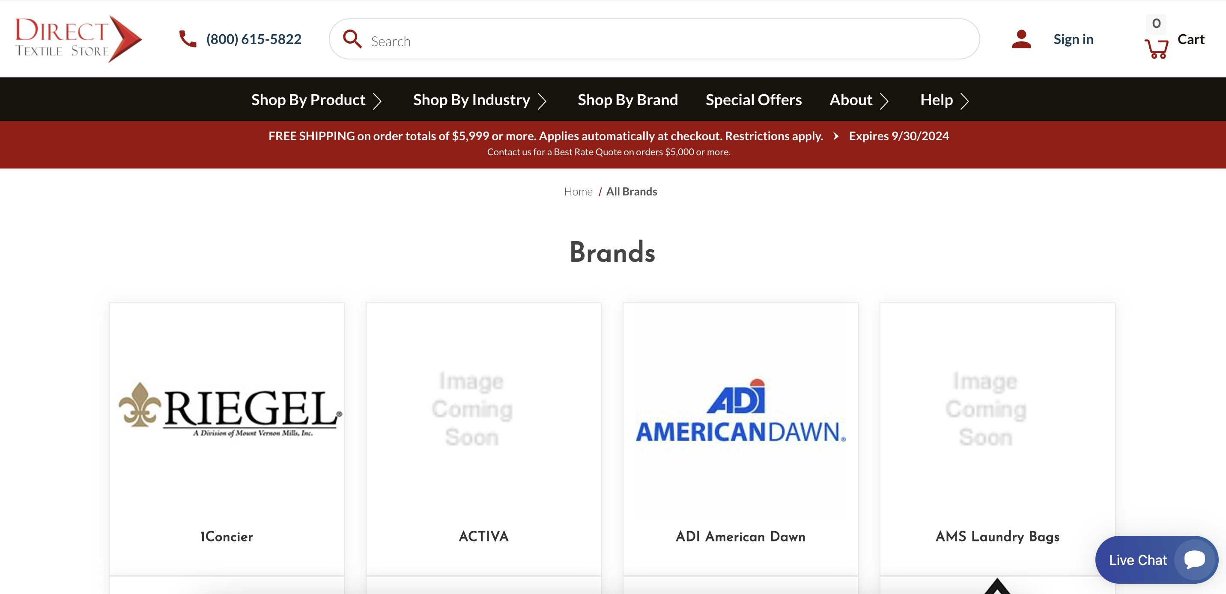
https://directtextilestore.com/ - USA
Warehouse abroad :
Next day delivery Quality check & buy Payment rotation faster
…………….Better price !

Slide 33
10 Approaches of entering export markets
Generating Importer leads - SPANCO ( HS Code )
Strategic institutional sales – US & EU Tenders, UN
Opening office or warehouse abroad
Online E Comm Sales approach as a tool of Global business
Visit abroad with a B2B meeting plan ( 2 Months plan in advance )
Agent appointment abroad
Participating in an overseas expo / Virtual EXPO / Webinar
Joint venture route with overseas companies (Importers)
Exporting through merchant exporters
Franchise / Brand approach

Slide 34
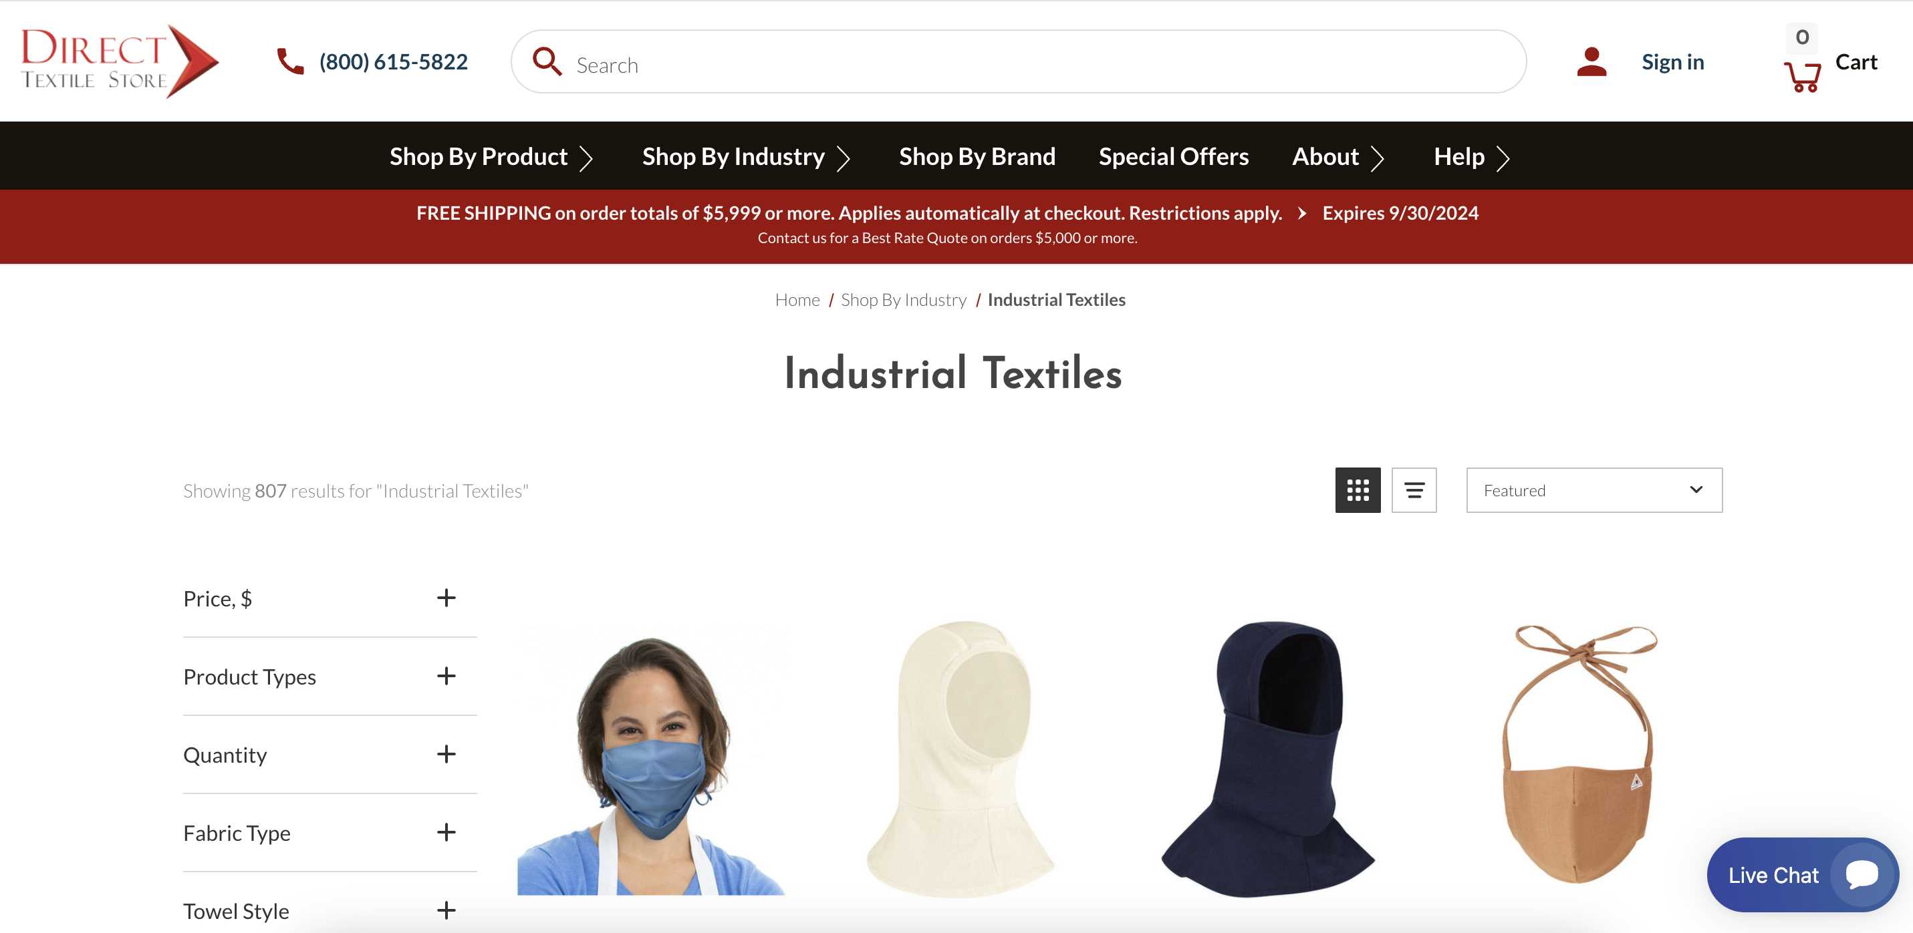
https://directtextilestore.com/ - USA

Slide 35
Examples of B2B
Tex Tech Industries : Tex Tech Industries
Eastex Products ​: Eastex Products, LLC
Technical Yarn Solutions (TYS)
https://www.technicalyarnsolutions.com/

Slide 36
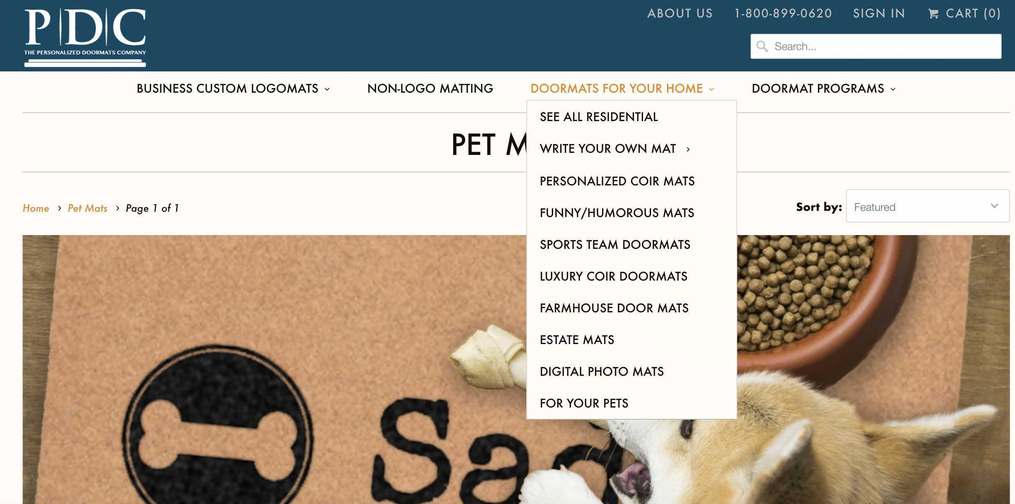
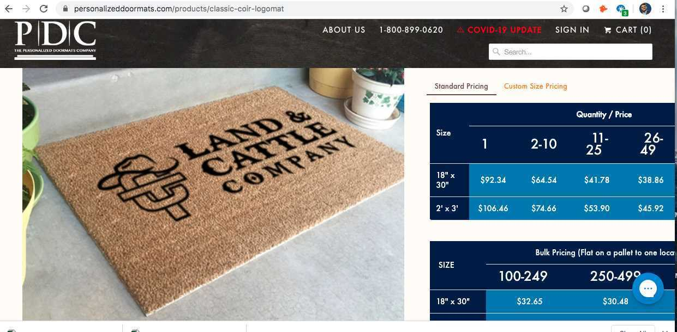
www.personalizeddoormats.com

Slide 37
10 Approaches of entering export markets
Generating Importer leads - SPANCO ( HS Code )
Strategic institutional sales – US & EU Tenders, UN
Opening office or warehouse abroad
Online E Comm Sales approach as a tool of Global business
Agent appointment abroad
Visit abroad with a B2B meeting plan ( 2 Months plan in advance )
Participating in an overseas expo / Virtual EXPO / Webinar
Joint venture route with overseas companies (Importers)
Exporting through merchant exporters
Franchise / Brand approach

Slide 38
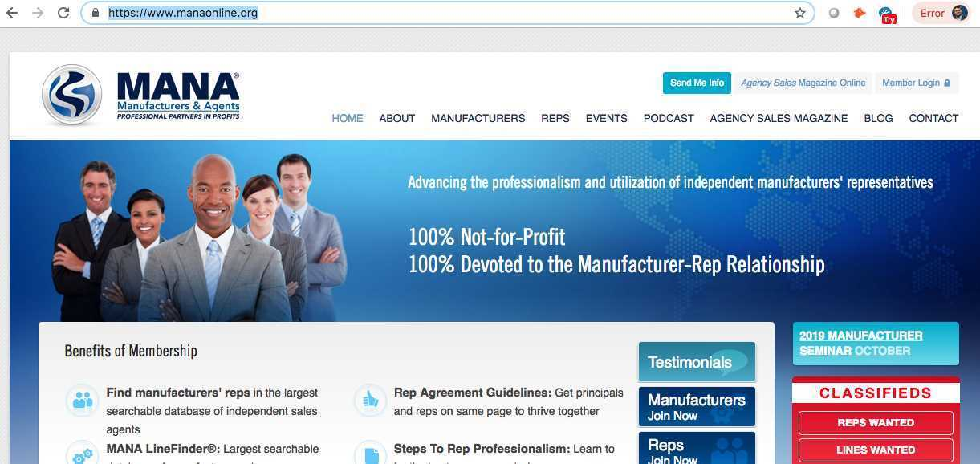
www.manaonline.org

Slide 39
10 Approaches of entering export markets
Generating Importer leads - SPANCO ( HS Code )
Strategic institutional sales – US & EU Tenders, UN
Opening office or warehouse abroad
Online E Comm Sales approach as a tool of Global business
Agent appointment abroad
Participating in an overseas expo / Virtual EXPO / Webinar
Visit abroad with a B2B meeting plan ( 2 Months plan in advance )
Joint venture route with overseas companies (Importers)
Exporting through merchant exporters
Franchise / Brand approach

Slide 40
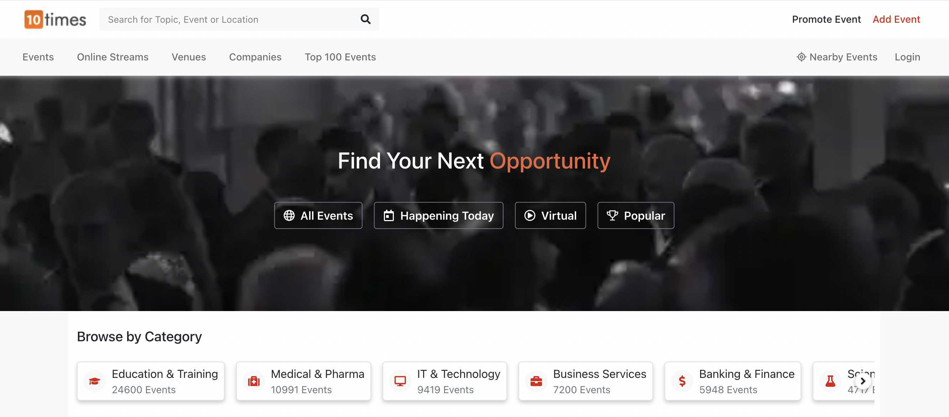
https://10times.com/

Slide 41
10 Approaches of entering export markets
Generating Importer leads - SPANCO ( HS Code )
Strategic institutional sales – US & EU Tenders, UN
Opening office or warehouse abroad
Online E Comm Sales approach as a tool of Global business
Agent appointment abroad
Participating in an overseas expo / Virtual EXPO / Webinar
Professionally plan your visit abroad with a B2B meeting plan
Joint venture route with overseas companies (Importers)
Exporting through merchant exporters
Franchise / Brand approach

Slide 42
Data is the new oil Numbers Quantification

Slide 44
Follow Exportfundas Podcast on Youtube
https://www.youtube.com/channel/UCOUuEL1r8wkYRXq-AykfLng

Slide 45
Our philosophy : Action @ Speed of thought
Follow us on social media:
https://www.facebook.com/globaljagat
https://www.linkedin.com/in/clusterpulse/
https://twitter.com/globaljagat
https://www.youtube.com/channel/UC9xUhauiTyCdZmCnDJ_9o-w
Handphone : India +91-9825506441 Emails: jagat@globaljagat.com
Ask questions please

Slide 46
Next Cohort : 224th Sept & Oct batch FULL & CLOSED 23 Nov to 27 Nov 2024 – 224th ( OPEN ) Register here : www.bit.ly/Cohort224 If you are part of trade associations / Chamber of commerce / Rotary club / business groups etc in your city, would love to take 1 / 2 hour sensitisation talk on exports – either online or physical “The Art & Science of exports – AI as a tool of export lead generation”

Slide 47
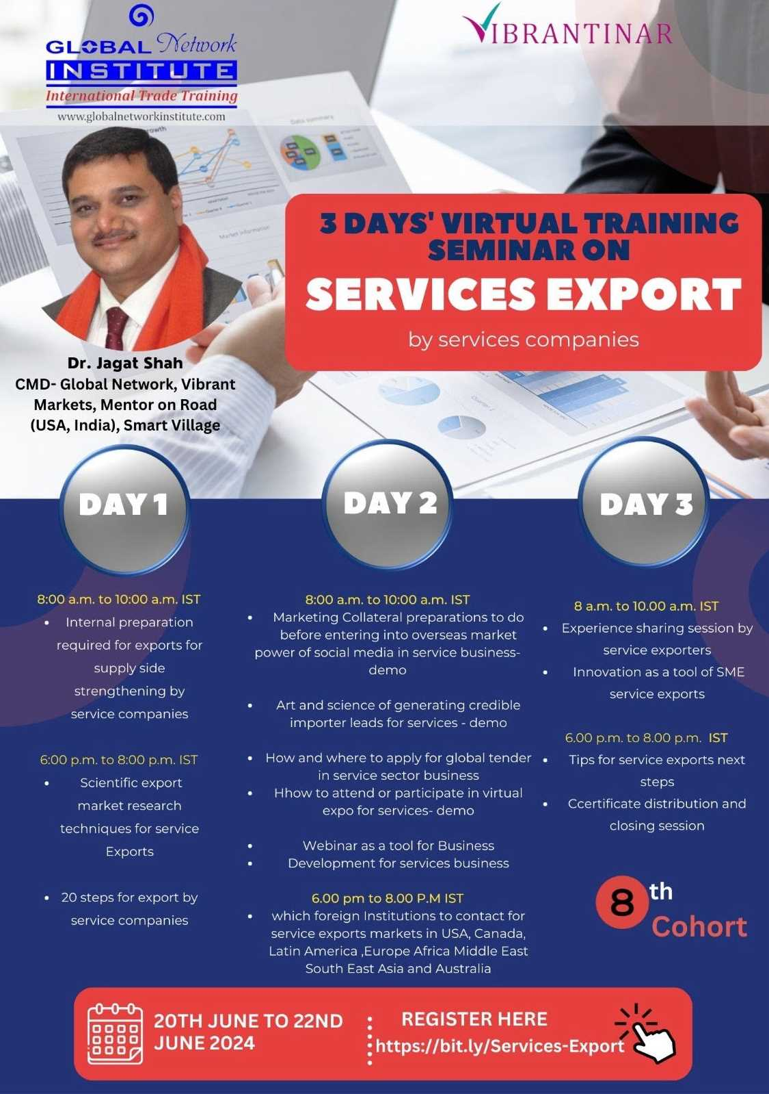
Services Export 25th. Sept to 27^{th Sept} 2024 8 am to 10 am IST & 6 pm to 8 pm IST Register here : https://bit.ly/Services-Export

Slide 48
www.globalnetworkindia.com
International trade advisory firm since 28
( 1997) years ( 180 biz delegations). Ex Trade & Investment commissioner of Government of Manitoba, Canada in India. Defense Offset
Vibrant Gujarat USA roadshow
Vibrant Kutch 2015
Vibrant Saurashtra 2016
Vibrant Ceramics 2017
Vibrant Tamil Nadu 2018
Vibrant Goa 2019
Vibrant Kongunadu 2020
Vibrant Virtual Expo
www.gninstitute.com
221 cohorts completed
883 seminars globally
6200 Participants
1200+ students migrated abroad
3200+ students are successful Exporters
1997 ( 27 years )
Vibrantinar – 183 done in pandemic year
9600 companies attended from 45 countries
Several success stories in business and profession mentioned in website
www.clusterpulse.org/
Economic development:
SME competitiveness & poverty elimination. 2004
Worked with Government of USA, Senegal, Oman, Canada & Brunei, worked on contracts with UNIDO, USAID, World Bank, ADB, GIZ, DFID, EU Projects & Government of India Projects.
Worked in Afghanistan for 10 years on SME projects.
( Benchmark)
Carpets, Dry Fruits, Handicrafts, Marble
www.mentoronroad.com
( 600,000 kms in last 18 years )
MOR India & UK
MOR USA
MOR Canada
MOR Africa
MOR Latin America
MOR EU
MOR Australia
Mentoring start ups, Corporates, Small & medium enterprises, Women business empowerment institutions & Indian diaspora.
www.smartvillage.biz
( 174 villages in 19 states ) From 2017
Smart village is about sources of earning for villagers (Kamai), healthcare (Dawai) and education (Padhai) in the villages in order to reverse the migration trend to cities.
www.vibrantmarkets.biz
600 clients in 20 nations
Primary & Secondary market research outside India
www.exportfundas.com
is one to one handholding portal for SME exporters. 2004
Export Fundas PODCAST
( Youtube )

Slide 49
We have worked in 46 countries

Slide 50
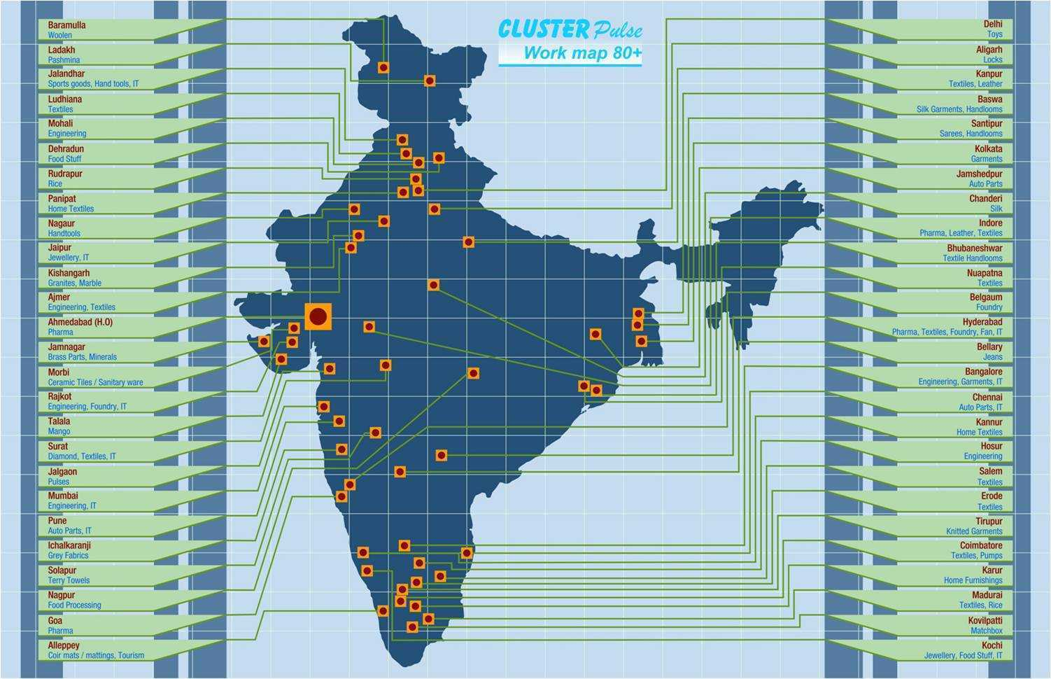
We have worked in 80 locations in India

Slide 51
Our Partners

Slide 52
