Slide 1
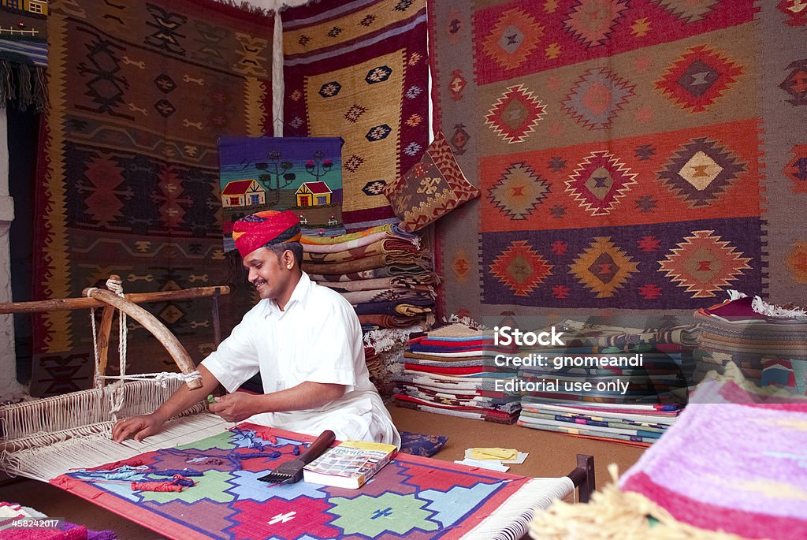
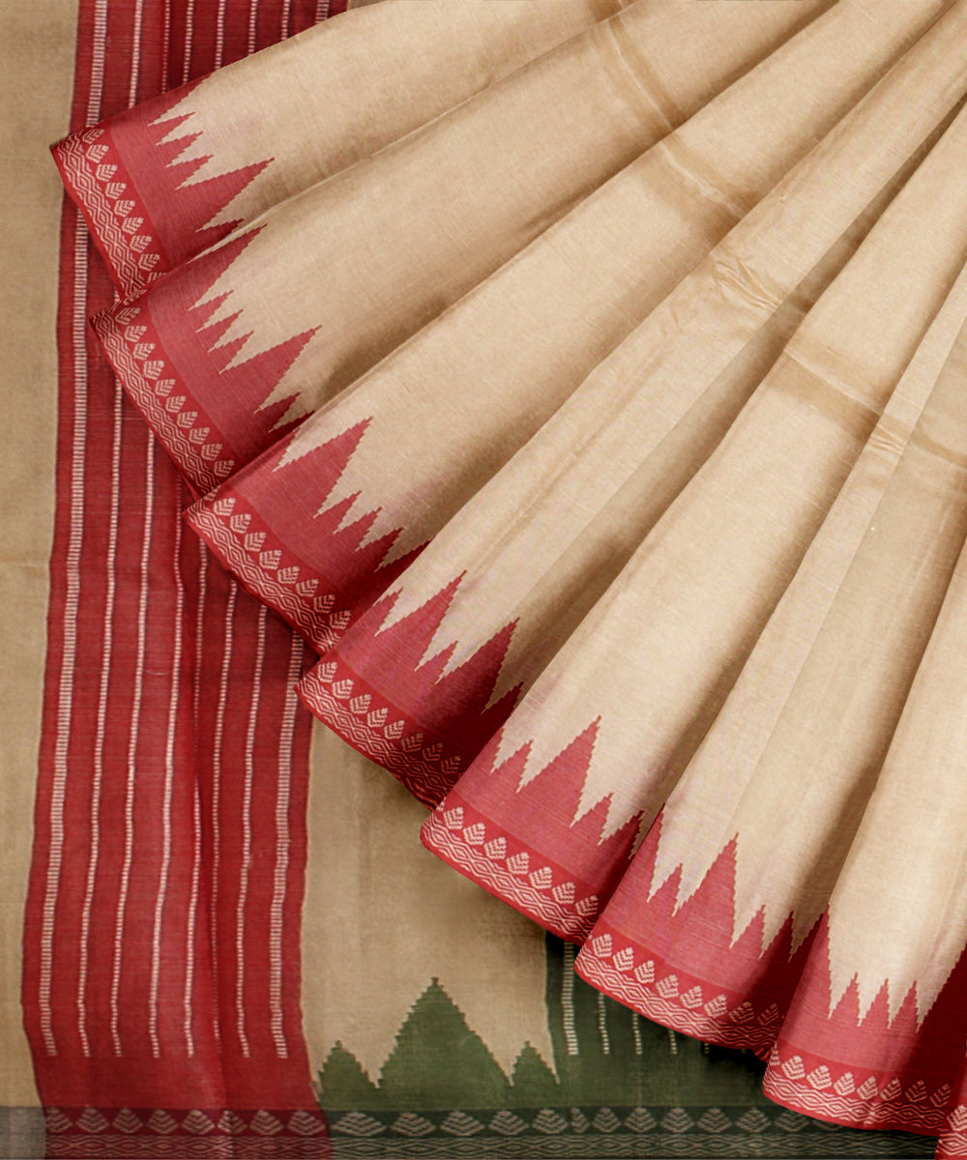
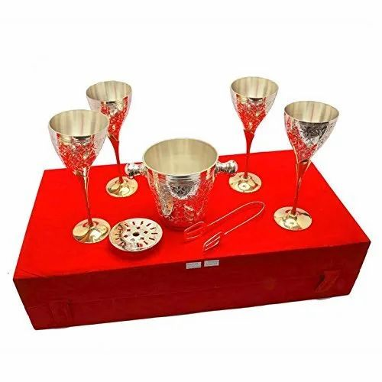
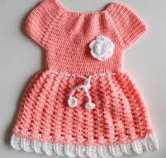
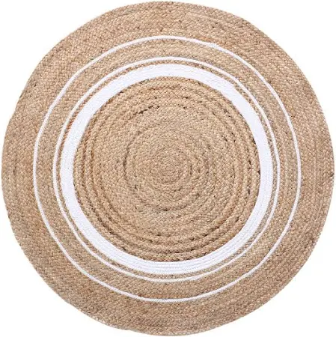
EKTA Event Shimla, Schedules: Exhibition-cum-Sale and Knowledge Sessions
Date 19th – 26th May 2025 | Exhibition-cum-Sale of Handlooms, Handicrafts, Silk, Wool and Jute Diversified Products Venue: Padam Dev Complex, The Ridge, Shimla | Fair Timings: 10 AM – 9 PM (All days) | Handlooms: 12 stalls + 3 Live Demos; Silk: 7 stalls Handicrafts: 12 Stalls + 3 Live Demos; Wool: 10 stalls Jute: 25 stalls (including 3 HP Govt stalls, 1 Textile Committee stall) NIFT: 1 stall
 | Knowledge Sessions: 11.00 AM – 1:00 PM Venue: Gaiety Theatre, Mall Road, Shimla | Knowledge Sessions: 2.00 – 5.00 PM Venue: Gaiety Theatre, Mall Road, Shimla | Speakers and Participants Nos.
19th May 2025 | Session | Initiatives by MoT (incl. PM MITRA, INFRA, SITP),| MoT and Himachal State Session| MPH Visit to Exhibition by the VIPs/Guests | Session | Exports | Export Div. MoT| MPH | MoT + HP State – 8 Speakers, 300 participants Exports – 4 speakers, 150 participants
20th May, 2025 | Session | SAMARTH | SAMARTH Division MoT | MPH Session | Jute Diversified Products-Skilling, backward & Forward Linkages, Market and Export opportunities | NJB | CH | Session NTTM| Jute Geo-Textiles and Tech. Textiles| NJB and NTTM MoT| MPH Session Silk | CSB|CH | Samarth – 4 Speakers, 150 participants JDPs NJB – 6 speakers, 70 participants NTTM+JGT NJB – 11 speakers, 200 participants, Silk CSB - 4 speakers, 50 participants
21st May 2025 | Session | Relevance of GI for Exports| Marketing, Branding & E-commerce| DC Handloom & DC Handicrafts |MPH Session | Himachal’s Wool Legacy, Wool & Silk blending | CWDB & CSB | CH | Session| Sustainable Fashion | NIFT | MPH Scope & Potential for Textiles manufacturing value chain in HP|TXC Office| CH | Handlooms + Handicrafts: 12 speakers, 200 participants Wool + Silk: 4 speakers, 50 participants NIFT: 4 speakers, 200 participants TXC: 5 speakers, 50 participants
Tentative Event Flow (Gaiety Theatre)
*MPH – Multi Purpose Hall, CH- Conference Hall
EKTA

